Slide 1
Urology Consults for the New Urologist
Updated by Luke Bidikov and Majdee Islam
July 2, 2018

Slide 2
Objectives
1. Understand the key elements of the history, examination, and investigative studies for a variety of common urologic consults.
2. Recognize how to triage routine, urgent, and emergent urologic conditions.
3. Describe key steps involved in procedures commonly performed in the outpatient or emergency department setting.

Slide 3
Topics
Nephrolithiasis
Trauma
Acute Scrotum
Fournier Gangrene
Difficult Foley
Priapism
Paraphimosis
Penile Fracture
Retained Catheters
Gross Hematuria

Slide 4
Reminders
Whenever you get a consult that needs intervention, always ask them to keep patient NPO until further notice
Many of our procedures involve splash hazards – get in the habit of wearing face/eye protection
LOAD THE BOAT
Notes:
Have intern mobilize necessary things before arriving.
LOAD THE BOAT, CALL EVERYTIME

Slide 5
Nephrolithiasis
Outpatient vs. Urgent vs. Emergent
Key Information
  Labs: CBC, UA/Urine Culture (everyone), creatinine, Coags if considering Perc
  Vitals
  Imaging details
  Co-Morbidities
  PO tolerance prior to arrival
  Previous trips to ER for same problem

Slide 6
Nephrolithiasis
Obstructing stone
HD stable
HD Unstable
Emergent PNT
Infected
Non-infected
Pain Controlled
Pain Uncontrolled
Outpatient mgmt or treat same day
Stent when able
Urgent stent or PNT
Emphysematous pyelonephritis
HD Stable
HD Unstable
Emergent stent
Emergent PNT
Notes:
Hypotension before OR, at induction will tank pressure

Slide 7
Nephrolithiasis
Urinalysis
  Beware of “the UA is dirty”
    Straight cath vs clean catch. ?Squamous cells
  RBCs, WBCs, Leuk Esterase without nitrites or bacteria can be nonspecific markers of inflammation
  Nitrite positive
    Results of Gram neg bacteria converting nitrate to nitrite
    Highly specific (90%), less sensitive (35-85%)
  Leukocyte esterase
    Produced by neutrophils
    Can have false negative if have bacteriuria without pyuria
Combo most predictive
Notes:
Circumcised-more likely to be dirty sample
The UA dipstick is very helpful. Leukocyte esterase has a sensitivity of 75% and specificity of 98% for the detection of a UTI. [25] A positive nitrite test has a specificity of 90% but a sensitivity as low as 30% for a UTI. [25] Combination of the 2 tests leads to a more accurate detection of a UTI with sensitivity of up to 88%

Slide 8
Quick Points Regarding UA
Squamous cells: Walter et al., ‘98- not good predictor of contamination (both cath and MSCC, ~21% predictive)
Nitrite Negative bacterial infections: Streptococcus (enterococcus), Pseudomonas
Keep in mind obstructing stones can prevent infected urine from coming down to bladder, may make UA appear negative
Crystals can be marker of dehydration, and not stones
Pyridium can cause urine to be falsely nitrite +
Notes:
Also, keep in mind, requires at least two hours for bacteria to grow in urine, so ask when the patient last voided before providing sample

Slide 9
Nephrolithiasis
Outpatient management
  Plain film KUB prior to discharge home
  Flomax 0.4mg every night
  Analgesia
  Aggressive hydration
  PO antiemetics
  Home with urine strainer – save any stones
  Follow up in 4-6 weeks if stone hasn’t passed

Slide 10
Nephrolithiasis
Special issues
  Uninsured AND out of county patients needing intervention @ DHHA
    All get PNTs (no stents) per policy approved by ED, Urology, and IR
    Calculated $13,000 cost savings compared to OR stent placement
  Acute renal failure
  Solitary kidney
  Immunocompromised
    DM, HIV, chemotherapy

Slide 11
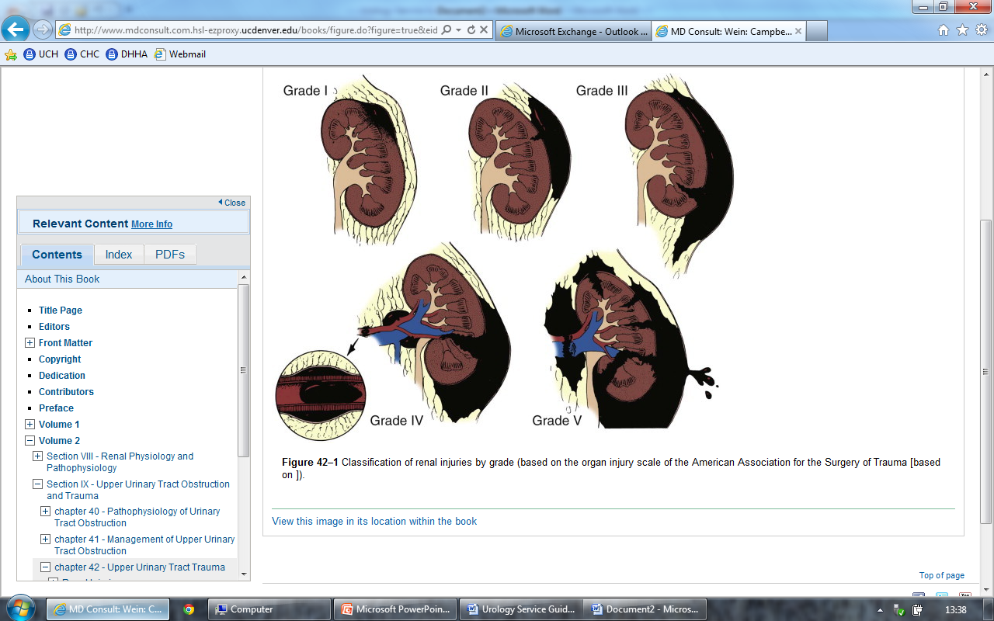
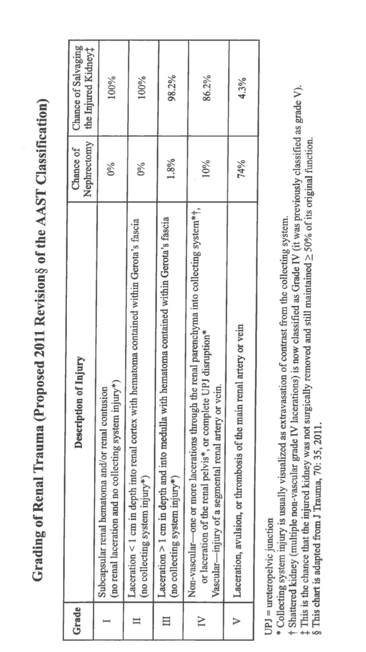
RENAL TRAUMA
Three things to consider:
Contusion/Hematoma
Lacerations
Vascular Injury
*Any collecting system injury puts you at grade 4
Notes:
I Contusion: Microscopic or gross hematuria, urologic studies normal
I Hematoma:Subcapsular, nonexpanding without parenchymal laceration
II Hematoma: Nonexpanding perirenal hematoma confined to renal retroperitoneum
II Laceration: <1 cm parenchymal depth of renal cortex without urinary extravasation
III Laceration: >1 cm parenchymal depth of renal cortex without collecting system rupture or urinary extravasation
IV Laceration: Parenchymal laceration extending through renal cortex, medulla, and collecting system
IV Vascular: Main renal artery or vein injury with contained hemorrhage
V Laceration: Completely shattered kidney
V Vascular: Avulsion of renal hilum, devascularizing the kidney

Slide 12
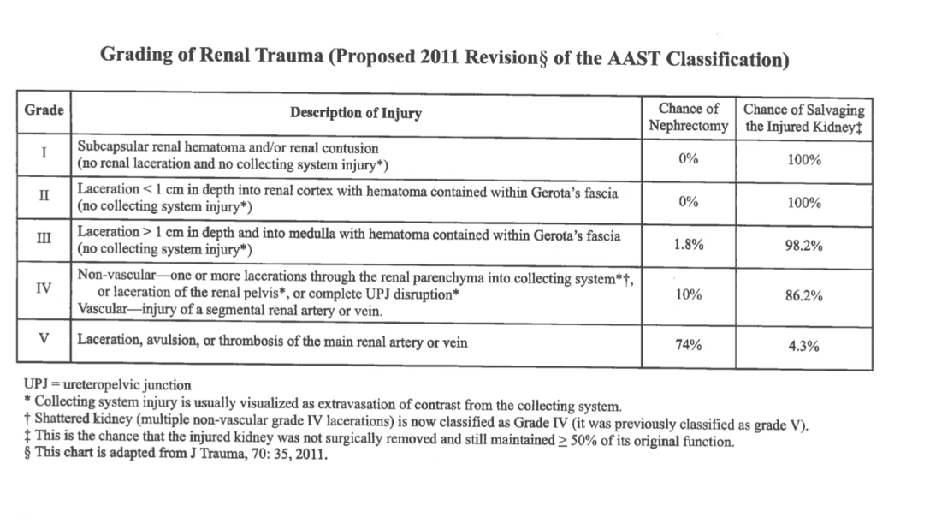
Notes:
Weiders 5h edition

Slide 13
Trauma - Renal
Conservative management
  HD stable grades I-IV
    98% can be successfully managed without exploration (Broghammer et al, 2007)
  HD stable grade V
    May be a role for observation
      6 hemodynamically stable, grade V blunt injuries, 4 kidneys demonstrated satisfactory function (Altman, 2000)
      More data in pediatrics (Voelzke et al, 2012, Santucci et al, 2011)

Slide 14
Trauma - Renal
IR management
  Angiography with embolization (Wein: Campbell-Walsh Urology, 2011)
    Bleeding from a renal segmental artery with or without parenchymal laceration
    HD instability with grade III to IV injury
    Arteriovenous fistula or pseudoaneurysm
    Persistent gross hematuria, and/or blood loss exceeding 2 units in 24 hours
  Endovascular stent
    Renal artery thrombus from intimal flap (Goodman, 1998)

Slide 15
Trauma - Renal
Operative management (Voelzke & McAninch, 2008)
  Absolute indications
    HD instability with shock
    Expanding/pulsatile renal hematoma (renal artery avulsion)
    Suspected renal pedicle avulsion (V)
    UPJ disruption
  Relative indications
    Urinary extravasation with nonviable tissue
    Renal injury with colon/pancreatic injury
    Delayed diagnosis of arterial injury

Slide 16
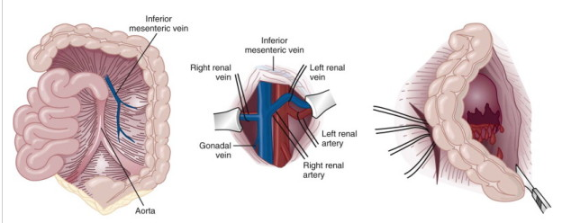
Trauma - Renal
Notes:
Want control of the vessels before opening the retroperitoneum

Slide 17
Trauma-Renal
Don’t forget to inform patients about long term need for monitoring following renal trauma
  HTN namely
  UA’s with PCP

Slide 18
Trauma - Ureter
Most Common Cause is Iatrogenic, followed by penetrating trauma
Delayed dx: more complications (urinoma, infection, fistula, renal loss, and death)
Think of Delayed with: Persistent flank or abdominal pain/mass, prolonged ileus, hydronephrosis, elevated BUN/Cr, prolonged output from surgical drains.
Suspect ureteral injury with: Penetrating wounds in proximity of the ureter (esp GSW), Sudden deceleration injury (esp in kids-spine more mobile, avulse UPJ), and any surgery in the area of the ureter

Slide 19
Trauma - Ureteral
Upper or middle (Superior to Iliac Vessels)
  Ureteroureterostomy (UU)
  Transureteroureterostomy (TUU)
  Autotransplantation
  Ileal ureter
Lower (Distal to Iliac Vessels)
  Ureteral reimplantation
  Psoas hitch
  Boari flap
Delayed vs Immediate Dx
Notes:
1) Most Common Cause is Iatrogenic, followed by penetrating trauma
2) Delayed dx: more complications (urinoma, infection, fistula, renal loss, and death)
3) Think of Delayed with: Persistent flank or abdominal pain/mass, prolonged ileus, hydronephrosis, elevated BUN/Cr, prolonged output from surgical drains.
4) Suspect ureteral injury with: Penetrating wounds in proximity of the ureter (esp GSW), Sudden deceleration injury (esp in kids-spine more mobile, avulse UPJ), and any surgery in the area of the ureter (LAR, HSX).

Slide 20
Trauma - Ureteral
Stent
  Minor contusion
    Risk of future stricture
PNT
  Damage control

Slide 21
Trauma - Bladder
Signs/symptoms
  Suprapubic pain
  Inability to void
  Gross hematuria
  Blood at meatus
  Inability to pass catheter

Slide 22
Trauma - Bladder
When to get a cystogram
  Absolute indications
    Pelvic fracture associated with gross hematuria
      CT cystogram
      29% will have bladder injury (Morey et al, 2001)
    Penetrating injury with microscopic or gross hematuria
  Relative indications
    Blunt trauma with gross hematuria (no pelvic fracture)
    Microscopic hematuria with pelvic fracture

Slide 23
Trauma - Bladder
Extraperitoneal injury
  Bladder decompression (22+Fr foley)
  Repeat CT cystogram prior to removal (2 weeks)
  May also repair if a pelvic operation is indicated for another reason
    Pelvic hardware
Intraperitoneal injury
  Surgical repair

Slide 24
Trauma - Urethra
When to get a urethrogram
  Blood at meatus
    Role of trying single pass with foley?
      Most think it is worth trying once
  Inability to pass catheter
  Urethral injuries occur concomitantly in 10% to 29% of patients with bladder rupture (Cass, 1989; Dobrowolski et al, 2002)

Slide 25
Trauma - Urethra
How to perform urethrogram
  Tip of small catheter (12Fr silicone) into fossa navicularis
  Occlude meatus with compression or slight inflation of foley balloon
  Inject contrast under fluoro (oblique or lateral decubitus position)

Slide 26
Trauma - Urethra
Surgical intervention
  Urethral foley
  SPT
  Primary realignment - varied results
    Voelzke et al, 2012
      Failure in 15 of 19 patients (78.9%)
      Subsequent management
        Posterior urethroplasty (8)
        Direct vision internal urethrotomy (DVIU) (3)
        DVIU followed by posterior urethroplasty (3)
    Best et al, 2008
      2 of 14 patients required stricture managemegnt after primary realignment

Slide 27
Trauma - Genitalia
Testicular rupture
  Tunica albuginea disruption, heterogeneous testicular appearance on US
  Require surgical exploration, washout, closure
Scrotal skin loss, burns, etc
  Debridement
  Immediate vs. delayed testicular coverage
Penile amputation
  Surgical repair with plastic surgeons
  Ask Dr. Maroni to tell you his patient stories…

Slide 28
Acute Scrotum
Appendage torsion
Testicular torsion
Epididymitis
Dermatitis
Fournier gangrene
Orchitis
Vasculitis
Viral illness
Trauma
Herrnia/hydrocele
Varicocele
Intrascrotal mass
Musculoskeletal pain
Referred pain

Slide 29
Acute Scrotum - Torsion
Acute onset of pain
  Nausea, vomiting, dysuria, fever
Tenderness, edema, erythema, absence of cremasteric reflex
  Cremasteric reflex preserved in up to 10% of proven torsion (Hughes et al, 2001; Nelson et al, 2003; Karmazyn et al, 2005; Murphy et al, 2006)
Manual reduction
  ”Open book” technique

Slide 30
Acute Scrotum - Torsion
Classic story and exam
  Proceed to OR emergently
Questionable story or exam
  Scrotal color Doppler US
    Highly variable sensitivity in literature (60 – 90+%)
    More recent studies suggest close to 90% (Gaitini et al, 2010)

Slide 31
Fournier Gangrene
(necrotizing fasciitis)
Risk factors
  DM, HIV, local trauma, paraphimosis, periurethral extravasation or urine, perirectal or perianal infections, and surgery such as circumcision or herniorrhaphy
Exam findings
  Pain, swelling, erythema, fever, crepitus, shock
  KEY: scrotal/perineal skin discoloration (purple) and blistering

Slide 32
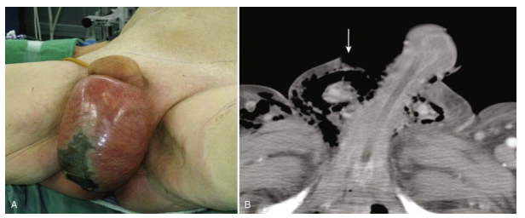
Fournier Gangrene

Slide 33
Fournier Gangrene
Labs & Radiology
  ARF, hyponatremia, hypocalcemia, air within soft tissues on KUB/CT/US
Surgical emergency
  Aggressive debridement
  May need to involve general surgery if extends beyond perineum

Slide 34
Difficult Foley
Does the patient need a foley?
Know the history
  What has been tried
  Where did they meet difficulty (meatus, urethra, prostate, etc)
  History of prostate/bladder operations, stricture disease
  Best to approach as a new formal consult, not just a technical issue

Slide 35
Difficult Foley
“Non-urologic” difficult foley
  Retraction, retraction, retraction
  High anxiety/delirium – consider medications to relax patient/sphincter
  “No resistance but he just couldn’t tolerate it” – use Urojet
  Carefully visualize anatomy in cases of atrophic vaginitis
  Always hub before inflating (particularly old men who don’t remember they’ve had TURP)

Slide 36
Difficult Foley
Simple BPH
  Think about a false passage from prior attempts
  Try bigger catheter (22Fr+) and/or Coudé catheter
Stricture history
  Try small (12 or 14Fr) silicone catheter
History of prostatectomy, TURP, or any transuretheral procedure
  Think bladder neck contracture/stricture
  Try small (12 or 14Fr) silicone catheter
Posterior urethral opening in female
  Coude catheter, over-finger technique

Slide 37
Difficult Foley
Difficult foley cart, scope with light cord, and light source
  Pile other stuff on top of it cart and wheel it down
Where do you get it?
  Ask one of us to show you if you don’t already know – much easier going in knowing than figuring it all out in middle of the night
  Shark grasper!

Slide 38
Difficult Foley – Foley Cart
  UroJet
  10cc saline flush
  Cysto tubing
  Amplatz renal dilator set
  Filiforms & followers set
  UroLock adapter
  16 Fr council tip catheter
  22 Fr 3-way Rusch catheter
  Cath tip punch
  5 Fr open ended ureteral catheter
  Amplatz SS wire
  Glide wire
  Punch SPT set
  #11 blade
Flex cystoscope & light cord
Supplies
  XL drape
  Betadine bottle
  Pack 4x4‘s
  XL gown
  Sterile gloves
  1000cc NS
  0 silk suture
  Needle driver
  Iris scissor
  Foley plug
  Foley bag
  Leg strap

Slide 39
Difficult Foley - Cystoscopy
Make sure you have all supplies, scope, light cord, and everything works
Recruit help
Consent – cystoscopy, foley placement over wire, urethral dilation, possible SPT
  Stricture
  Incontinence
  Injury to bowel/bladder
Antibiotics? Valium?
Notes:
CHECK THE SCOPE IN THE OR BEFORE GOING TO FLOOR/OR ED, MAKE SURE NOT A URETEROSCOPE.
May use a ureteroscope for very small strictures

Slide 40
Difficult Foley - Cystoscopy
Prep penis/lower abdomen
Hang irrigation
XL drape or gown (tear hole in middle – pull patient’s penis through)
Bring scope, light cord, cysto tubing, UroLock, UroJet (a few), wire, and catheter onto field
Pass off light cord and tubing to helper

Slide 41
Difficult Foley - Cystoscopy
Look for the small flap leading to true lumen
  Always on ventral side (3 to 9 o’clock)
True Lumen
Flap
False Passage (blind ending)

Slide 42
Difficult Foley - Cystoscopy
Pass wire through true lumen
Remove cystoscope, keeping wire in place
Have helper put on sterile gloves
Assuming no stricture, place Councill tip catheter over wire and lubricate heavily
Have helper hold wire while you advance catheter
KEY POINT: you must instruct helper to hold wire steady with slight back pressure so catheter slides over wire without buckling
Flush catheter to ensure correct placement
  A foley that flushes but does not withdraw is usually in the wrong spot (i.e. urethra)
Notes:
Make sure wire in bladder with 5 french open ended
WIRE IS USUALLY DIFFICULT TO REMOVE WHEN COUNCIL IS IN PLACE

Slide 43
Difficult Foley - Cystoscopy
Dilation of urethral stricture
  Amplatz renal dilators
    Dilate carefully given their stiffness
    Consider periodic check with scope to ensure dilation proceeding as expected
  Filliform & followers
    Can be placed blindly or along side cystoscope under vision
  Cook S~CurveTM Urethral Dilator Set
  Urethral dilating balloon
    Not currently available
    Works just like ureteral or renal dilator balloons

Slide 44
Suprapubic Tube
Explore the kits ahead of time
Ensure bladder is full
  Have ED bolus patient while you drive in/prepare
Supplies
  SPT kit
  Spinal needle w/syringe
  US
  Suture
  Basic instrument set
  Local analgesia
  Skin prep
  #11 blade

Slide 45
Suprapubic Tube
Examine for abdominal scars
  Consider IR placement if concern about bowel overlying bladder
Palpate and/or visually inspect bladder with US
Clean skin w/prep
Use US and/or spinal needle to localize bladder
Notes:
Can give a liter of fluid to continue to fill bladder to max capacity

Slide 46
Suprapubic Tube
Palpate pubic bone
Numb skin and tract to bladder
Incise skin over tract, use hemostat to spread fascia
Advance trocar into bladder (can watch under US)
Remove inner stylet (with Cook set)
  Don’t lose the sheath
Advance catheter into bladder
Connect to bag and suture into place

Slide 47
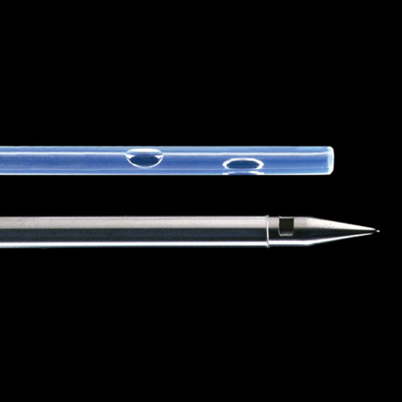
Cook© Cystostomy Set

Slide 48
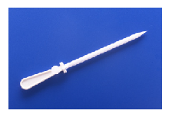
Rüsch© SupraFoley

Slide 49
Priapism
History
  Duration of erection
  Presence of pain
  Previous episodes of priapism and method of treatment
  Baseline erectile function
  Use of any medications (pills, injections)
  Medications and recreational drugs
  Sickle cell disease, hemoglobinopathies, hypercoagulable states
  Trauma to the pelvis, perineum, or penis

Slide 50
Priapism
Ischemic (low flow)
  Corporal bodies rigid, glans and sponge are not
  Painful
Non-ischemic (high flow-arteriocavernous shunts usually from trauma)
  Non-tender, partially erect
Initial investigation
  CBC w/diff, coags
  Corporal blood gas

Slide 51
Priapism
Coporal blood gas
  14g angiocath vs 18g needle
  Clean skin with alcohol pad
  Puncture into corporal body near penoscrotal junction at 3 or 9 o’clock position and/or lateral glans parallel with corporal body;
  Compress penis proximal to puncture site and aspirate blood
    Send first aspiration for analysis like any other ABG
  Ischemic
    PO₂ <30 (normal >90)
    PCO₂ >60 (normal <40)
    pH <7.25 (normal 7.4)

Slide 52
Priapism
Aspiration
  Use largest gauge needle available
  Leave needle in place, do not aspirate through angiocatheter
  Can compress penis to facilitate clearance but do not stick yourself
  Can irrigate between aspirations with NS
Aspiration alone may reduce in approx 1/3 of patients (AUA Guidelines, 2003)

Slide 53
Priapism
Phenylephrine (selective α₁-adrenergic receptor agonist) irrigation
  Normally comes as 10 mg/mL solution
    Can come as 1 mg/mL as well
    PAY ATTENTION TO CONCENTRATIONS
  Aspirate 10 mL of blood and inject phenylephrine every 3-5 minutes up to max dose volume of 1 mg phenylephrine (see table on next slide for volumes based on concentration)
  Monitor HR and BP during injection
  Use lower dose in children and adults with cardiovascular disease
  Don’t forget to ask if ED has used any

Slide 54
Priapism – Making Solution
Phenylephrine Concentration | 10 mg/mL | 10 mg/mL | 1 mg/mL | 1 mg/mL
Volume Solution | 1 mL (i.e. 10 mg) | 1 mL (i.e. 10 mg) | 1 mL (i.e. 1 mg) | 1 mL (i.e. 1 mg)
Volume Saline | 99 mL | 49 mL | 9 mL | 4 mL
Final Concentration | 100 ug/mL | 200 ug/mL | 100 ug/mL | 200 ug/mL
Injection Volume | 1-2 mL every 3-5 minutes | 1 mL every 3-5 minutes | 1-2 mL every 3-5 minutes | 1 mL every 3-5 minutes
Max Number Injections | 10 mL (i.e. 1000 ug) | 5 mL (i.e. 1000 ug) | 10 mL (i.e. 1000 ug) | 5 mL (i.e. 1000 ug)
REMEMBER: max dose is 1 mg (1000 ug) of phenylephrine

Slide 55
Priapism
If aspiration fails, proceed to OR
  Distal shunt first (corporoglanular)
    Tru-Cut biopsy needle through glans into corporal bodies (Winter shunt)
    11/15-blade through glans into corporal bodies (Ebbehoj)
      Can also use 10-blade variation (T-shunt: insert, rotate, remove)
    El-Ghorab-make incision on dorsum of glans
  Proximal shunt (corporospongiosal)
    Quackels: suture cavernosum to spongiousm
    Barry: superficial or deep dorsal vein anastamosed to cavernosum
    Grayhack: saphenous vein anastamosed to cavernosum

Slide 56
Paraphimosis
IS THE PATIENT CIRCUMCISED?
Manual reduction
  Fingers on phimotic band, thumbs on glans
  Push glans and pull phimotic band
“Death grip”
  Grasp penis like a baton
  Sequential application of pressure starting at glans and working proximal – hold to reduce edema
  Attempt manual reduction once edema reduced

Slide 57
Paraphimosis
Coban technique
  Wrap coban around penis (tightly) starting at glans and working proximal (like a Maypole)
  Leave in place for several minutes (or as long as it takes you to drive into hospital)
  Remove and manually reduce (if hasn’t already self-reduced)

Slide 58
Paraphimosis
Dorsal slit
  Penile block
  Lubricate and slide straight snap under phimotic band – snap tightly and leave in place for a few minutes
  Release snap and use iris scissor (or similar fine scissor) to cut band
  Oversew edges with absorbable suture
Circumcision

Slide 59
Dorsal Penile Block
1% plain lidocaine or 0.25% plain bupivicaine
  Inject bilaterally, just below pubis
  Inject on ventral side near penoscrotal junction

Slide 60
Penile Fracture
Tear in tunica albuginea over corpus cavernosum
History is diagnostic
  Popping sound, pain, rapid dutumensence, swelling/discoloration
Buck fascia intact – swelling of penis
Buck fascia disrupted – extension into scrotum, perineum, suprapubic region
Variable rates of urethral injury
  3-20% (Eke, 2002; Zargooshi, 2002; Jack et al, 2004; Derouiche et al, 2008)

Slide 61
Penile Fracture
Urgent surgical repair
Incision over defect or circumcising incision
Artificial erection if difficulty identifying injury
Tunica closure with 2-0 or 3-0 absorbable suture

Slide 62
Retained Catheters
Find out type of catheter
  If silicone, may just be resistance from ring formed by deflated balloon
Make sure balloon fully deflated with syringe
Cut balloon port
Attempt to pop balloon by passing back end (stiff side) of Amplatz SS wire through balloon port

Slide 63
Retained Catheters
If balloon palpable in perineum or urethra, can pop via transcutaneous insertion of fine needle
If near bladder neck, can use transrectal US to visualize and pop with PNBx needle (or similar long needle)
If heavily calcified or otherwise unable to be removed, may need OR for cystotomy

Slide 64
Gross Hematuria
Consider placement of large (20+Fr) 3-way foley
  Rusch if need to evacuate large clots
Attempt clearance with manual irrigation and CBI
  Get US to confirm clot clearance prior to CBI
Irrigation tricks
  Patience and more patience
  Move catheter around bladder
  The ‘pinch and pull’ maneuver

Slide 65
Gross Hematuria
(AUA Update, 1992)
Amicar (aminocaproic acid)
  Can give systemically or as CBI
  AIP pharmacy has protocol/concentration
Alum (potassium or ammonium sulfate)
  1-2% solution instilled as CBI
  Safe to use with VUR
  May precipitate and require manual irrigation
  Monitor aluminum levels in patients with renal insufficiency
Silver nitrate
  0.5 – 1% solution
  Instill for 10 – 20 minutes followed by NS irrigation

Slide 66
Gross Hematuria
(AUA Update, 1992)
Phenol (carbonic acid)
  Requires anesthesia and SPT
Prostaglandins
Formalin
  Requires anesthesia
  Must rule out VUR
    Ureteral occlusion balloons
Embolization

Slide 67
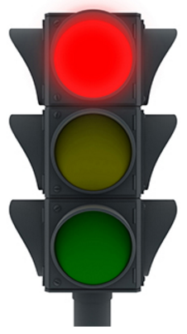

Urology Resident To Evaluate in Person
Suspect testicular torsion
Suspect penile fracture
Unresolved priapism
Suspect Fournier’s gangrene
Penile/scrotal consult with skin changes and/or SIRS criteria
Urolithiasis with SIRS criteria
Urolithiasis with solitary kidney
Most post-operative patients
  Especially with surgical wound issue
Trauma to the penis
Trauma to the urethra
Complex catheter placement
Hematuria requiring initiation of CBI
Plastibell issue
Bleeding s/p (pediatric) circumcision

Slide 68
Urology Resident To Evaluate in Person
Any patient going to the operating room
Any patient with SIRS criteria
Any uncertainty by the Urology resident

Slide 69

Patient to Follow-up in Urology Clinic*
Urolithiasis without SIRS criteria
Pain due to ureteral stent
  First, confirm ureteral stent is in correct position
Renal mass
  Please inform Dr. Cost of any Pediatric Urologic Oncology consult at the time of the consult
Testis mass
  Please inform Dr. Cost of any Pediatric Urologic Oncology consult at the time of the consult
Gross/microscopic hematuria
Urinary retention
Epididymitis/Epididymo-orchitis
Urinary tract infection
*Depending on clinical scenario, Urology resident may not need to evaluate patient in person

Slide 70

Patient to Follow-up with PCP*
Certain patients with epididymo-orchitis
Certain patients with urinary tract infection
*Depending on clinical scenario, Urology resident may not need to evaluate patient in person

