Slide 1

CARDiac SURGERY intern FLOOR ORIENTATION
University of Colorado
School of Medicine
Cardiothoracic Surgery

Slide 2
logistics

Slide 3
Morning Rounds
Pick up the pager from the night intern 6th floor-AIP2 @ 6am
You are expected to pre-round on all the floor patients on which we are primary and get the numbers. Our floor patients are usually in MSPCU (10th floor-AIP1) or CPCU (3rd floor-AIP2)
Patients we are consulted on, you should chart check to see if anything new happened (e.g. cath results, PFTs, carotids, echo etc.)
After getting the numbers, print several copies of the list for the fellows
If any inpatients are scheduled for surgery, please mark their chest with your initials during floor rounds

Slide 4
Morning Rounds
Once you are done seeing all our patients, we will go over them with the CTICU fellow at ~7:00AM
On Monday, Thursday, and Friday we meet in the CTICU (2nd floor-AIP1)
On Tuesday we have cardiac conference at 6:30am in AIP2, first floor, conference room D, 1.785
On Wednesday we have thoracic conference at 6:30am in the Freeman Surgery Conference Room 6101 in the Academic 1 office building, 6th floor

Slide 5
Important Things to Know for Rounds
POD# and surgery
Heart rate/rhythm
Blood pressure
VAD settings and LDH (if applicable)
I/Os
Drain output last 24hrs (pleural vs. mediastinal)
Morning lab results (INR, BUN, Cr, Hgb, WBC)
External pacing wires present/not present
Medications
  Beta blocker dose
  Diuretic dose
  Warfarin dose
Barriers to discharge
Your plan for the day

Slide 6
Daily Tasks
Once morning rounds are complete, the patients are split up between the providers on the floor
There is a smart phrase that is used for daily progress notes. “.ctprog”
You are expected to hold the pager during the day. Our 24 hr. cardiac pager number is 303-266-4316.
New consults- review patient records, examine patient, write note, and discuss with attending on call or fellow

Slide 7
OR Expectations
Make an effort to be in the OR.
  You will be welcomed!
You will be asked to assist in opening the chest and/or chest closure

Slide 8
End of the Day
Update floor fellow with any new issues
Update Epic/sign-out list
Sign out to night intern at 6pm, 6th floor-AIP2

Slide 9
Preoperative evaluation

Slide 10
Preoperative Testing (non-LVAD)
If you are asked to get a patient ready for surgery:
Consent
  Risks: bleeding, infection, stroke, organ failure, need for future operation, and death
NPO at midnight
Use Order set UCH Pre-Surgery Orders
  Preop antibiotics are located under the “cardiac” portion
    Vancomycin 15 mg/kg on call to OR
    Cefazolin 2 gram on call to OR
    Bactroban (aka, mupiricin) nasal ointment night before and morning of surgery
    Clindamycin 900 on call to OR if PCN allergy
CMP, CBC, PTT, PT/INR, A1C, UA
TEE for Anesthesiologists (this will be done intraop but don’t forget to order it)
CXR
Type and Cross (good for 72 hours)
  4/2/1 for most cases
Nursing Communication for Hibiclens scrub night before and morning of surgery
All cardiac surgery patients should have an ECHO and a coronary angiogram
Patients with a history of smoking / lung disease should have PFTs
CABGs should have carotid US
Patients with prior sternotomies should have a non-contrast chest CT
ACE/ARBs should be discontinued 2 days prior
ALL PATIENTS should have preoperative beta blockers unless contraindicated (and document it)
  Contraindications: bradycardia (HR<60), hypotension (systolics <90), balloon pump, inotropic support, decompensated heart failure
Make sure subcutaneous heparin is discontinued the day before surgery
Shut heparin drip off 4 hours prior to surgery or on the way to the OR if they have a balloon pump
Notes:
4/2/1= 4 RBCs/2 plasma/1 platelet

Slide 11
Preoperative Testing (LVAD)
If you are asked to get a patient ready for LVAD implantation:
Consent
  Risks: bleeding, infection, stroke, organ failure, need for future operation, and death
  Also consent for possible RVAD and other indicated valve procedures
NPO at midnight
Use Order set UCH Circulatory Care: Mechanical Assist Device (MAD) Pre-Op
    Click all the Antibacterials
    Vancomycin 15 mg/kg on call to OR
    Ceftazidime 2 gram on call to OR
    Bactroban nasal ointment night before and morning of surgery
    Ciprofloxacin 400 mg on call to OR if PCN allergy
CMP, CBC, PTT, PT/INR, A1C, UA (most labs have already been completed by the HF team)
CXR
Type and cross (good for 72 hours)
  6/4/1 for VAD, unless told otherwise
Patient should have an ECHO and a coronary angiogram
Patients with a history of smoking/lung disease should have PFTs
Patients with prior sternotomies should have a non-con chest CT
ACE/ARBs should be discontinued 2 days prior
Make sure subcutaneous heparin is discontinued the day before surgery
Shut heparin off 4 hours prior to surgery or on the way to the OR if they have a balloon pump
Notes:
6/4/1= 6 RBCs/4 plasma/1 platelet

Slide 12
Discharge information

Slide 13
Patient Discharge
Typically during the weekday the PAs will take care of discharging patients.
However, it is important for you to know our “standard” discharge recommendations.

Slide 14
Discharge
DePottyondy
Follow-up
  Patients can call the 24hr CT surgery number with questions or concerns 303-724-2799
  Follow up with CT surgery in 1 week
  The clinic is located in the Cardiac & Vascular Center on the 3rd floor of AIP2 (Anshcutz Inpatient Pavilion) which can be accessed via the E Elevators
    Dr. Aftab’s, Fullerton’s, and Cleveland’s scheduler is Lindsey Webster at 303-724-8762
    Dr. Reece’s and Pal’s scheduler is Kylea DePottyondy at 303-724-2809
  Follow up with PCP in 2-3 weeks.
  Follow up with cardiology in 4 weeks.

Slide 15
Discharge
Sternal PrecautionsSTERNAL PRECAUTIONS
  No driving for 4-6 weeks from the date of surgery.
  No lifting greater than 10 lbs for 6 weeks.
  Brace with a pillow when coughing or sneezing to protect your incision.
  Use the "elbow method" when moving in bed. Do not push with both arms behind you at the same time.
  Keep unloaded movements of the arms within a pain-free range, but there are no restrictions for personal care activities such as dressing, showering, or toileting.
  Carry objects close to your body and do not stretch your arms out while lifting.
  If you need to use your arms to stand up, keep your hands down at your sides. Do not push with both hands behind you at the same time.
  Keep your arms close to your body for any load-bearing or lifting activites and use pain as your guide.

Slide 16
Discharge
Wound Care
  OK to shower. Carefully wash the wound with soap and water. Pat the area dry. Do not take baths or use hot tubs until incision is completely healed, about 1 month. If you have sutures or staples, these will be removed at your postoperative clinic appointment.

Slide 17
Postoperative care basics

Slide 18
Cardiac Surgery Pathway
Description | POD 0 (Transfer to CTICU) | POD 1 (Transfer to MSPCU) | POD 2 | POD 3 | POD 4 | POD 5
Labs | CBC, BMP, Mg, Phos, PT/INR, PTT, ABG, VBG, Glucose on admission | CBC, BMP, Mg, Phos, PT/INR | CBC, BMP, Mg, Phos, PT/INR | CBC, BMP, Mg, Phos, PT/INR | CBC(DC if not indicated), BMP, Mg, Phos, PT/INR | CBC(DC if not indicated), BMP, Mg, Phos, PT/INR
Meds | Insulin gtt (for BG>or=150), Fentanyl and/or Precedex gtts, IV Abx, Statin, Lyte replacement, Fluid replacement, Vasoactives, Amicar or other fibrinolytic | SSI, Transition to oral medications, Bacitracin, Oxycodone, Tylenol, Aspirin, Colace, Senna/MOM, Diuretics, Lyte replacement | SSI, Transition to oral medications, Bacitracin, Oxycodone, Tylenol, Aspirin, Colace, Senna/MOM, Diuretics, Lyte replacement | SSI, PPI, Coumadin, Aspirin, Pain meds, Colace BID, Senna/MOM Diuretics, Lyte replacement, Heparin gtt(for Mech Valves) | SSI(DC if BG <150), PPI, Coumadin, Aspirin, Pain meds, Colace BID, Senna/MOM Diuretics(pending Creat), Lyte replacement, Heparin gtt bridge | SSI(DC if BG<150) PPI, Coumadin, Aspirin, Pain meds, Colace BID, Senna/MOM Diuretics, Lyte replacement, Heparin gtt bridge Additional DC Meds: Beta Blocker, Statin(CABG)
Diet | NPO--ice chips post extubuation with bedside swallow evaluation | Sips& chips, Advance as tolerated | Heart Healthy diet, Fluid restriction if applicable | Heart Healthy diet, Fluid restriction if applicable | Heart Healthy diet, Fluid restriction if applicable | Heart Healthy diet, Fluid restriction if applicable
Activity | Beach chair, Dangle 4 hours post-op, Ambulate Hour 20 | Chair position for all meals, Walk x3. IS: 10x/hour | Chair position for all meals, Walk x3. IS: 10x/hour | Chair position for all meals, Walk x4-5. IS: 10x/hour | Chair position for all meals, Walk x5. IS: 10x/hour, Shower If able | Chair position for all meals, Walk x5. IS: 10x/hour
Devices/Tests | Foley, Arterial Line, Pulmonary Artery Catheter, Cordis Introducer , Chest tubes, JP Drains and/or Hemovacs, External Pacer(if applicable) Extubate hr 4-5, ACHS, CXR/Esophagogastric tube XR on admission | SCD's while in bed, TEDs, If criteria met: remove LDA's | SCD's while in bed Xray, 4 hrs post drain removal if applicable, PIVs if possible | SCD's while in bed, Remove pacer wires, Chest Xray 4 hours following drain removal | SCD's while in bed, Remove drains if criteria met
MD Notes |  | Social Work/Case Management consult, Cardiac Rehab consult(if needed) | PT/OT order, Pleural drain<200 ok to DC, Mediastinal drains <100 ok to DC | Tele order for Floor status, Pleural drain<200 ok to DC, Mediastinal drains <100 ok to DC, Anti-coag for DC | Off tele order to shower | DC orders by 1000
RN Notes | Vitals/Drain output Q 15m x 1 h, Q30m x 2 hours, then Q1h Vitals, Glucose control Q1 if on Insulin gtt – Q4h otherwise, Strict Urine Output, Turn within 20 minutes of admission then Q2h | Q2/Q4 Vitals, CHG wipes for Foley/Central Lines, ACHS | DC Foley per IUC protocol, Wean O2, ACHS, Remove Sternal Bandage/Leg wraps, Yellow tape =Pleural drain Red tape= Mediastinal drain | Sternal precautions education, Anti-Coag goal for DC--pharm education for meds, ACHS, Wean O2 | If Mech MVR: INR goal 2.5-3.5, otherwise goal 2-3, ACHS, Wean O2 | ACHS(if indicated), Medication/Sternal precautions teaching, DC IV unless home ABX indicated, Wean O2

Slide 19
Postoperative Care Basics
All patients should be on:
  ASA 81 mg*
  Beta blocker (for the prevention of postop afib)**
  Statin
*HeartWare LVAD 325mg, HMII LVAD 81 mg
**LVAD and transplant patients should not get BBs unless otherwise directed by the heart failure team
On this service we do not:
  Use subcutaneous heparin for prophylaxis
  Restart ACEI/ARBs following surgery unless otherwise directed by heart failure service

Slide 20
Postoperative Care
Anticoagulation
  Atrial fibrillation
    INR goal 2-3
  Tissue valve
    INR goal 2-3 (2 months)
  Mechanical aortic valve replacement
    INR goal 2-3
    INR goal 2.5-3.5 if high risk (afib, DVT/PE)
  Mechanical mitral valve replacement
    INR goal 2.5-3.5
  LVADs
    INR goal 2-3

Slide 21
Chest tube removal
We typically removed mediastinal chest tubes when 24 hours output is ≤ 100ccs
We typically removed pleural chest tubes when 24 hours output is ≤ 200ccs
NEVER remove the last mediastinal drain if external pacing wires are still in place

Slide 22
Chest tube removal
Supplies: gauze, xeroform, Tegaderm, suture kit, chucks
Remove chest tube from suction
Cut suture
Have patient take a deep breath and “hum” while you pull the tube out
Tie down suture and apply occlusive dressing
Get a CXR 4 hours after removal to look for PTX

Slide 23
External pacing wire removal
If you have never pulled a pacing wire before, one of the PAs/fellows will observe your first one
Things to look for before removing wires
  Patient has not been paced for the last 24 hrs, currently not bradycardic
  Not thrombocytopenic (Plts need to be >80)
  Not anticoagulated
    INR should be less than 2
    Heparin held for 4 hours prior to removal

Slide 24
External pacing wire removal
Supplies: suture kit
There should be A (atrial) wires on the right and V (ventricular) wires on the left
Cut sutures holding the wires down
Have patient take a deep breath in and then exhale while you pull the wires out (first A leads, then V leads)
If you meet resistance, DO NOT pull harder and ask someone for assistance
Cardiac tamponade precautions should be initiated after removal
  Patients should remain in bed for 1 hour after wire removal
  Vitals signs every 15 minutes for 1 hour
  Monitor remaining chest tube output
If patient was previously on a heparin drip, restart 4 hours after removal

Slide 25
Atrial Fibrillation
Post op atrial fibrillation is very common, roughly 1/3 of our patient will have it during their hospitalization
If patient is hemodynamically compromised, they need quick DC cardioversion
If patient is in RVR and SBP >100, start with IV metoprolol 2.5-5 mg every 5 minutes (for a total of 3 doses)
Check lytes (K, Mg, Phos) and replete
  Goal (K >4, Mg >2, Phos >3)
Further intervention may be needed such as an amio or diltiazem drip but please discuss with team
  Loading amio dose is 150 mg, then 1 mg/min for 6 hours then 0.5 mg/min for 18 more hours (then transition to PO)
  Start dilt at 5 mg/hour. Increase in 5 mg/hr increments up to 20 mg/hr to maintain a HR of <120 BPM.
If the patient is in afib for >24 hours or has gone in and out of afib several times, they will usually need to be anticoagulated

Slide 26
LVADs
PI/Suction Events
  Normal variant
  Designed to protect patient from LV collapse
  Frequent or repetitive PI events should be investigated
    Pump speed too high
    Patient hypovolemic
      Most common reason, you may need to give albumin / NS
    Malposition of inflow cannula
  May occur during change of position or during cough/sneeze

Slide 27
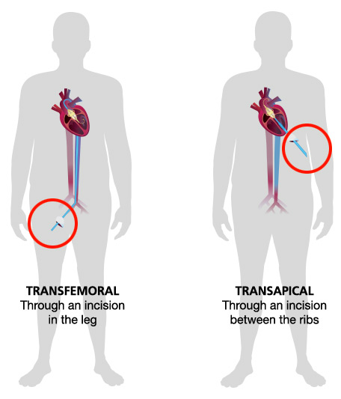
TAVR- Transcatheter Aortic Valve Replacement
Used for the treatment of aortic stenosis for moderate-high risk patients
This procedure is done in conjunction with interventional cardiology
http://newheartvalve.com/about-tavr/about

Slide 28
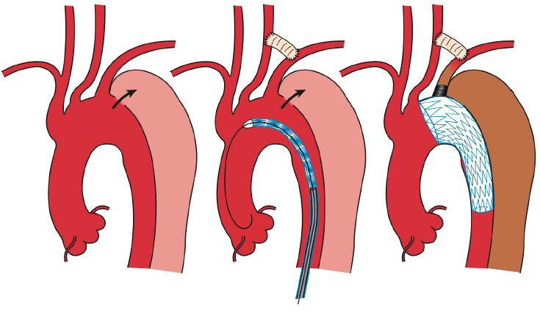
TEVAR- Thoracic Endovascular Aortic Repair
Used for the treatment of thoracic aortic aneurysms and type B aortic dissections
This procedure is done in conjunction with vascular surgery
Carotid-subclavian bypass or transposition is usually done 2 days prior to TEVAR
Consent should also include risk for paralysis and retrograde dissection
Often times, a lumbar drain will be placed prior to the TEVAR
http://www.annalscts.com/article/viewFile/3878/html/19841

Slide 29
Summary
If ever in question, ask for help!
Make an effort to be in the OR!

