Slide 1
Botox Facial Anatomy

Slide 2
Mechanism of Action
Botulinum toxin (BTX) is a neurotoxic protein produced by the bacterium Clostridium botulinum and related species.
It prevents the release of the neurotransmitter acetylcholine from axon endings at the neuromuscular junction and thus causes flaccid paralysis.

Slide 3
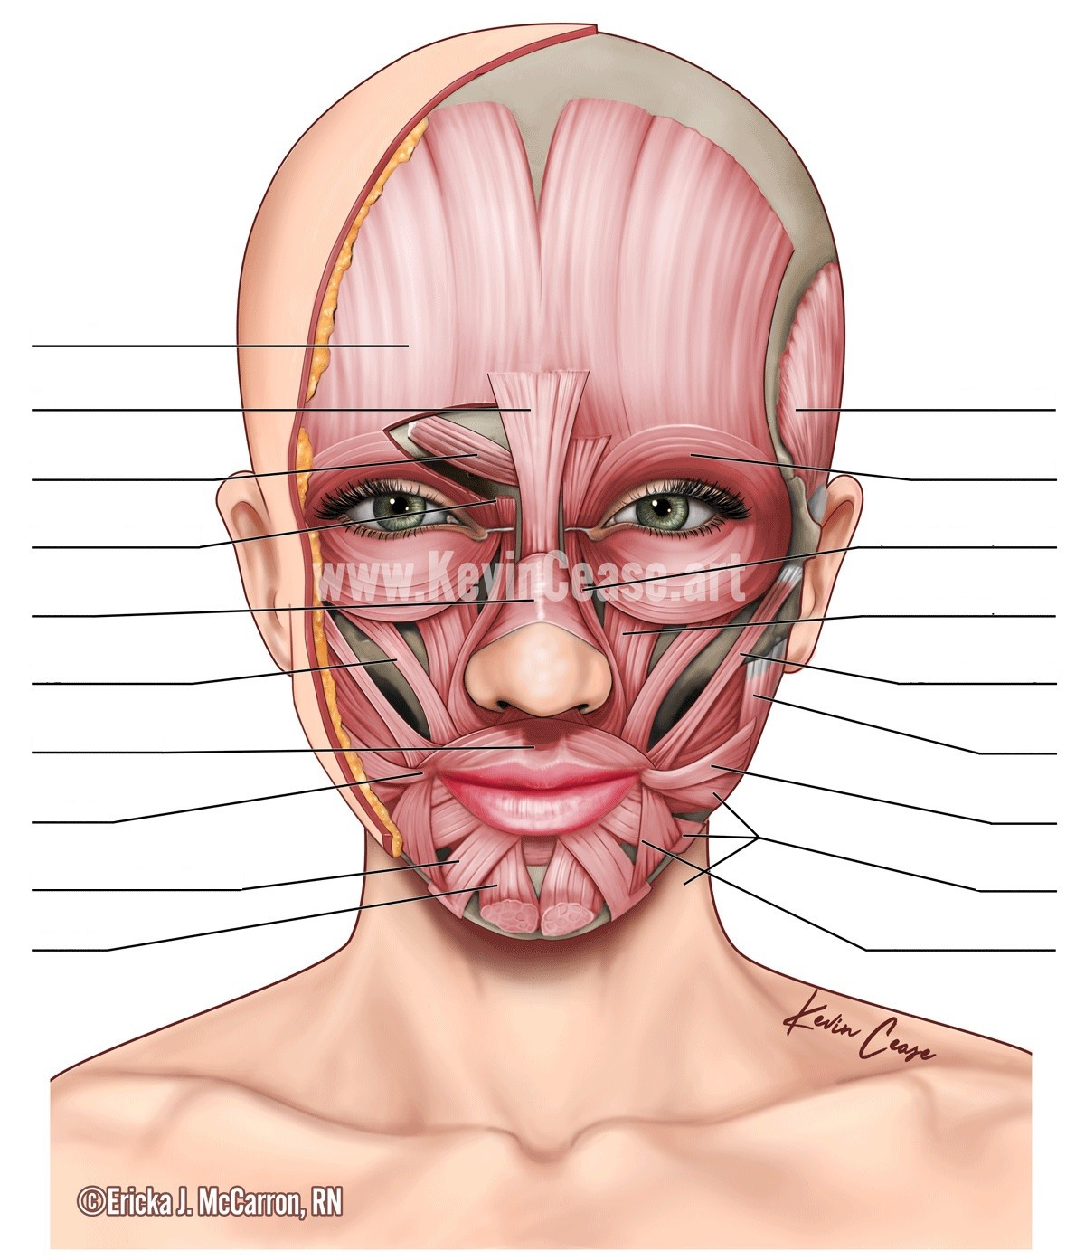

Slide 4
Frontalis

Slide 5
Origin | Galea aponeurotica
Insertion | Orbicularis oculi muscle
Artery | supraorbital and supratrochlear arteries
Nerve | Temporal Branch of Facial nerve
Actions | Raises eyebrows and wrinkles forehead Brow Elevator
Frontalis
“Forehead Lines”
10-20 units
Deep injections

Slide 6
Frontalis

Slide 7
Frontalis
Procerus

Slide 8
Origin | From fascia over the lower of the nasal bone
Insertion | Into the skin of the lower part of the forehead between the eyebrows
Artery | facial artery
Nerve | temporal branch of the facial nerve
Actions | Draws down the medial angle of the eyebrow giving expressions of frowning Brow Depressor
Frontalis
Procerus

Slide 9
Frontalis
Procerus

Slide 10
Frontalis
Procerus
Corrugator Supercilli

Slide 11
Origin | Supraorbital ridge ( Superciliary arches )
Insertion | Forehead skin, near eyebrow
Artery | Ophthalmic artery
Nerve | Temporal Branch of Facial nerve
Actions | Wrinkles forehead Brow Depressor
Frontalis
Procerus
Corrugator Supercilli

Slide 12
Frontalis
Procerus
Corrugator Supercilli
Glabella
(Procerus & Corrugator)
“Frown Lines”
10-25 units

Slide 13
Frontalis
Procerus
Corrugator Supercilli

Slide 14
Frontalis
Procerus
Corrugator Supercilli
Depressor Supercilli

Slide 15
Origin | Medial orbital rim
Insertion | Medial aspect of bony orbit
Nerve | Temporal Branch of Facial nerve
Actions | Depression of eyebrow
Frontalis
Procerus
Corrugator Supercilli
Depressor Supercilli

Slide 16
Frontalis
Procerus
Corrugator Supercilli
Depressor Supercilli

Slide 17
Frontalis
Procerus
Corrugator Supercilli
Depressor Supercilli
Nasalis

Slide 18
Origin | Maxilla
Insertion | Nasal bone
Artery | Superior labial artery
Nerve | Buccal branch of the facial nerve
Actions | Compresses bridge, depresses tip of nose, elevates corners of nostrils
Frontalis
Procerus
Corrugator Supercilli
Depressor Supercilli
Nasalis
“Bunny Lines”
5-10 units
Superficial injection
At wrinkles

Slide 19
Frontalis
Procerus
Corrugator Supercilli
Depressor Supercilli
Nasalis

Slide 20
Frontalis
Procerus
Corrugator Supercilli
Depressor Supercilli
Nasalis
Zygomaticus Minor

Slide 21
Origin | zygomatic bone
Insertion | skin of the upper lip
Artery | facial artery
Nerve | buccal branch
Actions | elevates upper lip
Frontalis
Procerus
Corrugator Supercilli
Depressor Supercilli
Nasalis
Zygomaticus Minor
Don’t Inject

Slide 22
Frontalis
Procerus
Corrugator Supercilli
Depressor Supercilli
Nasalis
Zygomaticus Minor

Slide 23
Frontalis
Procerus
Corrugator Supercilli
Depressor Supercilli
Nasalis
Zygomaticus Minor
Orbicularis Oris

Slide 24
Origin | Maxilla and mandible
Insertion | Skin around the lips
Artery | Inferior labial artery and superior labial artery.
Nerve | cranial nerve VII, buccal branch
Actions | It is sometimes known as the kissing muscle because it is used to pucker the lips.
Frontalis
Procerus
Corrugator Supercilli
Depressor Supercilli
Nasalis
For patients who rely on lip contraction for their occupation or avocation (for example, scuba divers or wind instrument players), this injection should probably be avoided. In addition, there are some patients that are not able to tolerate the inability to use a straw.
Zygomaticus Minor
Orbicularis Oris
“Smokers Lines” or
“Lip Flip”
2-6 units
Superficial
1-2 u at each
quadrant of lip
at/adjacent vermillion border

Slide 25
Frontalis
Procerus
Corrugator Supercilli
Depressor Supercilli
Nasalis
Zygomaticus Minor
Orbicularis Oris

Slide 26
Frontalis
Procerus
Corrugator Supercilli
Depressor Supercilli
Nasalis
Zygomaticus Minor
Orbicularis Oris
Modiolus

Slide 27
-chiasma of facial muscles held together by fibrous tissue, located lateral and slightly superior to each angle of the mouth.
-It is contributed to by the following muscles: orbicularis oris, buccinator, levator anguli oris, depressor anguli oris, zygomaticus major, risorius, platysma, levator labii superioris.
-important in moving the mouth, facial expression and in dentistry. It is extremely important in relation to stability of lower denture, because of the strength and variability of movement of the area. It derives its motor nerve supply from the facial nerve, and its blood supply from labial branches of the facial artery
Frontalis
Procerus
Corrugator Supercilli
Depressor Supercilli
Nasalis
Zygomaticus Minor
Orbicularis Oris
Modiolus
Don’t Inject

Slide 28
Frontalis
Procerus
Corrugator Supercilli
Depressor Supercilli
Nasalis
Zygomaticus Minor
Orbicularis Oris
Modiolus

Slide 29
Frontalis
Procerus
Corrugator Supercilli
Depressor Supercilli
Nasalis
Zygomaticus Minor
Orbicularis Oris
Modiolus
Depressor Labii Inferioris

Slide 30
Origin | oblique line of the mandible, between the symphysis and the mental foramen
Insertion | integument of the lower lip, Orbicularis oris fibers, its fellow of the opposite side
Nerve | facial nerve - Mandibular branch
Actions | Depression of the lower lips
Frontalis
Procerus
Don’t Inject, unless purposefully
Injecting to correct asymmetry
Corrugator Supercilli
Depressor Supercilli
Nasalis
Used to fix asymmetric smiles
5 units per side, medium depth
If accidentally inject → no lip depression at that side, the other side will be unopposed and droop
Zygomaticus Minor
Orbicularis Oris
Modiolus
Depressor Labii Inferioris

Slide 31
Frontalis
Procerus
Corrugator Supercilli
Depressor Supercilli
Nasalis
Zygomaticus Minor
Orbicularis Oris
Modiolus
Depressor Labii Inferioris

Slide 32
Frontalis
Procerus
Corrugator Supercilli
Depressor Supercilli
Nasalis
Zygomaticus Minor
Orbicularis Oris
Modiolus
Depressor Labii Inferioris
Mentalis

Slide 33
Origin | anterior mandible
Insertion | chin
Nerve | mandibular branch of facial nerve
Actions | elevates and wrinkles skin of chin, protrudes lower lip
Frontalis
Procerus
Corrugator Supercilli
Depressor Supercilli
Nasalis
-Potential complications of this injection include asymmetry of the lower lip and mouth, which can occur as a result of inactivation of the depressor labii.
-In severe cases of asymmetry, the effect may be partially ameliorated by injecting the contralateral depressor labii so that both sides of the mouth are even.
Zygomaticus Minor
Orbicularis Oris
Modiolus
Depressor Labii Inferioris
Mentalis
“Pruny Chin”
2-10 units

Slide 34
Frontalis
Procerus
Corrugator Supercilli
Depressor Supercilli
Nasalis
Zygomaticus Minor
Orbicularis Oris
Modiolus
Depressor Labii Inferioris
Mentalis

Slide 35
Frontalis
Procerus
Temporalis
Corrugator Supercilli
Depressor Supercilli
Nasalis
Zygomaticus Minor
Orbicularis Oris
Modiolus
Depressor Labii Inferioris
Mentalis

Slide 36
Frontalis
Procerus
Temporalis
Corrugator Supercilli
TMJ
15-25 u per side, deep
Depressor Supercilli
Nasalis
Zygomaticus Minor
Origin | Temporal lines on the parietal bone of the skull and the superior temporal surface of the sphenoid bone
Insertion | Coronoid process of the mandible and retromolar fossa
Artery | Deep temporal arteries
Nerve | Deep temporal nerves, branch(es) of the anterior division of the mandibular nerve (V3)
Actions | Elevation and retraction of mandible
Antagonist | Platysma muscle
Orbicularis Oris
Modiolus
Depressor Labii Inferioris
Mentalis

Slide 37
Frontalis
Procerus
Temporalis
Corrugator Supercilli
Depressor Supercilli
Nasalis
Zygomaticus Minor
Orbicularis Oris
Modiolus
Depressor Labii Inferioris
Mentalis

Slide 38
Frontalis
Procerus
Temporalis
Corrugator Supercilli
Orbicularis Oculi
Depressor Supercilli
Nasalis
Zygomaticus Minor
Orbicularis Oris
Modiolus
Depressor Labii Inferioris
Mentalis

Slide 39
Origin | frontal bone; medial palpebral ligament; lacrimal bone
Insertion | lateral palpebral raphe
Artery | ophthalmic, zygomatico-orbital, angular
Nerve | Temporal (orbital, palpebral) & zygomatic (lacrimal) branches of facial nerve
Actions | closes eyelids Lateral Brow Depressor
Antagonist | levator palpebrae superioris
Frontalis
Procerus
Temporalis
Corrugator Supercilli
Orbicularis Oculi
Depressor Supercilli
“Eyebrow Lift”
Superficial 0.5cm above orbital rim at tail of brow
1-4 units per side
“Crows Feet”
Superficial 5-15 units / side at wrinkles
Nasalis
Zygomaticus Minor
Orbicularis Oris
Modiolus
Depressor Labii Inferioris
Mentalis

Slide 40
Frontalis
Procerus
Temporalis
Corrugator Supercilli
Orbicularis Oculi
Depressor Supercilli
Nasalis
Zygomaticus Minor
Orbicularis Oris
Modiolus
Depressor Labii Inferioris
Mentalis

Slide 41
Frontalis
Procerus
Temporalis
Corrugator Supercilli
Orbicularis Oculi
Depressor Supercilli
Levator Labii Superioris Alaequae nasi
Nasalis
Zygomaticus Minor
Orbicularis Oris
Modiolus
Depressor Labii Inferioris
Mentalis

Slide 42
Origin | Nasal bone
Insertion | Nostril and upper lip
Nerve | Buccal branch of facial nerve
Actions | Dilates the nostril; elevates the upper lip and wing of the nose
Frontalis
Procerus
Temporalis
Corrugator Supercilli
Orbicularis Oculi
Depressor Supercilli
Levator Labii Superioris Alaequae nasi
Nasalis
“Gummy Smile”
2-6 units each side
Elevate tip of nose (Depressor Nasii Septii)
2 units
Superficial at base of columella or columella or tip
Zygomaticus Minor
Orbicularis Oris
Modiolus
Depressor Labii Inferioris
Mentalis

Slide 43
Frontalis
Procerus
Temporalis
Corrugator Supercilli
Orbicularis Oculi
Depressor Supercilli
Levator Labii Superioris Alaequae nasi
Nasalis
Zygomaticus Minor
Orbicularis Oris
Modiolus
Depressor Labii Inferioris
Mentalis

Slide 44
Frontalis
Procerus
Temporalis
Corrugator Supercilli
Orbicularis Oculi
Depressor Supercilli
Levator Labii Superioris Alaequae nasi
Nasalis
Levator Labii Superioris
Zygomaticus Minor
Orbicularis Oris
Modiolus
Depressor Labii Inferioris
Mentalis

Slide 45
Origin | Medial infra-orbital margin
Insertion | Skin and muscle of the upper lip (labii superioris)
Artery | facial artery
Nerve | buccal branch of the facial nerve (C.N. VII)
Actions | Elevates the upper lip
Frontalis
Procerus
Temporalis
Corrugator Supercilli
Orbicularis Oculi
Depressor Supercilli
Levator Labii Superioris Alaequae nasi
Nasalis
Levator Labii Superioris
Zygomaticus Minor
Don’t Inject
Orbicularis Oris
Modiolus
Depressor Labii Inferioris
Mentalis

Slide 46
Frontalis
Procerus
Temporalis
Corrugator Supercilli
Orbicularis Oculi
Depressor Supercilli
Levator Labii Superioris Alaequae nasi
Nasalis
Levator Labii Superioris
Zygomaticus Minor
Orbicularis Oris
Modiolus
Depressor Labii Inferioris
Mentalis

Slide 47
Frontalis
Procerus
Temporalis
Corrugator Supercilli
Orbicularis Oculi
Depressor Supercilli
Levator Labii Superioris Alaequae nasi
Nasalis
Levator Labii Superioris
Zygomaticus Minor
Zygomaticus Major
Orbicularis Oris
Modiolus
Depressor Labii Inferioris
Mentalis

Slide 48
Origin | anterior of zygomatic
Insertion | modiolus of mouth
Artery | facial artery
Nerve | zygomatic and buccal branches of the facial nerve
Actions | draws angle of mouth upward and laterally
Frontalis
Procerus
Temporalis
Corrugator Supercilli
Orbicularis Oculi
Depressor Supercilli
Levator Labii Superioris Alaequae nasi
Nasalis
Levator Labii Superioris
Zygomaticus Minor
Zygomaticus Major
Orbicularis Oris
Don’t Inject
Modiolus
Depressor Labii Inferioris
Mentalis

Slide 49
Frontalis
Procerus
Temporalis
Corrugator Supercilli
Orbicularis Oculi
Depressor Supercilli
Levator Labii Superioris Alaequae nasi
Nasalis
Levator Labii Superioris
Zygomaticus Minor
Zygomaticus Major
Orbicularis Oris
Modiolus
Depressor Labii Inferioris
Mentalis

Slide 50
Frontalis
Procerus
Temporalis
Corrugator Supercilli
Orbicularis Oculi
Depressor Supercilli
Levator Labii Superioris Alaequae nasi
Nasalis
Levator Labii Superioris
Zygomaticus Minor
Zygomaticus Major
Orbicularis Oris
Masseter
Modiolus
Depressor Labii Inferioris
Mentalis

Slide 51
Origin | zygomatic arch and maxillary process of zygomatic bone
Insertion | Angle and lateral surface of ramus of mandible, coronoid process
Artery | masseteric artery
Nerve | mandibular nerve (V3)
Actions | elevation (as in closing of the mouth) and protrusion of mandible
Frontalis
Procerus
Temporalis
Corrugator Supercilli
Orbicularis Oculi
Depressor Supercilli
Levator Labii Superioris Alaequae nasi
Nasalis
Levator Labii Superioris
Zygomaticus Minor
Zygomaticus Major
Orbicularis Oris
Masseter
Modiolus
Softer Jawline / TMJ
15-50 units
Depressor Labii Inferioris
Mentalis

Slide 52
Frontalis
Procerus
Temporalis
Corrugator Supercilli
Orbicularis Oculi
Depressor Supercilli
Levator Labii Superioris Alaequae nasi
Nasalis
Levator Labii Superioris
Zygomaticus Minor
Zygomaticus Major
Orbicularis Oris
Masseter
Modiolus
Depressor Labii Inferioris
Mentalis

Slide 53
Frontalis
Procerus
Temporalis
Corrugator Supercilli
Orbicularis Oculi
Depressor Supercilli
Levator Labii Superioris Alaequae nasi
Nasalis
Levator Labii Superioris
Zygomaticus Minor
Zygomaticus Major
Orbicularis Oris
Masseter
Modiolus
Risorius
Depressor Labii Inferioris
Mentalis

Slide 54
Origin | Parotid fascia
Insertion | Modiolus
Artery | Facial artery
Nerve | Buccal branch of the facial nerve
Actions | Draws back angle of mouth
Frontalis
Procerus
Temporalis
Corrugator Supercilli
Orbicularis Oculi
Depressor Supercilli
Levator Labii Superioris Alaequae nasi
Nasalis
Levator Labii Superioris
Zygomaticus Minor
Zygomaticus Major
Orbicularis Oris
Masseter
Modiolus
Risorius
Depressor Labii Inferioris
Don’t Inject
Mentalis

Slide 55
Frontalis
Procerus
Temporalis
Corrugator Supercilli
Orbicularis Oculi
Depressor Supercilli
Levator Labii Superioris Alaequae nasi
Nasalis
Levator Labii Superioris
Zygomaticus Minor
Zygomaticus Major
Orbicularis Oris
Masseter
Modiolus
Risorius
Depressor Labii Inferioris
Mentalis

Slide 56
Frontalis
Procerus
Temporalis
Corrugator Supercilli
Orbicularis Oculi
Depressor Supercilli
Levator Labii Superioris Alaequae nasi
Nasalis
Levator Labii Superioris
Zygomaticus Minor
Zygomaticus Major
Orbicularis Oris
Masseter
Modiolus
Risorius
Depressor Labii Inferioris
Platysma
Mentalis

Slide 57
Origin | subcutaneous tissue of infraclavicular and supraclavicular regions
Insertion | base of mandible; skin of cheek and lower lip; angle of mouth; orbicularis oris
Artery | branches of the Submental artery and Suprascapular artery
Nerve | Cervical branch of the facial nerve
Actions | Draws the corners of the mouth inferiorly and widens it (as in expressions of sadness and fright). Also draws the skin of the neck superiorly when teeth are clenched
Antagonist | Masseter, Temporalis
Frontalis
Procerus
Temporalis
Corrugator Supercilli
Orbicularis Oculi
Depressor Supercilli
Levator Labii Superioris Alaequae nasi
Nasalis
Levator Labii Superioris
Zygomaticus Minor
Zygomaticus Major
Orbicularis Oris
Masseter
Modiolus
Risorius
Depressor Labii Inferioris
Platysma
Mentalis
“Platysma bands”
25-50 u (10u per band) Medium depth
Nefertiti Lift
10 u per side (4 injection sites) along jawline

Slide 58
Frontalis
Procerus
Temporalis
Corrugator Supercilli
Orbicularis Oculi
Depressor Supercilli
Levator Labii Superioris Alaequae nasi
Nasalis
Levator Labii Superioris
Zygomaticus Minor
Zygomaticus Major
Orbicularis Oris
Masseter
Modiolus
Risorius
Depressor Labii Inferioris
Platysma
Mentalis

Slide 59
Frontalis
Procerus
Temporalis
Corrugator Supercilli
Orbicularis Oculi
Depressor Supercilli
Levator Labii Superioris Alaequae nasi
Nasalis
Levator Labii Superioris
Zygomaticus Minor
Zygomaticus Major
Orbicularis Oris
Masseter
Modiolus
Risorius
Depressor Labii Inferioris
Platysma
Mentalis
Depressor Anguli Oris

Slide 60
Origin | Tubercle of mandible
Insertion | Modiolus of mouth
Artery | Facial artery
Nerve | Mandibular branch of facial nerve
Actions | Depresses angle of mouth
Frontalis
Procerus
Temporalis
Corrugator Supercilli
Orbicularis Oculi
Depressor Supercilli
Levator Labii Superioris Alaequae nasi
Nasalis
Levator Labii Superioris
Zygomaticus Minor
Zygomaticus Major
Orbicularis Oris
Masseter
Modiolus
Risorius
Depressor Labii Inferioris
Platysma
Mentalis
Depressor Anguli Oris
“RBF aka Resting Bitch Face”
2-6 units per side Medium depth

Slide 61
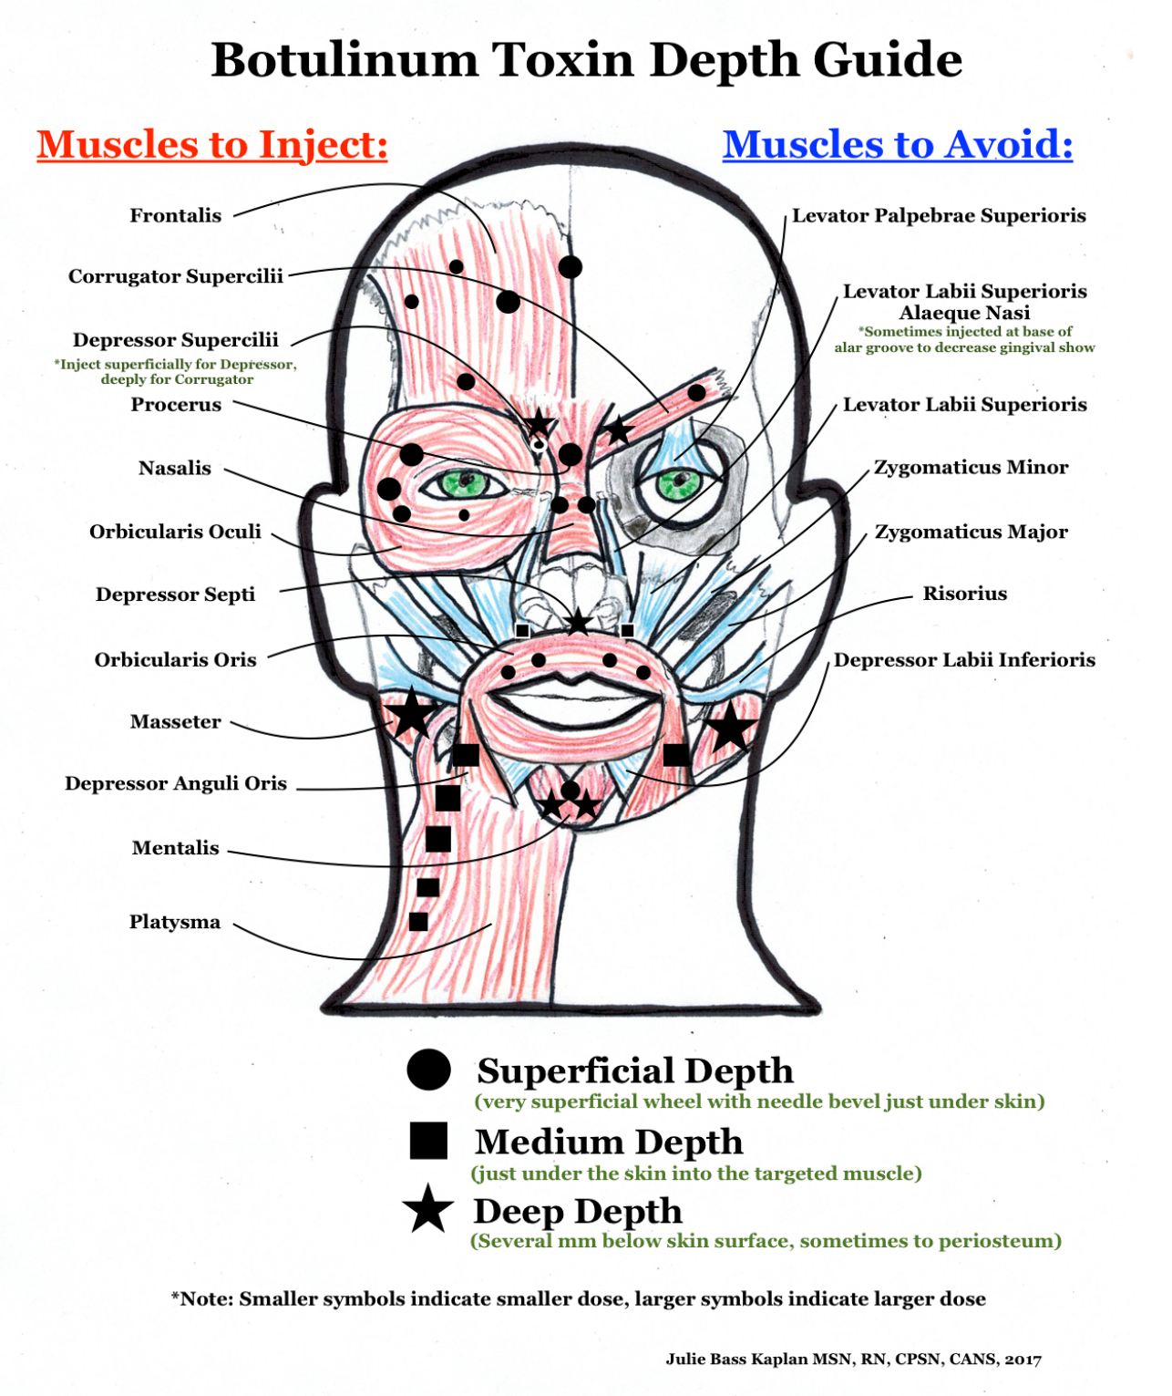

Slide 62
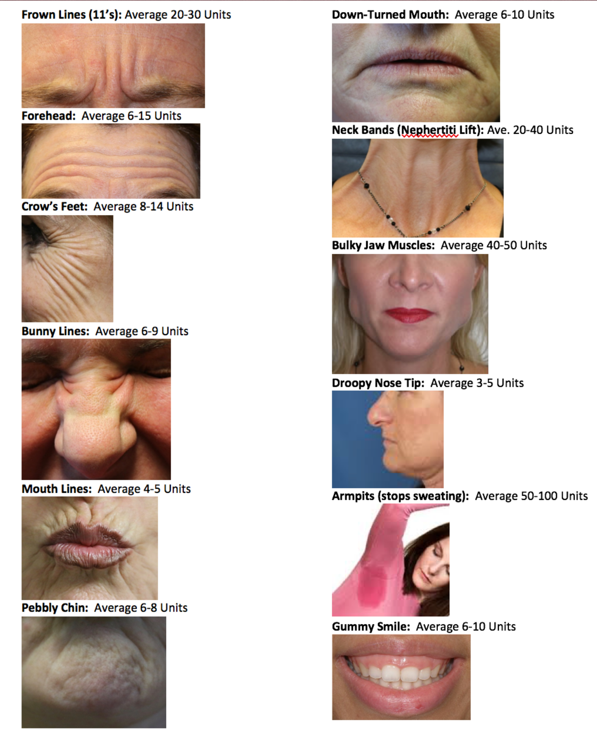

Slide 63
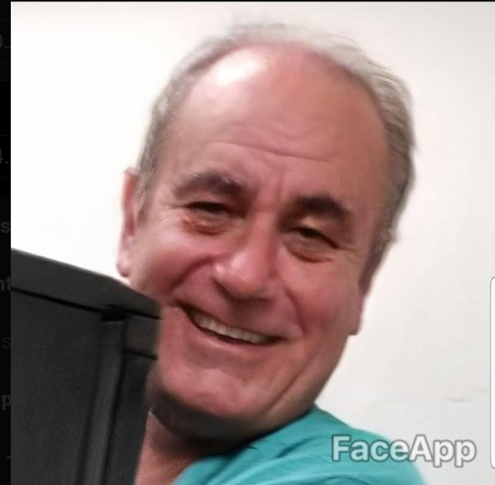

Slide 64
