Slide 1
Common Hand Consults
Sanjeev Puri PGY-9

Slide 2
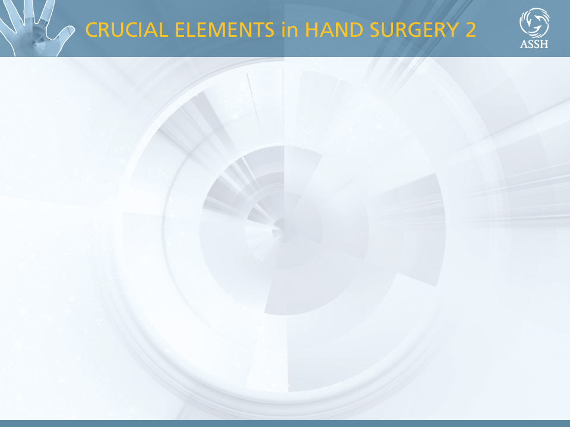
Patient Demographics
  Age
  Hand dominance
  Gender
  Occupation
History & Physical Exam - Adult

Slide 3
Chief Complaint
  Onset of the condition: acute vs. chronic
  Mechanism: traumatic vs. atraumatic
  Pain: location, intensity, radiation, aggravating, and relieving factors
  Neuro : tingling, weakness, balance, clumsiness
  Vascular: color changes, cold sensitivity
  Swelling
  Mechanical: clicking, snapping, popping, or catching
History & Physical Exam - Adult

Slide 4
Injury Details
  Mechanism (crush, sharp, etc.)
  Time of occurrence
  Place: Work (?comp?), home, marina, etc.
  Prior history of trauma, injury, or surgery
  NPO status
  Tetanus immunization history
History & Physical Exam - Adult

Slide 5
Physical Examination: 8 Parts
  Inspection
  Palpation
  Range of motion
  Stability
  Muscle and Tendon Function
  Nerve Assessment
  Vascular Assessment
  Integument Assessment
History & Physical Exam - Adult

Slide 6
Common Hand Consults
Mangled/Amputated Digit
Finger Laceration
Finger Fractures
Metacarpal Fractures
Distal Radius Fractures
Abscess
Flexor Tenosynovitis

Slide 7
Mangled Digit/Amputation
Things to think about
  Level of amputation
  Salvageable or not salvageable
  Coverage options

Slide 8
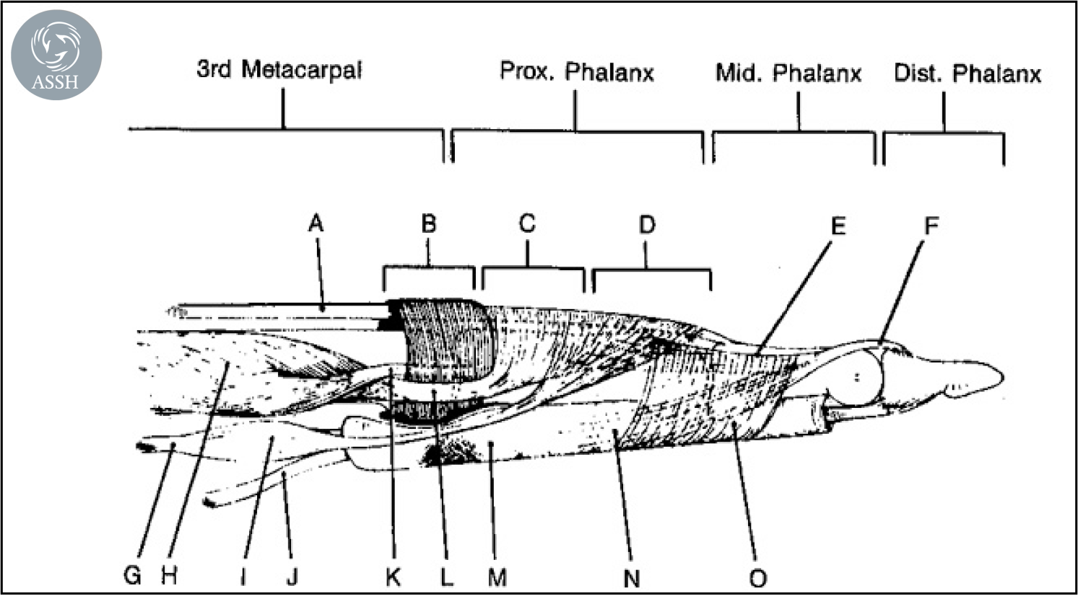
Level of Amputation based on tendinous insertions
  Extensor insertions
  Flexor insertions
Anatomy - Hand

Slide 9
What do we need?
  Consent
  Sterile Gloves and betadine
  1-2L Irrigation and Irrigation Bucket
  Lidocaine plain, 10cc syringe, 18 and 25 gauge needles, prep pads
  Small procedure tray, Rongeur (not included in tray)
  4-0 Vicryl, 4-0 Nylon (or prolene) +/- 4-0 Chromic
  4x4s, xeroform, kerlex

Slide 10
What do we do?
  Steps to amputation do not require any particular order
  Perform digital block
  Wash out wound
  Dissect and tie off both digital arteries
  Dissect and clamp/cut both nerves
  Pull and cut flexor tendon
  Cut back bone
  Close primarily vs with flap

Slide 11
Finger Laceration
Things to think about
  Volar vs dorsal
  Vascular exam
  Sensory exam
  Tendon exam
  Radiographic findings

Slide 12
Considerations
  More structures palmar, but tendons more superficial dorsal
  Cap refill is enough of a vascular exam
  Check sensation on the radial and ulnar sides
  Check for occult fractures
  Extensor lag vs problems with flexion
Anatomy - Hand

Slide 13
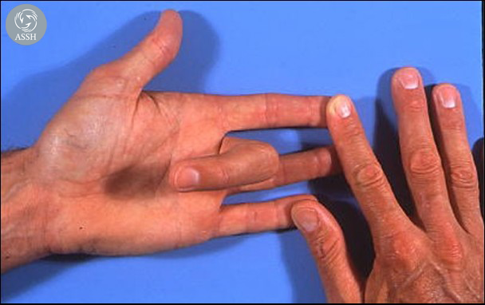
Regional Review Course 1998
Testing for flexor digitorum sublimus function

Slide 14
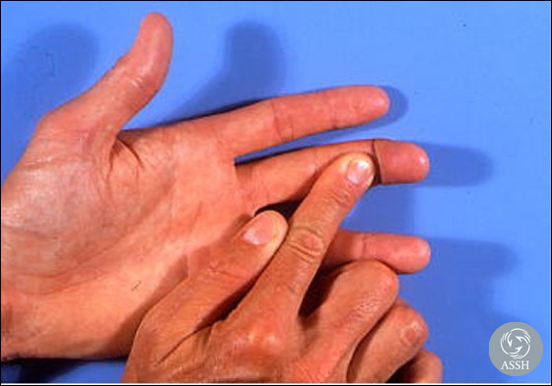
Regional Review Course 1998
Testing for flexor digitorum profundus function

Slide 15
What do we do?
  Consent
  Perform digital block
  Wash out wound
  Extensor tendons can be fixed in the ED
  Flexor tendons, nerve injuries and dysvascular fingers require the OR
  Close with 4-0 nylon vs prolene

Slide 16
Finger Fractures
Determine Open vs Closed
  Open need copious washout in the ED, abx and prompt surgical correction
  The vast majority of phalanx fractures require surgical intervention with the exception of the distal phalanx
  Treat with finger splint vs volar resting splint
  If any signs of malrotation, consider buddy taping

Slide 17
Metacarpal Fractures
Incredibly common fractures
Differentiate operative vs nonoperative
Physical exam should include standard hand exam as well as an exam for scissoring (as with prox phalanx fxs)

Slide 18
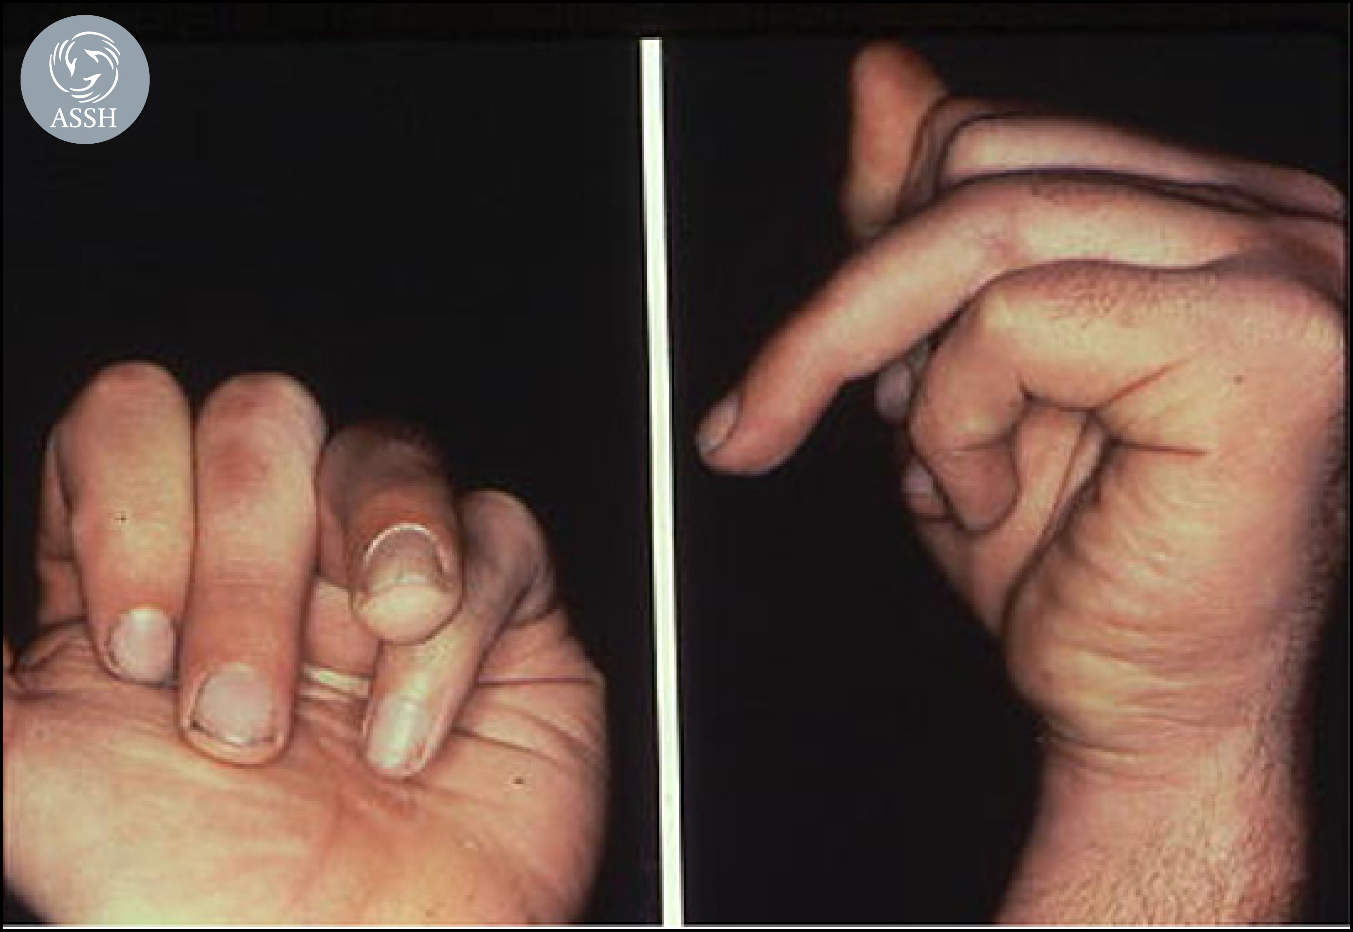
Regional Review Course 1998
Malrotation of ring finger due to proximal phalanx fracture. Note that malrotation is most obvious when fingers are flexed and viewed end-on.

Slide 19
Reduction Technique
Reduction technique
First administer a hematoma block
Jahss Maneuver – Flex PIP and MCP to 90 degrees, pushing from volar on the finger and dorsal just proximal to the fracture site with slight distraction only if necessary
Place in dorsal blocking or ulnar gutter (volar resting is sometimes ok)

Slide 20
Distal Radius Fractures
Considerations
  Open vs closed
  Intra articular vs extra articular
  Angulation of the fracture
  Displacement
  Translation
  Comminuted vs two or three part
  Check pulses and sensory exam (acute carpal tunnel)
  Check for snuffbox tenderness

Slide 21
Reduction
Start with hematoma block from the dorsal side
Finger traps if necessary (better for bigger patients)
Recreate deformity, distract, and reduce
Volar resting splint
Can add dorsal component if comminuted
Sugartong if DRUJ disruption suspected
DON’T FORGET TO RECHECK PULSES!
Ask about carpal tunnel symptoms

Slide 22
Abscesses
Things to think about
  Dorsal vs Volar
  Tendon symptoms
  Cellulitis or necrotizing infection
  Does this patient fit a category that requires antibiotics?
  Does this need to be admitted?

Slide 23
What do we need?
  Consent
  Sterile Gloves and chloraprep stick (betadine if open)
  1-2L Irrigation and Irrigation Bucket
  Lidocaine w epi, 10cc syringe, 18 and 25 gauge needles, prep pads
  I&D tray (has scalpel)
  Culture swab and packing material
  4x4s and kerlex

Slide 24
What do we do?
  Mark out the edges of cellulitis if present
  Alcohol prep and lidocaine adjacent to the abscess
  Drain abscess (use blunt dissection in the hand whenever possible)
  Send culture and pack the wound
  Wrap in a soft dressing

Slide 25
Flexor Tenosynovitis
Defined as infection within the flexor sheath
Difficult area as it is a privileged space, supports a limited volume
Kanavel’s signs: Fusiform swelling, Fixed flexed position, pain with passive extension, Tenderness over the tendon sheath remote from the area of concern (most important)

Slide 26
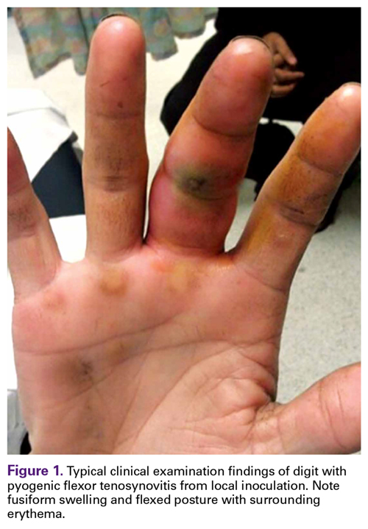
Do we drain it at the bedside?
Can this wait until I’m finished with other consults?
Is there imaging that might help me?
Is this a surgical emergency?

Slide 27
What to do
Call the resident immediately
Consent the patient for drainage of flexor tenosynovitis if instructed to do so
Start abx

Slide 28
Questions???

