Slide 1
Extensor Tendons
Andrew Peredo, MD
10/21/19

Slide 2
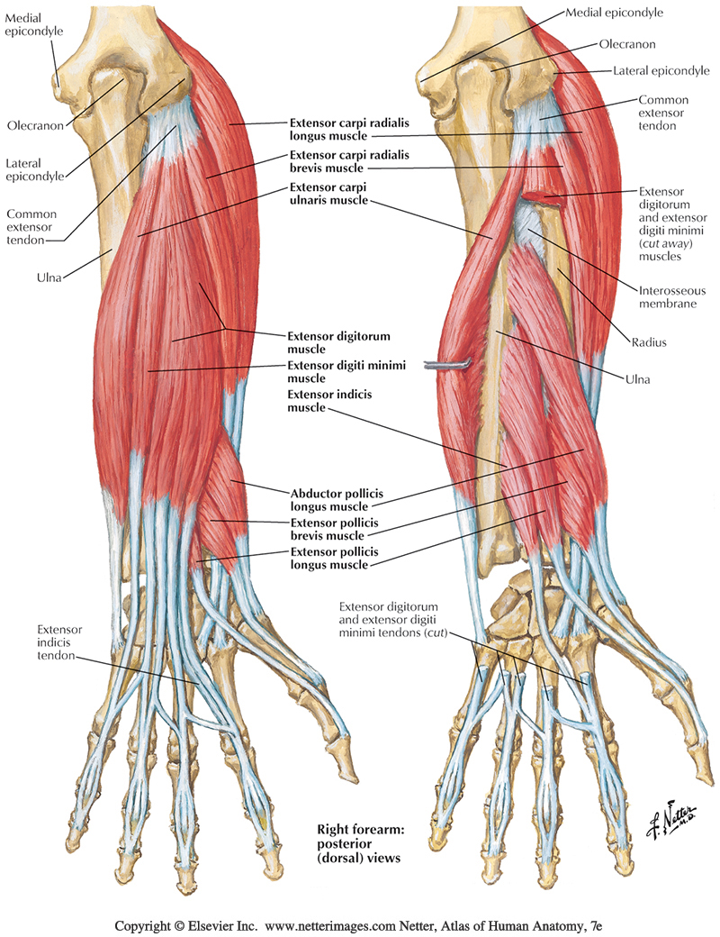
Anatomy

Slide 3
Anatomy
Inserts into base of index finger metacarpal
Action:
  extend and aBduct the wrist.

Slide 4
Anatomy

Slide 5
Anatomy
Inserts into base of middle finger metacarpal
Action:
  extend and aBduct the wrist.

Slide 6
Anatomy

Slide 7
Anatomy
Inserts into base of small finger metacarpal
Action:
  extend and aDduct the wrist.

Slide 8
Anatomy

Slide 9
Anatomy
Inserts the middle and distal phalanges
Action:
  extend finger and wrist

Slide 10
Anatomy

Slide 11

Anatomy
EDM joins the ulnar side of the ED tendon to extend the small finger

Slide 12
Anatomy

Slide 13
Anatomy
EI joins the ulnar side of the ED tendon to extend the index finger
  Ulnar to EDC of index finger

Slide 14
Anatomy

Slide 15
Anatomy
  inserts into base of thumb metacarpal
  Action: aBduct the thumb at the CMC jt→ thereby moving the thumb anteriorly
    also assists in extending and rotating the thumb.

Slide 16
Anatomy

Slide 17
Anatomy
  Inserts into base of thumb proximal
  Action:
    extend and aBduct the thumb

Slide 18
Anatomy

Slide 19
Anatomy
  Inserts into base of thumb distal phalanx
  It uses listers tubercle as fulcrum to help EPB extend and aBduct the thumb
    as well as extend the thumb distal phalanx

Slide 20
Anatomy
Deep Muscles
APL – Abductor Pollicis Longus
EPB – Extensor Pollicis Brevis
EPL – Extensor Pollicis Longus
EIP – Extensor Indicis Propius
Superficial Muscles
ERCL – Extensor Carpi Radialis Longus
ERCB – Extensor Carpi Radialis Brevis
EDC – Extensor Digitorum Communis
EDM – Extensor Digit Minimi
ECU – Extensor Carpi Ulnaris
Radial n. innervation
Notes:
The extrinsic muscle-tendon units arise from the lateral elbow, radius, ulna, and forearm interosseous membrane. The wrist extensor muscles include the extensor carpi radialis longus (ECRL), the extensor carpi radialis brevis (ECRB), and the extensor carpi ulnaris (ECU). The thumb and finger extensor muscles include the abductor pollicis longus (APL), the extensor pollicis brevis (EPB), the extensor pollicis longus (EPL), the extensor indicis proprius (EIP), the extensor digitorum communis (EDC), and the extensor digiti minimi (EDM).
Intrinsic Muscles: The intrinsic muscle-tendon units include seven interossei (three palmar and four dorsal) and four lumbricals. The interossei muscles originate on the finger metacarpals with distal attachments to the extensor apparatuses and the bases of the proximal phalanges: four are dorsal that assist with abduction of the index, middle, and ring fingers, and three are palmar that assist with adduction of the index, ring and small fingers.
The lumbrical muscles originate on the FDP tendons and insert into the radial lateral bands distally. The combined intrinsic muscle-tendon units course volar to the axis of rotation of MCP joint and dorsal to the axes of rotation of PIP and DIP joint. This anatomic arrangement leads to MCP joint flexion and IP joint extension with muscle contraction.

Slide 21
A 62-year-old woman is evaluated for acute rupture of an extensor tendon after undergoing closed treatment of a nondisplaced distal radius fracture 6 months ago. The tendon most likely to be involved is located in which of the following extensor compartments?
A) First
B) Second
C) Third
D) Fourth
E) Fifth

Slide 22
A 62-year-old woman is evaluated for acute rupture of an extensor tendon after undergoing closed treatment of a nondisplaced distal radius fracture 6 months ago. The tendon most likely to be involved is located in which of the following extensor compartments?
A) First
B) Second
C) Third
D) Fourth
E) Fifth
Spontaneous rupture of the extensor pollicis longus (EPL) tendon is reported to occur in approximately 0.3 to 5% of nondisplaced or minimally displaced distal radius fractures, but it can also occur without trauma or in patients with inflammatory conditions such as rheumatoid arthritis.
  This is thought to arise from a loss of vascularity and atrophic changes in the compartment, and, because the tendon substance is usually degenerated, primary repair of the tendon is usually not possible.
Tendon transfer using the extensor indicis proprius is the standard of care.
Spontaneous rupture of other extensor tendons can occur in association with other conditions (e.g., rheumatoid arthritis), but would be exceedingly uncommon in the clinical scenario presented.
The EPL passes through the third extensor compartment. Extensor tendon-compartment relationships include the following:

Slide 23
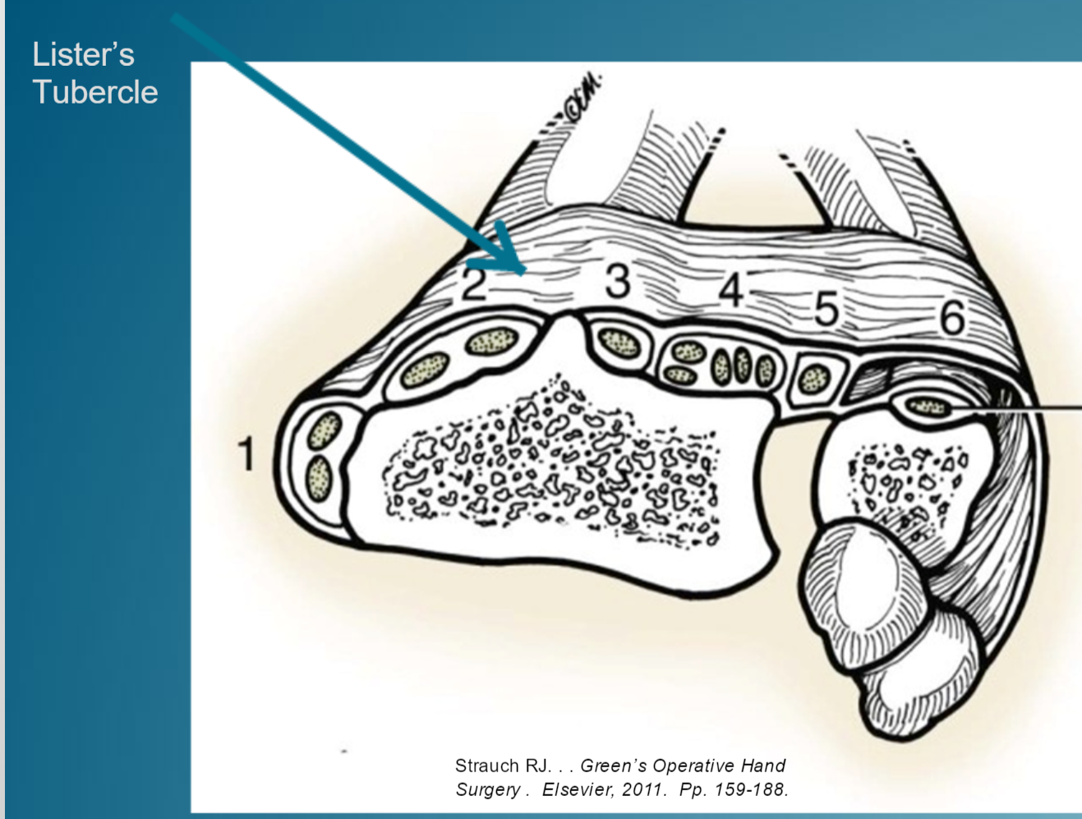
Extensor Compartments
Compartment 1: APL, EPB
(Volar snuffbox border)
Compartment 2: ECRL, ECRB
Lister’s Tubercle
Compartment 3: EPL
(Dorsal snuffbox border)
Compartment 4: EIP, EDC
Compartment 5: EDM
Compartment 6: ECU
Notes:
The wrist and finger extensor tendons pass through six retinacular compartments along the dorsal aspect of the wrist.
-The first extensor compartment contains the APL and EPB tendons, which insert onto the bases of the thumb metacarpal and proximal phalanx, respectively.
-The ECRL and ECRB tendons course through the second extensor compartment and attach to the bases of the second and third metacarpals, respectively.
-The EPL tendon courses through the third extensor compartment and inserts onto the dorsal base of the thumb distal phalanx.
-The EIP and EDC tendons pass through the fourth extensor compartment
- the EDM tendon passes through the fifth extensor compartment,
- and the ECU tendon passes through the sixth extensor compartment.
The EIP, EDC, and EDM tendons join the finger extensor apparatuses, whereas the ECU tendon inserts onto the base of the fifth metacarpal. The relationship of the EIP and the EDC of the index finger usually puts the EIP ulnar and deep to the EDC. In addition, the muscle belly of the EIP extends more distally. Juncturae tendinum are filamentous and tendinous bands that interconnect the extensor tendons of the index, long, ring, and small fingers at the dorsum of the hand.

Slide 24
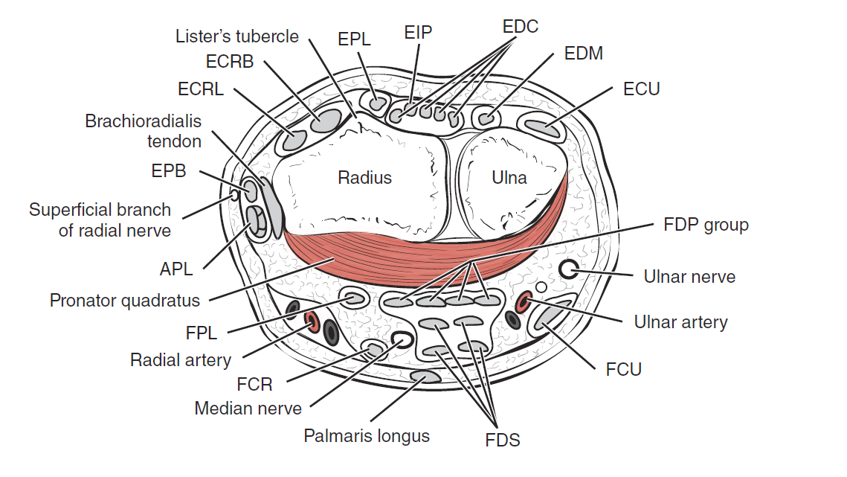

Slide 25
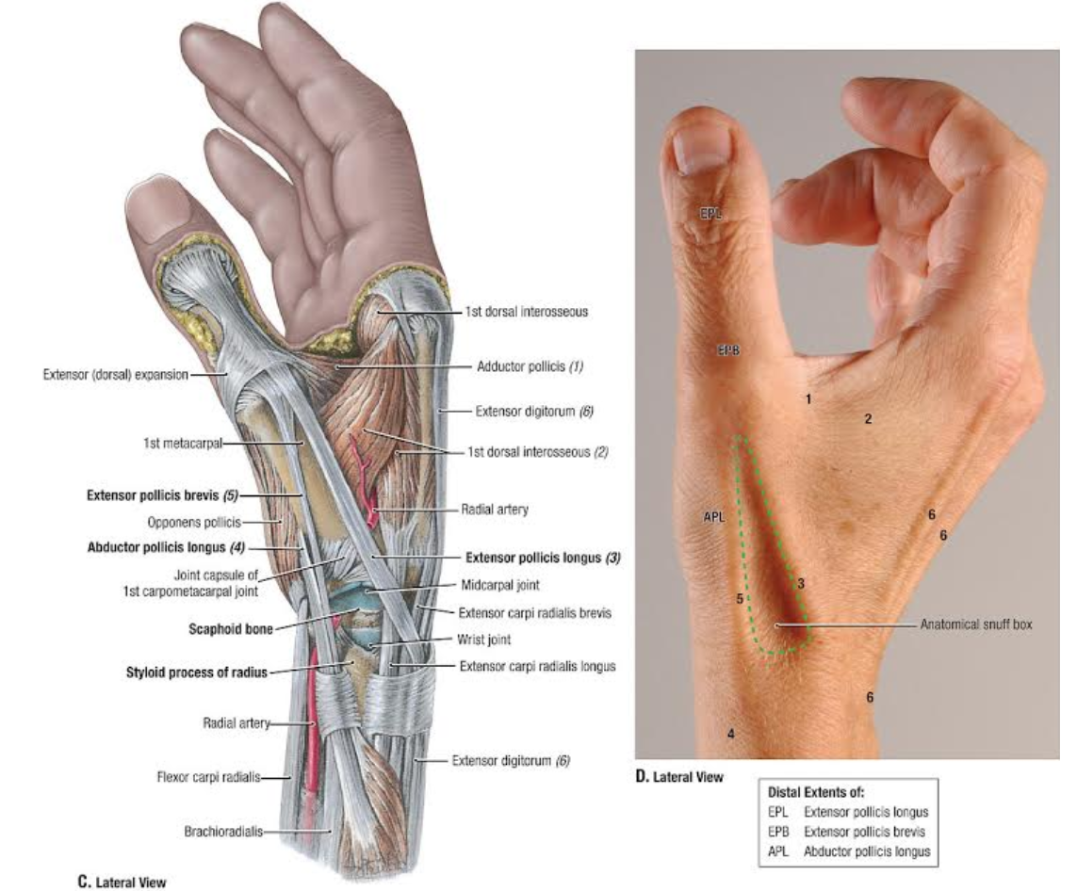
Surface Landmarks

Slide 26
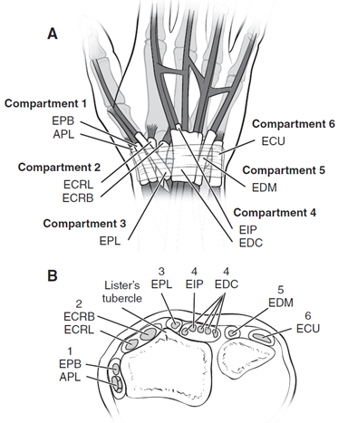
1st Compartment
Abductor pollicis longus - APL
  inserts into base of thumb metacarpal
  almost always has multiple slips
Extensor pollicis brevis - EPB
  Inserts into base of thumb proximal
  rarely multiple slips

Slide 27
2nd Compartment
Extensor carpi radialis longus (ECRL)
  Inserts into base of index finger metacarpal
Extensor carpi radialis brevis (ECRB)
  Inserts into base of middle finger metacarpal

Slide 28
3rd Compartment
Extensor pollicis longus (EPL)
  Inserts into base of thumb distal phalanx
  Relative independence of action across all three joints because of multiple attachments to dorsal apparatus

Slide 29
4th Compartment
Extensor digitorum communis (EDC)
Often has two slips to ring finger
Slip to small finger absent in up to 56% of population
Extensor indicis proprius (EIP)
Ulnar to EDC of index finger
Most distal myotendinous junction

Slide 30
5th Compartment
Extensor digiti minimi (EDM); also called extensor digiti quinti (EDQ)
Two slips in 80% of population

Slide 31
6th Compartment
Extensor carpi ulnaris (ECU)
Only extensor tendon with a true sheath
Tear of sheath
  Leads to ulnar-sided wrist pain and popping sensation with subluxation of ECU

Slide 32
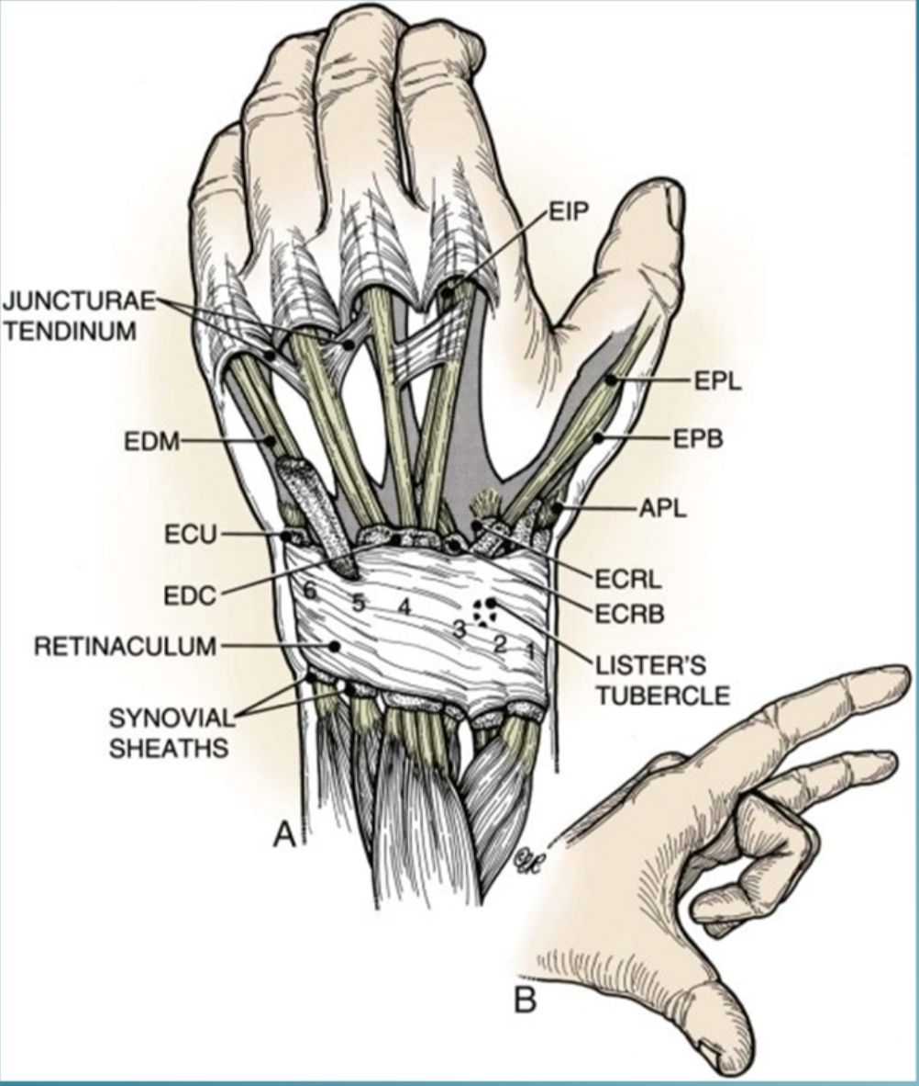

Slide 33
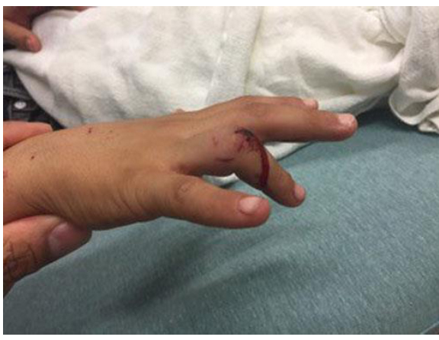
A 50-year-old woman comes to the emergency department after sustaining an avulsion injury of the right ring finger proximal interphalangeal (PIP) joint. A photograph is shown. Examination shows the central slip is disrupted, and the inside of the PIP joint is visible through the dorsal wound. The patient is able to actively extend the PIP joint. Which of the following anatomical structures allows the patient to extend the PIP joint?
A) Extrinsic extensor tendon
B) Interosseous muscle tendon
C) Lateral conjoined tendon
D) Oblique retinacular ligament
E) Sagittal band

Slide 34
A 50-year-old woman comes to the emergency department after sustaining an avulsion injury of the right ring finger proximal interphalangeal (PIP) joint. A photograph is shown. Examination shows the central slip is disrupted, and the inside of the PIP joint is visible through the dorsal wound. The patient is able to actively extend the PIP joint. Which of the following anatomical structures allows the patient to extend the PIP joint?
A) Extrinsic extensor tendon
B) Interosseous muscle tendon
C) Lateral conjoined tendon
D) Oblique retinacular ligament
E) Sagittal band

Slide 35
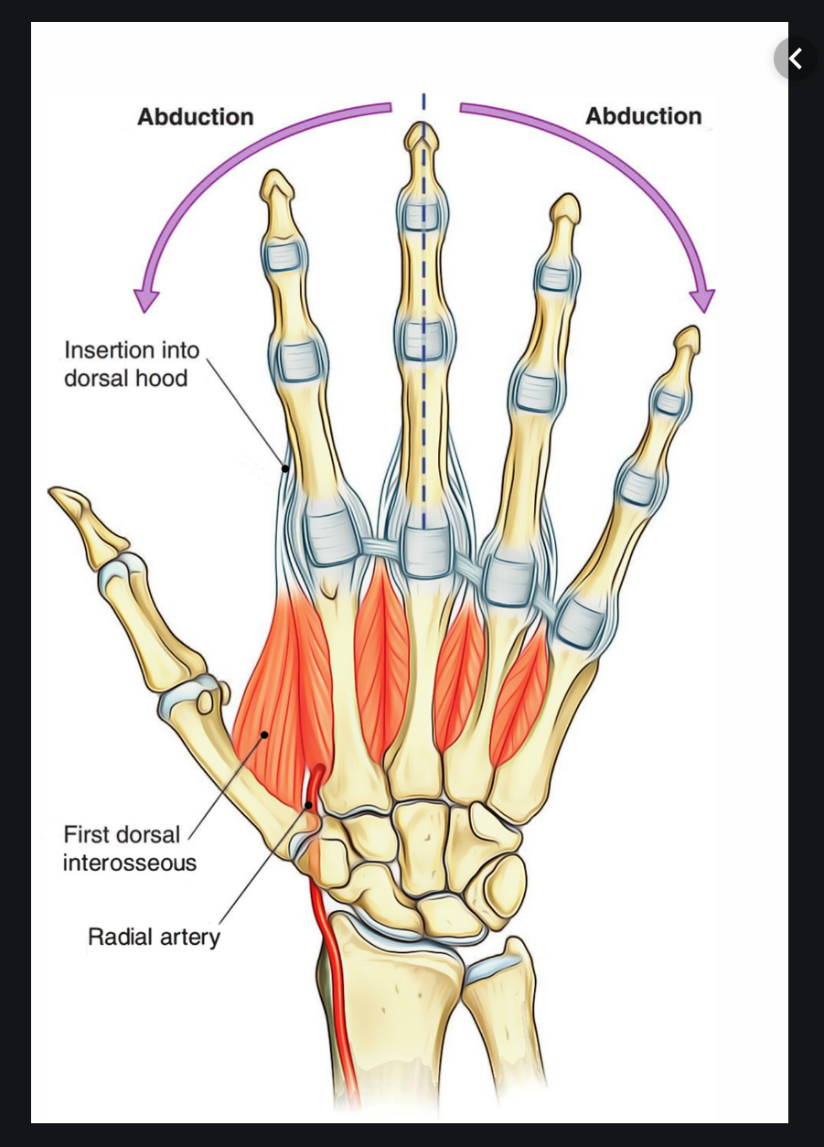
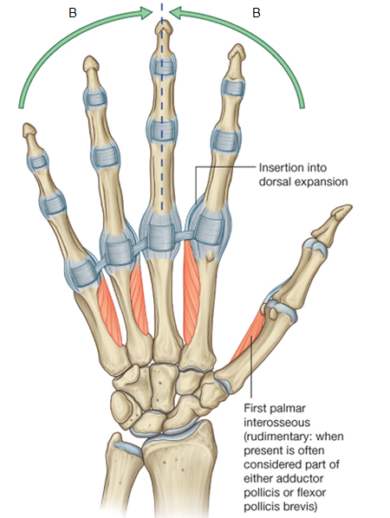
Intrinsics
Interossei:
Dorsal interossei:
  Four muscles, bipennate
  Actions:
    aBduct fingers
    flex MCP jts
    extend IP jts (only with MCPs flexed)
  Innervated by ulnar nerve
Palmar (volar) interossei:
  Three muscles, unipennate
  Actions:
    aDduct fingers
    flex MCP jts
    extend IPs (only with MCPs flexed)
  Innervated by ulnar nerve
Mnemonic: DAB and PAD your interossei
  DAB (dorsal abduct)
  PAD (palmar adduct).

Slide 36
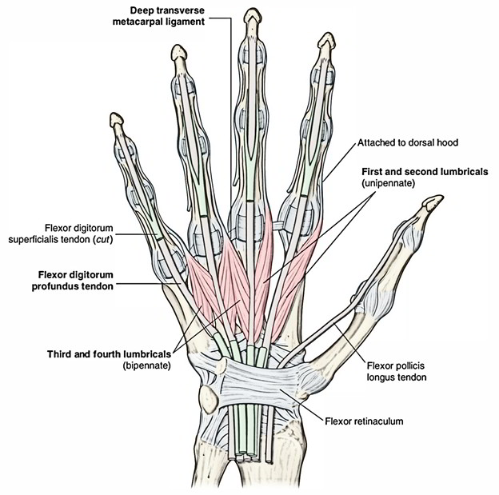
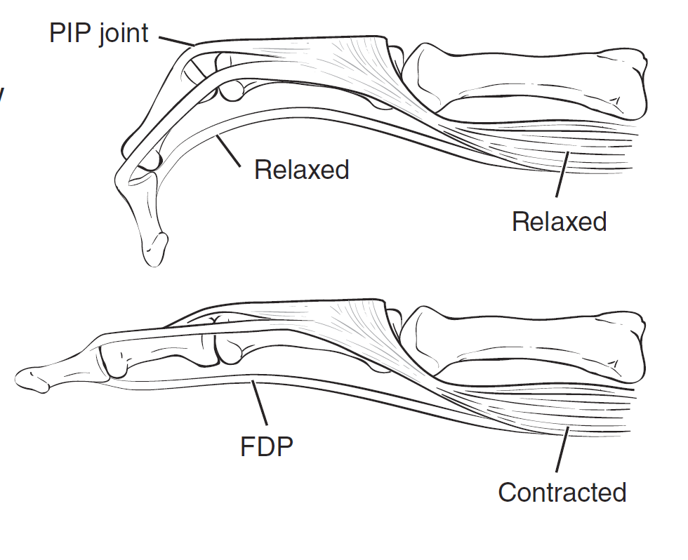
Intrinsics
Lumbricals
  Originate on the FDP tendon and insert on the extensor hood
  Actions:
    Prime extensors of IPs
    weak flexors of MP joints
  Index & long finger lumbricals innervated by median n.
  Ring & small finger lumbricals innervated by ulnar n.
*Lumbrical plus Deformity
  Occurs when FDP shortens (i.e. finger amp) → tension on the lumbricals
  Results in paradoxical extension of IP jt while attempting flexion

Slide 37
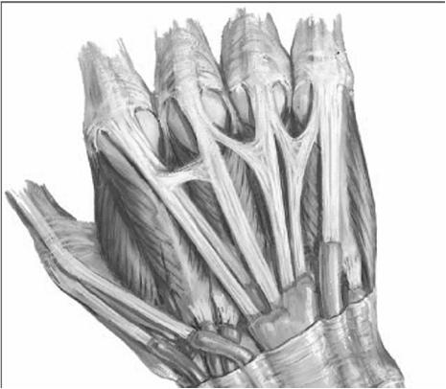
Juncturae Tendinum
Interconnect EDC tendons
Most variable anatomy of extensor system
  Consistency varies: Fascial, ligamentous, or tendinous
Can provide some cross-tendon motion in cases of lacerated EDC tendons proximal to the juncturae
  leading to misdiagnosis

Slide 38
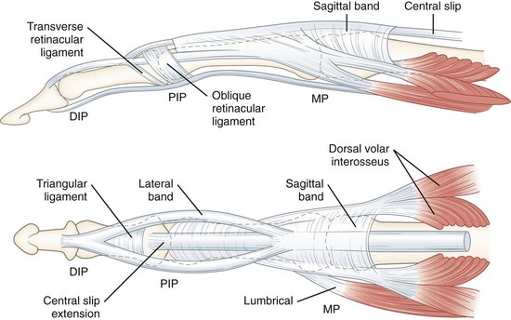
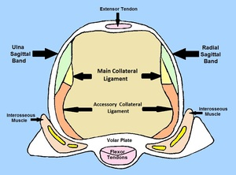
Sagittal Band
Originate from intermetacarpal plate on either side of metacarpal head
Form dorsal expansion, or hood
Maintain central slip of extensors over MP joints, preventing lateral subluxation
Prevent MP joint hyperextension

Slide 39
Anatomy
Other components of the extensor apparatus stabilize the extensor hood and co-ordinate joint movement

Slide 40
Anatomy
Triangular Ligament
  A thin tissue connecting the conjoined lateral bands over the middle phalanx
  Prevents separation and volar migration of the lateral bands when the PIP is flexed

Slide 41
Anatomy
Transverse Retinacular ligaments
  Originate from each side of the PIP jt volar plate
  Insert dorsally into the adjacent conjoined lateral band
  Stabilize and limit dorsal migration of the lateral bands during PIP jt extension

Slide 42
Anatomy
Oblique Retinacular ligaments
  Arise from the flexor tendon sheath and volar aspect of the proximal phalanx
  Course distally to insert onto the dorsal base of the distal phalanx with the terminal extensor tendon, thus linking and coordinating PIP and DIP joint motion

Slide 43
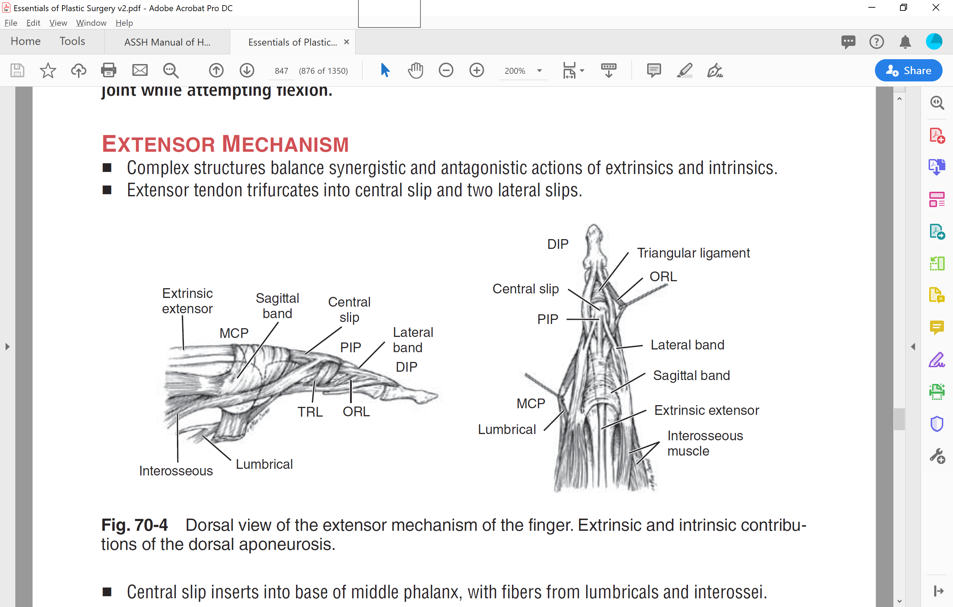
Extensor Anatomy
Active extension of a digit is provided by the extensor mechanism of the digit.
The extensor mechanism consists of the conjoining of the extrinsic muscles to the intrinsic muscles
  Extrinsic muscles:
    EDC
    EDM
    EIP
  Intrinsic muscles:
    Lumbricals
    dorsal and palmar interosseous muscles

Slide 44
Extensor Anatomy
The extrinsic tendons produce digital extension at all three joints:
    MCP joint
    PIP joint
    DIP joint.
  The extensor mechanism has specific attachments at each these three sites.
The intrinsic muscles produce digital extension at
    PIP jt
    DIP jt
  concomitant flexion at the MCP joint.

Slide 45
Extensor Anatomy
The extensor mechanism is complex
  normal digital extension is dependent on:
    a delicate balance between the intrinsic and extrinsic muscles
    the integrity of each of the insertion sites.
Normal digital extension is dependent on a balance of the pull on the PIP and DIP joints.
  Any affliction that results in either over-pull at one joint, or loss of pull at either joint, can result in a deformity.

Slide 46
Extensor Anatomy - PIP
Extension at the PIP joint is produced by contributions from:
  extrinsic tendons (EDC)
    contribute to extension at the PIP jt by its direct attachment to the dorsal base of the middle phalanx through the central slip.
  intrinsic muscles.
    proximal to the insertions of central slip, the EDC tendon is joined by the intrinsic muscles through the lateral bands, and both the EDC and intrinsic muscles contribute to PIP extension.

Slide 47
Extensor Anatomy - DIP
Extension of the DIP joint is produced by:
  extrinsics (EDC, EDM, and EIP)
    extends distal phalanx by direct attachment at the dorsal base of the phalanx through the terminal tendon.
  intrinsic tendons.
    Proximal to the DIP jt, the EDC tendon joins the intrinsic muscles
      forms the conjoined lateral tendons (or conjoined lateral bands).
    Both tendons then continue to form the terminal tendon
      inserts on the distal phalanx to produce DIP extension.

Slide 48
Extensor Anatomy - MCP
Extension of the MCP joints is produced primarily by extensor pull of the EDC.
  In the small finger and index fingers, there are additional contributions by the EDQ and EIP tendons, respectively.
The EDC tendons contribute to extension at the MCP joint by pulling on the sagittal bands.
  The sagittal bands loop around to the palmar surface of the base of the proximal phalanx.
  When the EDC muscle contracts, its tendon extends the proximal phalanx by pulling on the sagittal bands, which act like a sling and pull on the proximal phalanx to produce MCP joint extension.

Slide 49
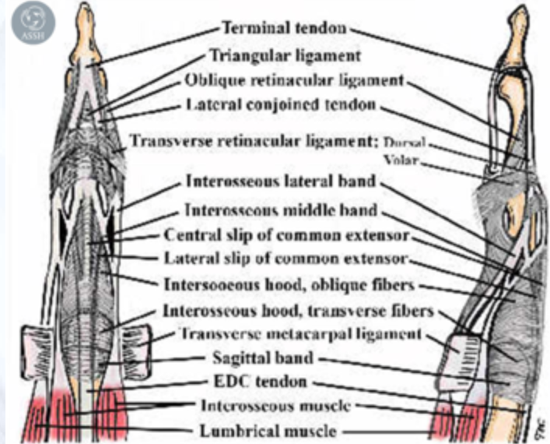
Extensor Hood Anatomy

Slide 50
Extensor Hood Anatomy

Slide 51
Extensor Hood Anatomy

Slide 52
Extensor Hood Anatomy

Slide 53
Extensor Hood Anatomy

Slide 54
Extensor Hood Anatomy

Slide 55
Extensor Hood Anatomy

Slide 56
Extensor Hood Anatomy

Slide 57
Extensor Hood Anatomy

Slide 58
Extensor Hood Anatomy

Slide 59
Extensor Hood Anatomy

Slide 60
Extensor Hood Anatomy

Slide 61
Extensor Hood Anatomy

Slide 62
Extensor Hood Anatomy

Slide 63
Extensor Hood Anatomy

Slide 64
Extensor Hood Anatomy

Slide 65
Extensor Hood Anatomy

Slide 66
Extensor Hood Anatomy

Slide 67
Extensor Hood Anatomy

Slide 68
Extensor Hood Anatomy

Slide 69
Extensor Hood Anatomy

Slide 70
Extensor Hood Anatomy

Slide 71
Extensor Hood Anatomy

Slide 72
Extensor Hood Anatomy

Slide 73
Extensor Hood Anatomy

Slide 74
Extensor Hood Anatomy

Slide 75
Extensor Hood Anatomy

Slide 76
Extensor Hood Anatomy

Slide 77
Extensor Hood Anatomy

Slide 78
Extensor Hood Anatomy

Slide 79
Extensor Hood Anatomy

Slide 80
Extensor Hood Anatomy

Slide 81
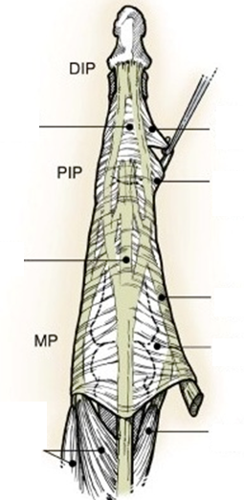
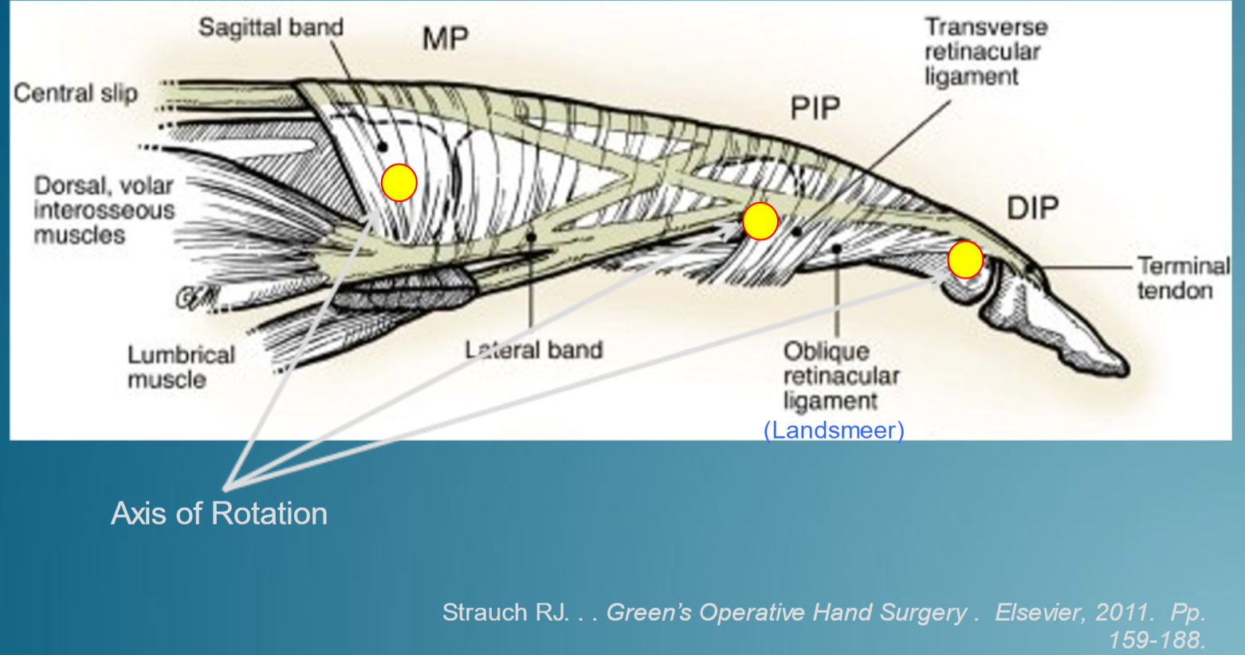
Extensor Hood Anatomy
Triangular Ligament
Oblique retinacular ligament
Transverse retinacular
ligament
Central slip
Lateral Band
Sagittal Band
Dorsal & Volar
Interosseous muscles
Lumbrical muscle
Notes:
The finger extensor apparatus is comprised of the extrinsic and intrinsic tendons and soft tissue-stabilizing structures. The extrinsic tendon contribution to each finger passes dorsally over the MCP joint before trifurcating into a central slip, which continues and inserts into the dorsal base of the middle phalanx, and two lateral slips (radial and ulnar). The interosseous and lumbrical tendons form a lateral band on each side of the digit. These lateral bands join with the lateral slips of the extrinsic extensor tendon at the level of the PIP joint to form the conjoined lateral bands. The two conjoined lateral bands converge dorsally and insert at the base of the distal phalanx as the terminal extensor tendon.
Structures stabilizing the finger extensor apparatus and coordinating joint movement include the sagittal bands (interconnect the extrinsic extensor tendons to the MCP joint volar plate), the transverse retinacular ligaments (interconnect the lateral bands to the PIP joint volar plate), and the triangular ligament (interconnect the conjoined lateral bands over the middle phalanx). The oblique retinacular ligaments (ORL) are variably present and assist with linking IP joint motion (active DIP joint flexion leads to tightening of the ORL and concurrent PIP flexion, whereas active PIP joint extension leads to tightening of the ORL and concurrent DIP extension). These ligaments arise rom the palmar plate of the PIP joint and flexor tendon sheath and insert onto the dorsal base of the distal phalanx with the terminal extensor tendon.

Slide 82
Extensor Hood Anatomy
TRL prevents dorsal subluxation of lateral bands
Triangular ligament prevents volar subluxation of lateral bands
ORL (Landsmeer): Originates on flexor tendon sheath and inserts into terminal tendon
  Helps extend DIP when PIP is being extended

Slide 83
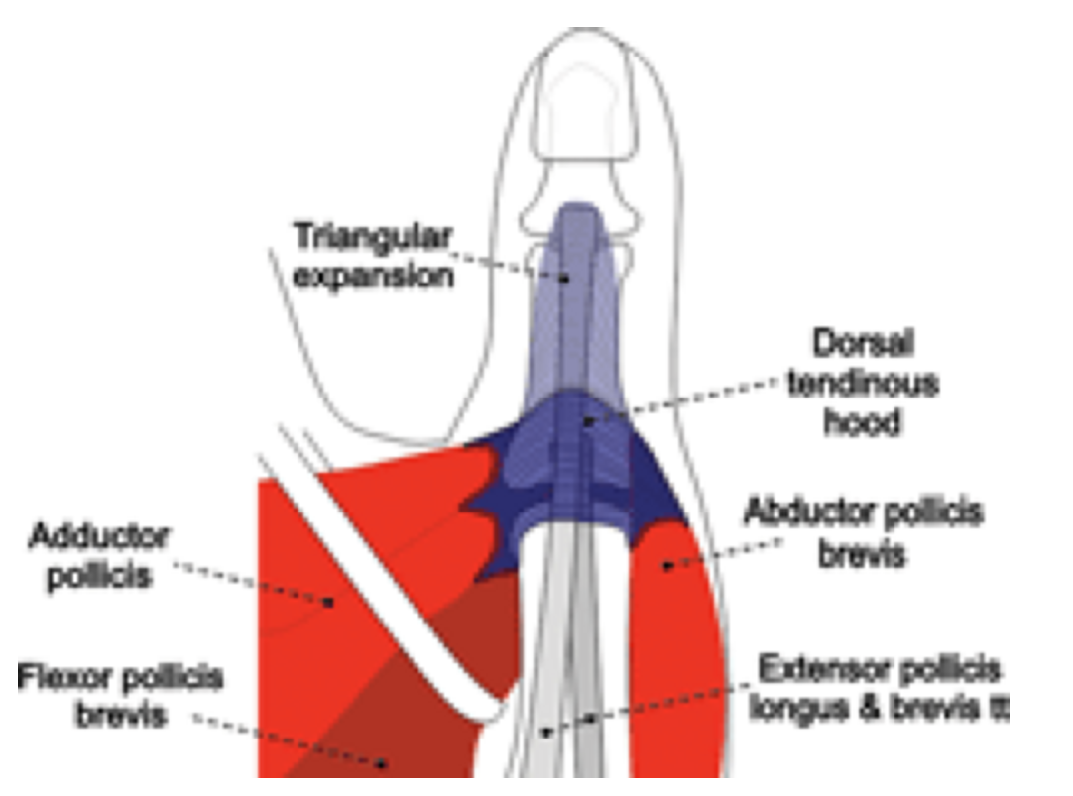
Thumb extensor apparatus
The extensor apparatus of the thumb is composed of the tendons of:
  EPL
  EPB
  Dorsal tendinous hood
    (equivalent of the sagittal band)
  triangular expansion
    adductor pollicis
    FPB
    APB
Notes:
The thumb extensor apparatus is a less complex structure.
-The EPL tendon is the primary IP extender, it is necessary for strong thumb retropulsion and IP joint hyperextension. The EPL tendon passes over the MCP joint, stabilized by two sagittal bands, and attaches directly to the dorsal base of the distal phalanx. It is the only tendon to lift the thumb off table-top with palm down.
-The EPB primary MCP extender, the tendon courses radial to the EPL tendon and inserts onto the dorsal base of the proximal phalanx to assist with MCP joint extension.
-APL abducts the thumb at metacarpal base
-Three intrinsic thumb muscles (abductor pollicis brevis, flexor pollicis brevis, and adductor pollicis) weakly contribute to thumb extension via attachments to the extensor apparatus.

Slide 84
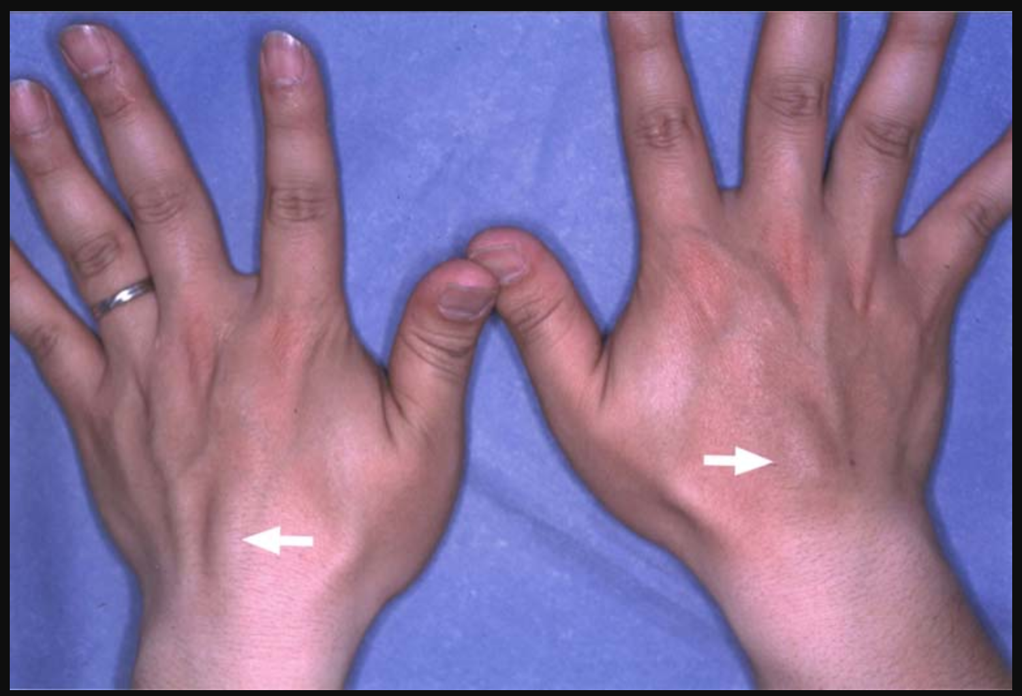
Anatomic Variations
Extensor digitorum brevis manus muscle is present in 3% of hands
Anomalous muscle located on dorsal wrist, with tendons inserting into extensors of hand
  Can be confused with a dorsal wrist ganglion.

Slide 85
Anatomic Variations
The EIP tendon is normally positioned ulnar to the index finger EDC tendon, and the EDM tendon is normally positioned ulnar to the small finger EDC tendon.
  Infrequently, the EIP tendon courses radial to the index finger EDC tendon.
The small finger EDC tendon is absent in > 50% of individuals and the EPB tendon is absent in ∼5% of individuals.
The APL tendon is composed of two or more tendon slips and there are often duplicate EDC tendon slips to the ring and small fingers.
The EPB is often located in a separate subcompartment within the first dorsal compartment.

Slide 86
Initial Evaluation
History
  Hand lac with loss of extension
  Rapid forced digital flexion – avulsion
PE:
  Loss of digit extension (partial/complete)
    Tendon laceration: can not hold position after passive extension
    Tendon Subluxation: can hold in extension
    Other causes of extension deficit (jt or radial nerve injury)
Radiographs, US, MRI
Initial treatment
  Wound care
  Splinting

Slide 87
Acute Extensor Tendon Injury
A thorough clinical examination is fundamental in diagnosing an acute extensor tendon injury.
  Inspect the soft tissue envelope
  Assess neurovascular status
  Observe active wrist and finger motions
    Independent extension of either the long or ring finger requires intact EDC tendon slips.
    Autonomous extension of the index and small fingers requires functional EIP and EDM tendons, respectively.
    Weakness of extension against resistance may imply a partial tendon injury.
Imaging with an ultrasound or MRI may confirm a suspected partial or complete tendon laceration.

Slide 88
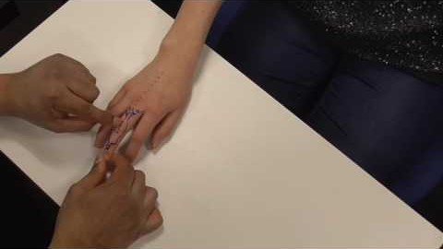

Slide 89
Thumb Injuries
Hyperextension of the thumb IP joint necessitates an intact EPL tendon.
Incomplete IP joint extension may be possible following disruption of the EPL tendon (proximal to the MCP joint) if the thumb intrinsic muscles are intact.

Slide 90
Tendon Injury
An isolated extensor tendon injury distal to the MCP joint
  rarely amenable to definitive management in the ER setting.
  The extensor apparatus is positioned close to the skin surface and retracts minimally after injury
    allowing for splint immobilization or direct suture repair.
Injuries proximal to the MCP joint are associated with tendon retraction and separation of the tendon ends.
  Tendon retraction, multiple extensor tendon lacerations, contaminated wounds, and complex injuries with loss of bone and soft-tissues are better managed in the OR.
Tendon repair is ideally performed within 7 days of injury but can be attempted several weeks following injury.

Slide 91
Tendon Repair
Extensor Tendon Healing
  3 Sources of Nutrition
    Endogenous circulation
    Synovial Fluid diffusion
    Exogenous circulation (from adhesions)
Vascular Supply
  Myotendinous junction
  Bony insertion
  Paratenon along the length of the tendon
  Long mesotenon within synovial-lined dorsal retinaculum
  *No Vincular vessels, unlike flexor tendons

Slide 92
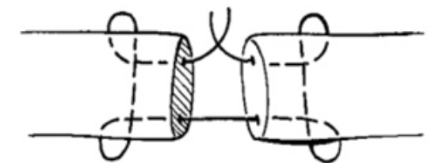
Tendon Repair
Damaged extensor tendon ends must be handled with care
  excess manipulation may lead to scar formation and impede tendon excursion.
For more distal injuries (Zones 1-4) the tendon is flat
  Figure of 8 or mattress suture repair, or running
    An epitendinous suture of 5-0 or 6-0 nonabsorbable suture will add strength to the construct, but placement of additional suture material may be prohibited by small tendon size.
Zones 5-8: tendon caliber thickens
  Core Suture method
    3-0 or 4-0 nonabsorbable suture material provides acceptable strength
Avoid large knots with monofilament suture outside the tendon
  they may be palpable under the thin dorsal soft tissue coverage.
  Braided core sutures are less conspicuous.
Tendon shortening should be minimized
  this will cause extensor tendon tightness and loss of finger flexion.

Slide 93
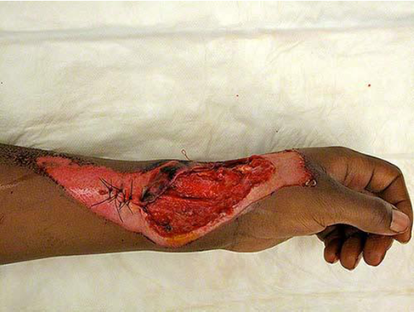
A 28-year-old woman is brought to the emergency department after sustaining an injury to the arm during a motor vehicle collision. A
photograph is shown. Physical examination shows inability to extend the index or long fingers, and a rent in the dorsal wrist capsule. Which of the following extensor zones is most likely involved?
A) II
B) III
C) IV
D) V
E) VI

Slide 94
A 28-year-old woman is brought to the emergency department after sustaining an injury to the arm during a motor vehicle collision. A
photograph is shown. Physical examination shows inability to extend the index or long fingers, and a rent in the dorsal wrist capsule. Which of the following extensor zones is most likely involved?
A) II
B) III
C) IV
D) V
E) VI

Slide 95
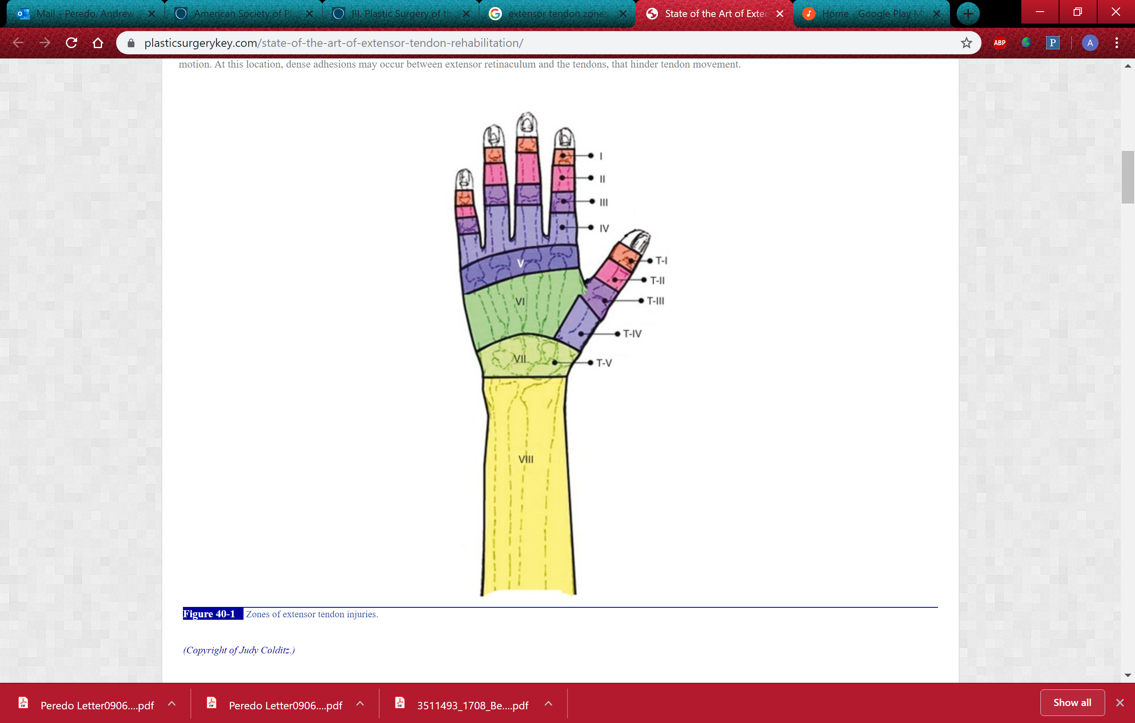
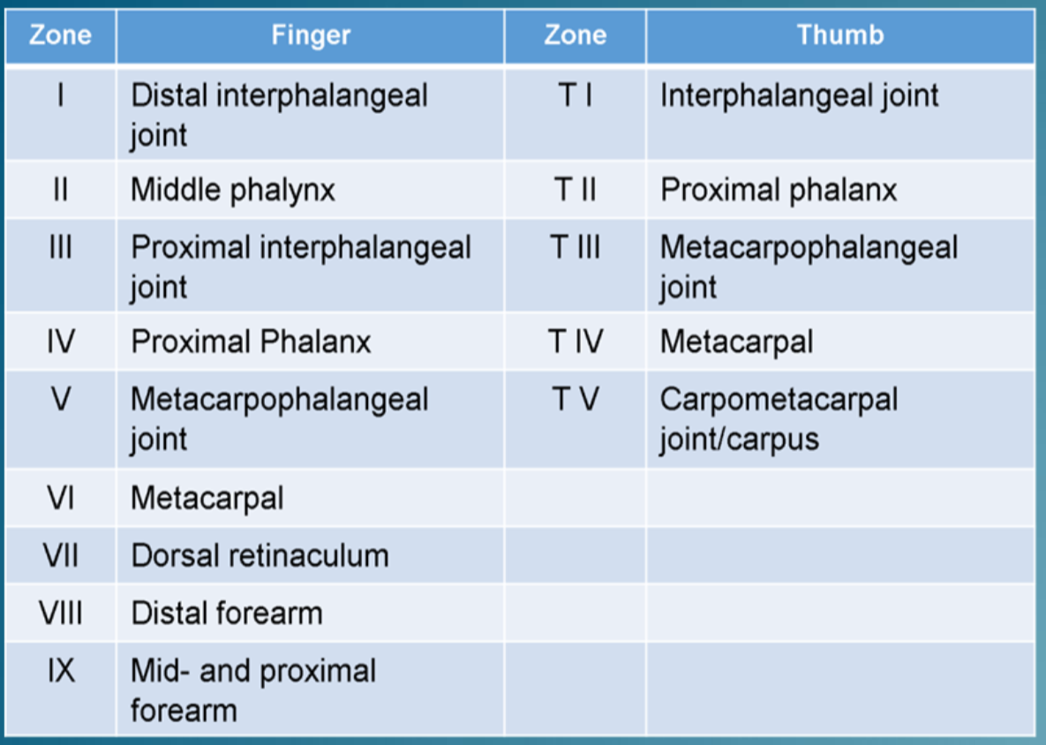
Extensor Zones of Injury
Odd numbers over joints, even over bones

Slide 96
Zones of Extensor Tendon injury
Zone 1: Terminal Tendon
Zone 2: triangular ligament
Zone 3: central slip
Zone 4: over proximal phalanx
Zone 5: over MCP jt
Zone 6: over metacarpals
Zone 6-9: proximal

Slide 97
A 25-year-old man who is a graduate student comes to the office for evaluation of the right ring finger 4 weeks after sustaining an axial impact. A diagnosis of soft-tissue mallet finger is noted. Which of the following is the most appropriate treatment in this patient?
A) Arthrodesis
B) Orthosis
C) Pinning in extension
D) Tendon grafting
E) Terminal tendon repair

Slide 98
A 25-year-old man who is a graduate student comes to the office for evaluation of the right ring finger 4 weeks after sustaining an axial impact. A diagnosis of soft-tissue mallet finger is noted. Which of the following is the most appropriate treatment in this patient?
A) Arthrodesis
B) Orthosis
C) Pinning in extension
D) Tendon grafting
E) Terminal tendon repair

Slide 99
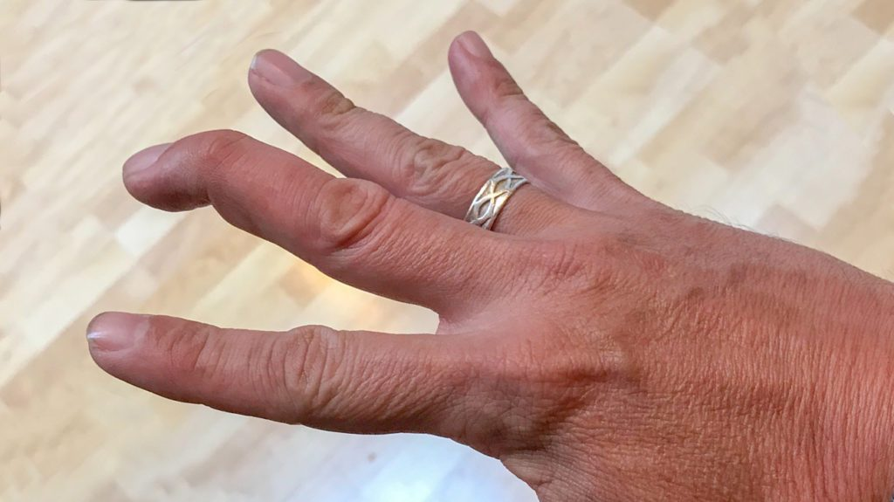
Zone I Injury
Loss of DIP extension
  Disruption of the extensor mechanism at the DIP jt
  Most are traumatic
    Sudden forced flexion of the extended fingertip
    Stretching or tearing of extensor tendon
    OR
    Avulsion of tendon insertion from the dorsum of distal phalanx, with or w/o a fragment of bone
  Less Frequent
    Forced hyperextension of DIP jt →fracture at dorsal base of distal phalanx
    Open injuries: laceration, crush or deep abrasion
  Mallet Finger Subtypes
    Tendinous
    Bony

Slide 100
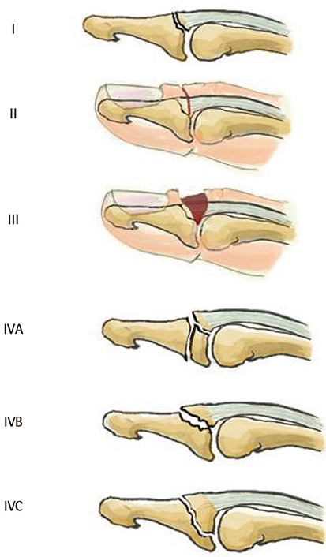
Zone I - Mallet finger
Doyle Classisfication:
Type I: Closed, bony or non-bony
    injury with loss of tendon continuity, with or without small avulsion fracture
Type II: Open
    Laceration at or proximal to distal interphalangeal (DIP) joint with loss of tendon continuity
Type III: Open with loss of skin, subQ and tendon
    Deep abrasion with loss of skin, subcutaneous cover, and tendon substance
Type IV
  A: Pediatric Trans-epiphyseal plate fracture (Seymour)
  B: Fracture of 20%-50% of articular surface, hyperflexion
  C: Fracture of >50% of articular surface, hyperextnesion
    volar subluxation of distal phalanx

Slide 101
Zone I Mallet finger - Treatment
Type I
Nonsurgical
  Immobilization of DIP joint only, in full extension
    Dorsal or volar-based aluminum foam splint, or plastic (Stack) splint
    Requires at least 6 weeks of continuous extension followed by 2 weeks of splinting at night
    Careful observation of skin to prevent necrosis or maceration
      Volar splint less effective but fewer skin complications
    one episode of flexion “starts the clock over.”
Surgical
  Percutaneous pinning across DIP joint in full extension
    May be warranted in certain occupations (e.g., surgeons)
    Option for patients incapable of compliance (e.g., children)

Slide 102
Zone I Mallet finger - Treatment
Type II
Primary Closure
  Running monofilament suture, incorporating skin and tendon
    Remove suture after 10-14 days
  Splint as for type I
Type III
Typically requires local flap for reconstruction of soft tissue
  Terminal extensor reconstructed secondarily with tendon graft

Slide 103
Zone I Mallet finger
Treatment
Type IV
  CRPP when possible
  Open reduction with transarticular K-wire
    pull-out suture or K-wire fracture fragment fixation
  Fixation protected with splint for 6 weeks, then K-wires removed and progressive motion begun

Slide 104
Zone I Mallet finger
Treatment
Closed Zone 1- Tendinous Mallet
  Splint 6-8 weeks
Closed Zone 1 – Bony Mallet
  Avulsion <50% of articular surface are stable injuries
  Avulsion with volar subluxation of the distal phalanx→unstable

Slide 105
Zone I Mallet finger
Operative Treatment
Open injuries
  I&D, tendon repair (+/- DIP pinning to take tension off repair)
  May include skin in repair (tenodermadesis)
  May require soft tissue coverage/tendon reconstruction in degloving
Bony Mallet
  ORIF w/ wires/mini-screws (+/- DIP pinning)
  Extension block pinning
Patients unable to comply with splint
  Buried transarticular wire

Slide 106
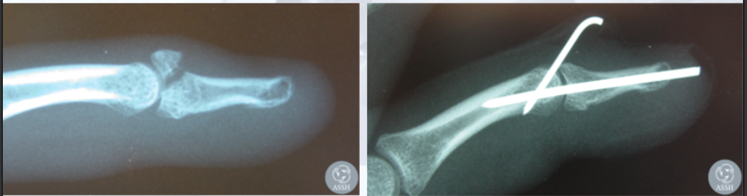
Zone I Mallet finger
Treatment
Open Zone 1
  Operative treatment recommended by most authors
  +/- transarticular K-wire in full extension

Slide 107
Zone I Mallet finger
Closed Treatment Complications
  Poor Compliance
  Pain intolerance
  Persistent pain
  Decreased ROM (flexion >extension)
Rayan et al, J Hand Surg 1987
  Rate ~45%
  Transient skin problems
    Macerations, ulceration, tape allergy/effects
  Many complications with dorsal aluminum splints
  Skin blanching at 50% of passive DIP hyperextension (avg 14 degrees)

Slide 108
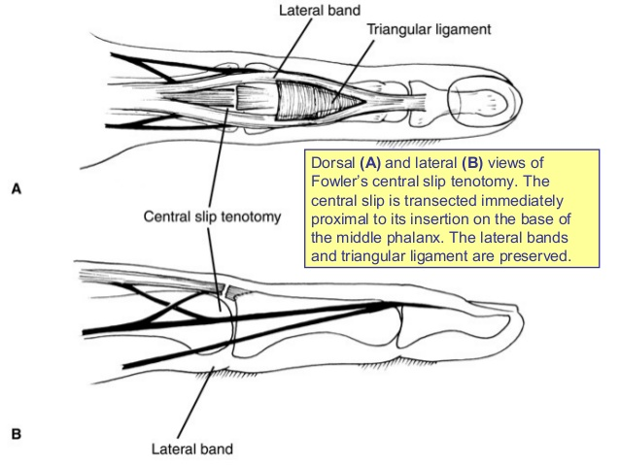
Chronic mallet finger
Treatment
Attempt Splinting protocol
Extensor tendon reconstruction
Fowler’s central slip tenotomy
DIP fusion
ORL reconstruction
  In pt’s w/ swan-neck deformity due to untreated mallet

Slide 109
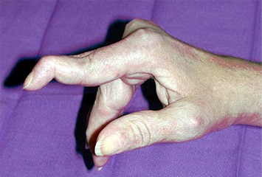

Slide 110
Swan Neck Deformity
characterized by flexion at the DIP joint and hyperextension at the PIP joint.
  results from imbalance of the extensor mechanism of the digit
    from either laceration or incompetence (stretch) of the extrinsic tendon force on the distal phalanx
    or from over-pull of the extensor mechanism (intrinsic and extrinsic) at the PIP

Slide 111
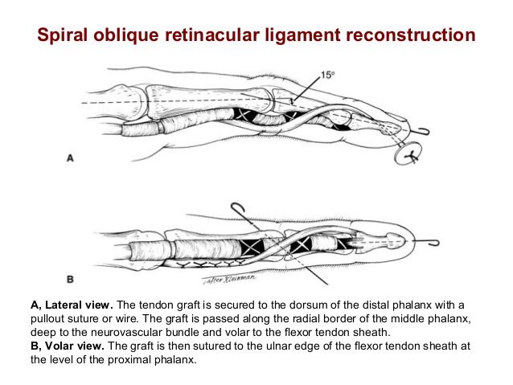
Zone I Mallet finger-
Swan Neck Deformity
precursor, mallet finger
  Lateral bands contract and migrate dorsally
  Treatment:
    Treat mallet
    Splint digit as boutonniere
    SORL
precursor, volar pate laxity (PIP)
  Treatment:
    Volar Plate reconstruction (FDS Slip)

Slide 112
Thumb Injuries
Zone TI & TII Mallet Thumb
Mallet thumb
  Closed injuries treated by splinting, as with fingers
  Open injuries treated with direct repair
  EPL is substantial and holds suture well.
  Repair is protected with splinting for 6 weeks.
Notes:
Closed tendinous and small avulsion fractures are immobilized with an IP joint extension orthosis for a minimum of 6 weeks.
Open injuries are repaired and the IP joint is splinted or pinned in extension for a comparable period of time. Loss of tendon substance may necessitate intercalary tendon grafting (eg, palmaris longus tendon).
A forearm-based thumb spica orthosis is preferred after surgery in Zone TII: The thumb sagittal bands are not substantial enough to prevent excess tension across the repair in this zone.

Slide 113
Zone II
Partial lacerations (less than 50% of surface)
  Repair is not required.
  Debride frayed edges and provide closure or wound care.
  Begin active motion after 7-10 days, or after wound is healed.
Lacerations greater than 50% of surface
  The tendon is often too thin for a core suture.
  Repair with a running 4-0 suture, followed by 5-0 epitendinous cross-stitch.
  Splint the PIP joint for 6 weeks, with DIP joint free.

Slide 114
Thumb Injuries
Zone TII
  The EPL can usually hold a core-type suture at this level.
    Add an epitendinous suture.
  Splint or pin the IP joint for 6 weeks, with the MP joint free.
    Some advocate for short, forearm-based thumb spica cast with thumb in full extension.
      The thumb sagittal bands are not substantial enough to prevent excess tension across the repair in this zone.

Slide 115
Zone III
Central Slip injury
  Leads to loss of active PIP extension
  if palmar subluxation of lateral bands →Boutonniere deformity develops
  Flexion of the PIP
Hyperextension of DIP
  Can occur within a week
Notes:
Early management is predicated upon recognition of the central slip injury.
Weak PIP joint extension and/or a supple PIP joint extensor lag are pathognomonic findings.
Closed tendinous or small central slip avulsion injuries may be treated by orthosis.
A displaced fracture at the dorsal base of the middle phalanx may require fracture repair or excision of the bone fragment and reattachment of the central slip.

Slide 116
Zone III
Closed avulsion (boutonniere injury)
  Often misdiagnosed as a jammed or sprained finger
Diagnosis
  Swelling and tenderness are observed at base of dorsal middle phalanx/PIP jt
  PIP jt extension exhibits weakness against resistance.
    Extension function is preserved with only one lateral band intact.
  Loss of 15-20º active PIP extension
    with wrist and MCPs flexed
  Weak extension of the middle phalanx against resistance
  +Elson’s Test
  MRI or ultrasound can confirm injury.
Notes:
Early management is predicated upon recognition of the central slip injury.
Weak PIP joint extension and/or a supple PIP joint extensor lag are pathognomonic findings.
Closed tendinous or small central slip avulsion injuries may be treated by orthosis.
A displaced fracture at the dorsal base of the middle phalanx may require fracture repair or excision of the bone fragment and reattachment of the central slip.

Slide 117
Elson’s Test
PIP jt placed at 90 degrees over the edge of a table
Pt is asked to extend the PIP jt against resistance
Pressure felt by the examiner over the middle phalanx indicated an intact central slip
The DIP jt is flexible
In a complete rupture
  Any extension effort results in a rigid DIP jt due to the lateral bands
Will not help with partial ruptures and may be hindered by pain or lack of cooperation

Slide 118
Zone III – Closed Injury
Treatment
  Splint PIP in full extension for 6 weeks with MP and DIP joints free.
    Follow with active PIP flexion and 2 weeks of splinting at night.
  K-wire fixation of the PIP joint is an alternative.
  Open reduction or reinsertion for avulsion fracture; fragment is viewed using radiographs.
    +/- suture anchor
Notes:
Early management is predicated upon recognition of the central slip injury.
Weak PIP joint extension and/or a supple PIP joint extensor lag are pathognomonic findings.
Closed tendinous or small central slip avulsion injuries may be treated by orthosis.
A displaced fracture at the dorsal base of the middle phalanx may require fracture repair or excision of the bone fragment and reattachment of the central slip.

Slide 119
Zone III
Open injury
  The PIP joint is violated easily; irrigate thoroughly.
Pt who maintains active PIP extension against resistance
  Active motion
  Close follow-up
Pt with active PIP extension, but weak against resistance
  Extension splint 3-4 weeks
  Close follow up
Patient with extensor lag
  Open repair
    3 or 4-0 core suture, +/- 5-0 epitendinous
    May require microsuture anchor if injury at the central slip insertion
      Inadequate distal stump of tendon can be addressed by drilling a transverse hole through dorsal base of middle phalanx or by using a bone anchor.
  Splint as for previously described closed injury.
Notes:
Open tendinous injuries, and PIP joint dislocations with a residual extensor deficit of ≥30°, are best managed with central slip repair.
Snow Procedure- reflects portion of the central slip distally
Can address loss of tendinous substance
Aiche procedure- centralizing dorsal strips of the lateral bands

Slide 120
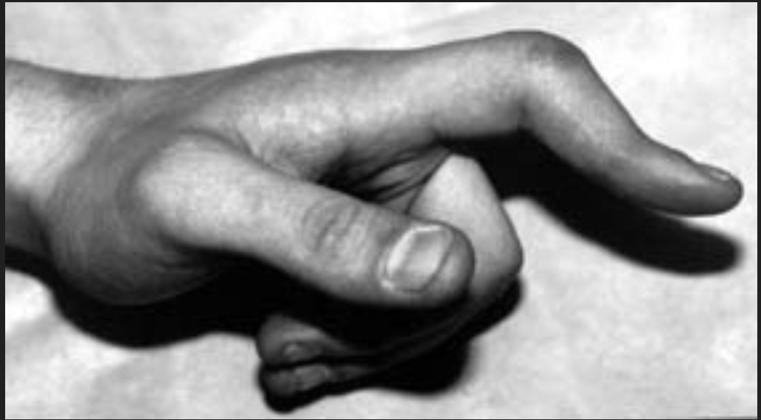

Slide 121
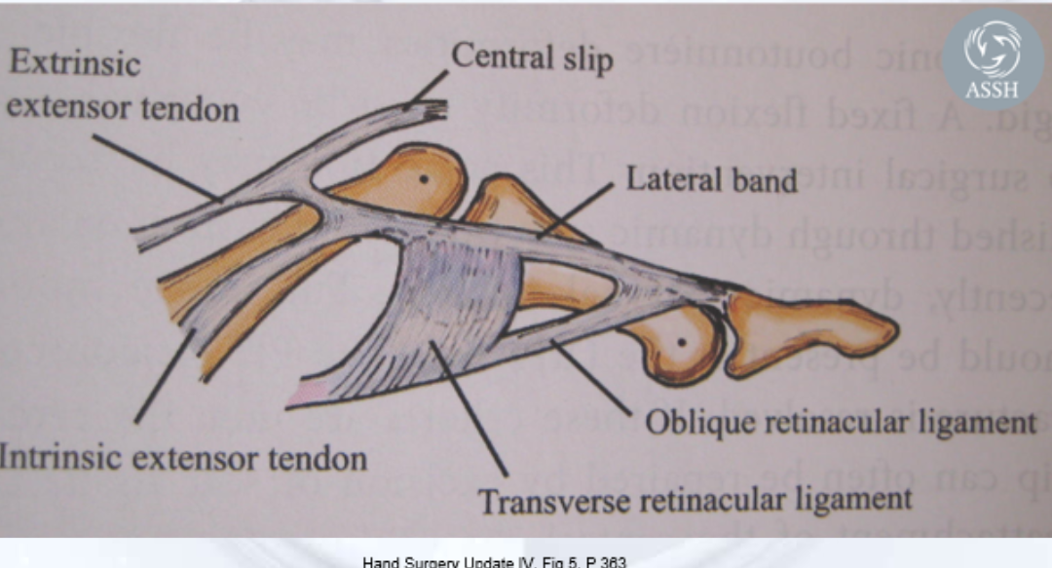

Slide 122
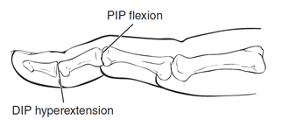
Zone III
Primary goal of treatment:
Prevent development of boutonniere deformity
    DIP hyperextension with flexion deformity of the PIP joint
  Deformity can take weeks to develop, because lateral bands slowly migrate volarly.
  Secondary reconstruction of chronic boutonniere is difficult.
  Prevention is much easier than treatment.
Notes:
The boutonniere finger deformity denotes a flexion posture of the PIP joint with concurrent hyperextension of the DIP joint.
This abnormality results from disruption of the central slip attachment to the dorsal base of the middle phalanx, as well as disruption of the triangular ligament across the dorsal aspect of the middle phalanx.
Initially, the lateral bands remain dorsal to the PIP joint axis of rotation and maintain the PIP joint in extension.
If left untreated, the lateral bands migrate volarly, leading to PIP joint flexion and increased tension on the conjoined lateral bands with development of a DIP joint hyperextension deformity.

Slide 123
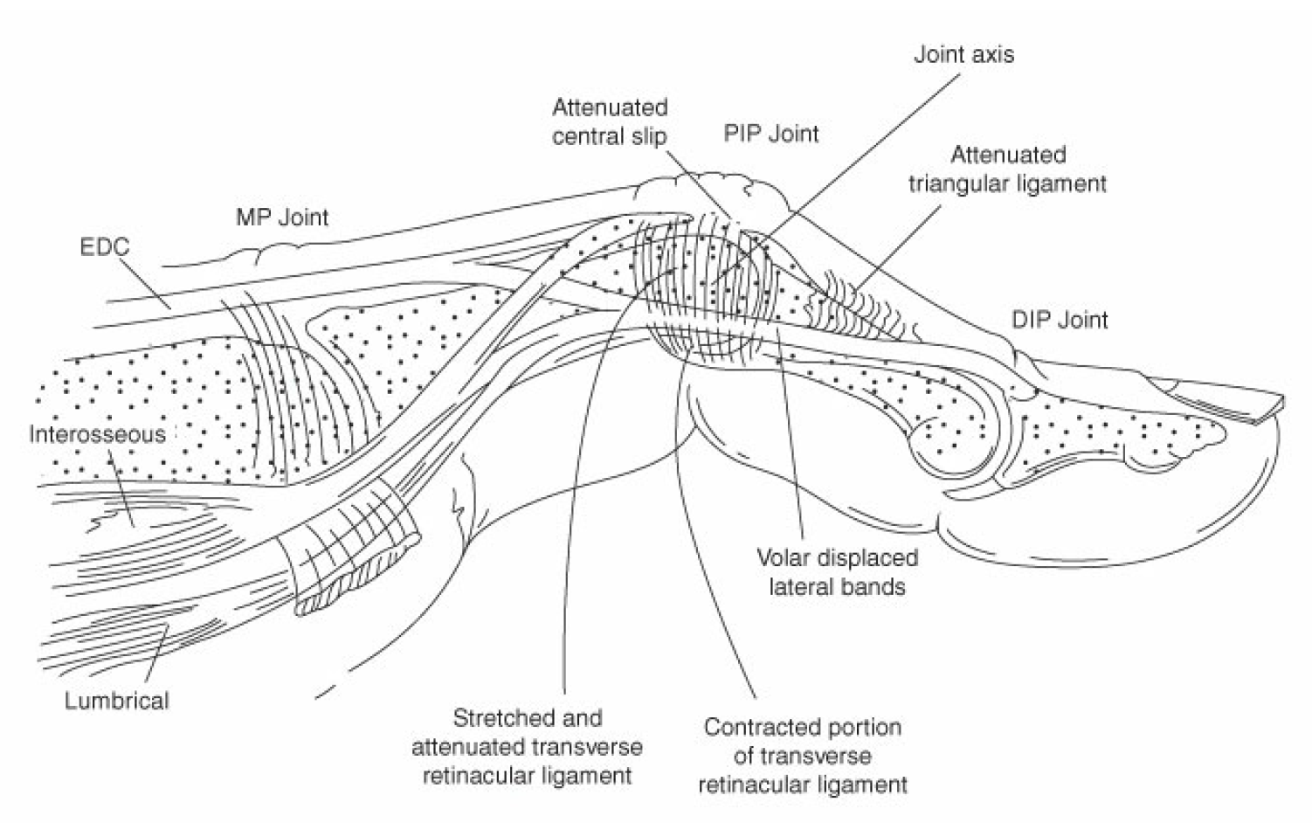
Boutonniere Deformity

Slide 124
Chronic Zone III injuries
Stage I: Supple boutonniere deformity
  Active extension + extension splinting
Stage II: Fixed boutonniere deformity (contracted lateral bands
  Trial of active extension therapy + extension splinting
  Tenotomy: release the lateral bands distal to the central slip
  Maintain the spiral oblique retinacular ligament
  Allows central slip to relax, but maintains DIP extension
Stage III: Fixed boutonniere deformity – jt degeneration
  May require arthroplasty or fusion

Slide 125
Chronic Zone III injuries
Boutonniere Deformity Treatment
  Repair with repositioning of the lateral bands (+/- staged PIP contracture release
  Fowler’s terminal tenotomy
  PIP jt arthrodesis

Slide 126
A 24-year-old woman comes for evaluation 6 days after sustaining a jamming injury to the long finger of the left hand with resultant central slip disruption and acute boutonnière injury. X-ray studies are negative for fracture or dislocation. Treatment with splint immobilization is planned. Which of the following is the most appropriate position of the finger for application of the splint?
A) Distal interphalangeal (DIP) joint extended, proximal interphalangeal (PIP) joint extended
B) DIP extended, PIP free
C) DIP flexed, PIP flexed
D) DIP flexed, PIP free
E) DIP free, PIP extended

Slide 127
A 24-year-old woman comes for evaluation 6 days after sustaining a jamming injury to the long finger of the left hand with resultant central slip disruption and acute boutonnière injury. X-ray studies are negative for fracture or dislocation. Treatment with splint immobilization is planned. Which of the following is the most appropriate position of the finger for application of the splint?
A) Distal interphalangeal (DIP) joint extended, proximal interphalangeal (PIP) joint extended
B) DIP extended, PIP free
C) DIP flexed, PIP flexed
D) DIP flexed, PIP free
E) DIP free, PIP extended

Slide 128
Zone IV
Partial injuries are common, because the tendon is broad at this level.
A laceration involving <50% of the tendon width
  managed by the immobilization of both IP joints in extension for 3–4 weeks
    with or without inclusion of the MCP joint.
Injury including >50% of the tendon width
  typically repaired and the digit is immobilized in a comparable manner.
    Repair central tendon laceration with 4-0 core suture and 5-0 epitendinous cross-stitch.
    Maintain exact length relationships.
Splint with wrist in 20- to 30-degree extension, MP joints in 70- to 90-degree flexion, and IP joints in full extension.
  Begin passive extension after 1 week and gentle active extension at 4 weeks.
  Isolated lateral band laceration can be repaired with a single 5-0 epitendinous cross-stitch.
Notes:
A laceration involving <50% of the tendon width is managed by the immobilization of both IP joints in extension for 3–4 weeks, with or without inclusion of the MCP joint. An injury including >50% of the tendon width is typically repaired and the digit is immobilized in a comparable manner.

Slide 129
Zone II & IV
Zone 2,4 injuries – most commonly due to laceration
  Acute zone 2,4,6
    Lateral band, EDC laceration
    Can excise one lateral band without losing extension

Slide 130
Thumb Injuries
Zones TIII - TIV
  Injury to one or both, EPL or EPB is possible.
    Both tendons are large enough for core sutures.
A closed, nondisplaced EPB tendon avulsion injury
  treated by application of a forearm-based, thumb spica orthosis with the thumb MCP joint in full extension for 6 weeks.
Open disruption of the EPB tendon may necessitate tendon repair
  to prevent development of a boutonniere deformity (MCP joint flexion and IP joint hyperextension).
Active IP joint motion is permitted in both cases.
Notes:
A closed, nondisplaced EPB tendon avulsion injury is treated by application of a forearm-based, thumb spica orthosis with the thumb MCP joint in full extension for 6 weeks.
Open disruption of the EPB tendon may necessitate tendon repair to prevent development of a boutonniere deformity (MCP joint flexion and IP joint hyperextension).
Active IP joint motion is permitted in both cases.

Slide 131
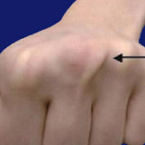

Slide 132
Zone V
Open tendon lacerations – “Fight Bite”
  Review radiographs carefully
  Debride wound edges and irrigate thoroughly
  Leave human bite wounds open
    Eikinella, Staph, Strep, Cornyebacterium
  Must Challenge the joint and washout MP jt aggressively
  Lacerations at this level are often partial.
  Repair large lacerations as for zone IV injuries.
  Postoperative management is as for zone IV injuries.
Notes:
A fight bite over the MCP joint often includes damage to the EDC tendon and one or both sagittal bands. A partial or complete EDC tendon laceration can be overlooked as the tendon will retract proximally with finger extension. To avoid missing this injury, the wound should be explored with the MP and IP joints in flexion. Initial management of a fight bite involves copious wound irrigation and debridement of foreign material. Antibiotics are administered, the tetanus vaccination status is assessed, and serological testing for HIV and hepatitis is entertained. Definitive repairs of the tendon and sagittal band(s) injuries may be delayed in the presence of gross contamination.

Slide 133
Zone V
Open sagittal band laceration
  This must be repaired to prevent subluxation of the tendon.
    Use cross-stitch with 4-0 or 5-0 suture.
  Splint with MP joints in full extension for 3-5 days, then follow with gentle flexion and extension exercises.
  Prevent abduction or adduction by buddy-taping to the adjacent finger.
Notes:
A partial or complete laceration of the EDC tendon over the MCP joint is repaired. Postoperatively, the wrist is immobilized in extension, the MCP joint is immobilized in neutral to slight flexion, and the finger IP joints are positioned in neutral.
Open sagittal band injuries with damage to greater than two-third of the structure, and sagittal band injuries leading to divergent extensor tendon subluxation in the index and small fingers should be repaired surgically.
Disruption of one or both sagittal bands may occur in the absence of EDC tendon injury. Disruption of the radial sagittal band is more common than disruption of the ulnar sagittal band, with a propensity for involvement of the long finger.

Slide 134
Zone V
Closed sagittal band injury
  Injury occurs following blunt trauma, forceful extension, or flexion of digit.
  Diagnosis
    Tenderness, swelling, and inability to actively extend MP joint
    Subluxation of extensor tendon (usually ulnar) with flexion
    Patient capable of holding finger in extension once passively positioned
  Treatment
    Acute injuries (within 2 weeks)
    (**if EDC tendon is centered over the metacarpal head)
      Flexion block:hand based splint that holds MP joints in extension for 6 weeks
    Late injuries (after 2 weeks) or if EDC is malpositioned
      Primary repair when possible, or one of many reconstructive procedures
Notes:
Closed injuries >3 weeks in duration may require repair of the torn sagittal band and/or release of the contralateral sagittal band.

Slide 135
Thumb Injuries
Zone TV
APL or EPB can be lacerated.
  Look for concomitant injuries to the superficial radial nerve branches or the radial artery.
Lacerations of the APL and/or EPL tendons are repaired and the thumb is immobilized for 4-6 weeks in a forearm-based, thumb spica cast.
  APL repair: MCP joint is included
  EPL repair: both the MCP and IP joints are incorporated
If a thumb extensor tendon injury occurs beneath the extensor retinaculum and requires repair,
  the respective extensor compartment is released to permit unrestricted tendon gliding.

Slide 136
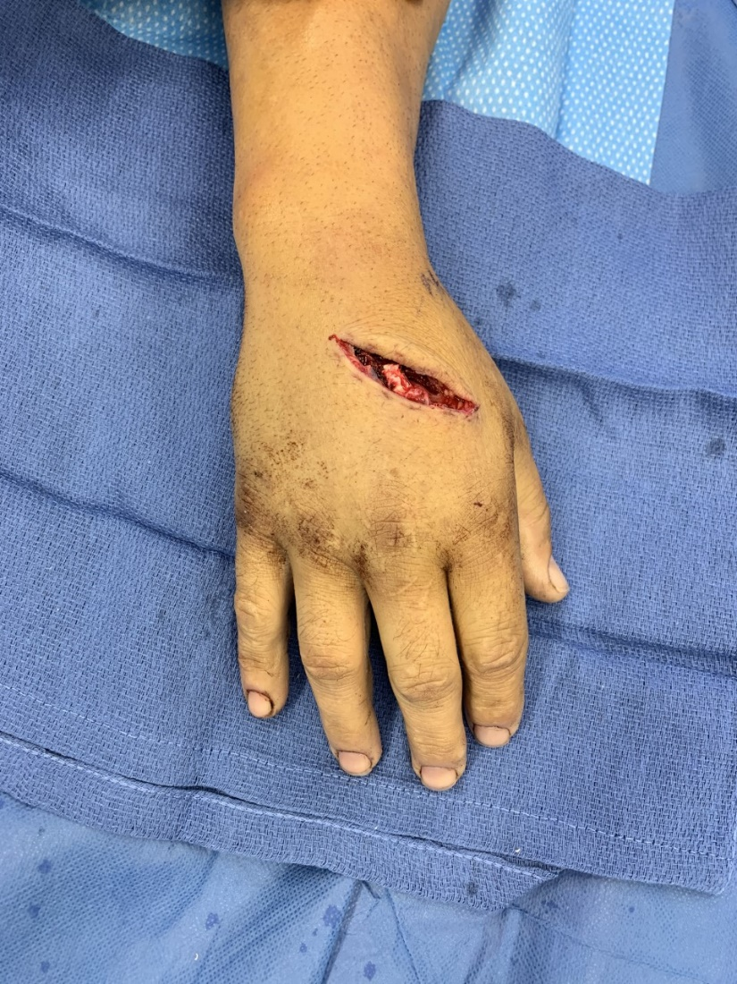
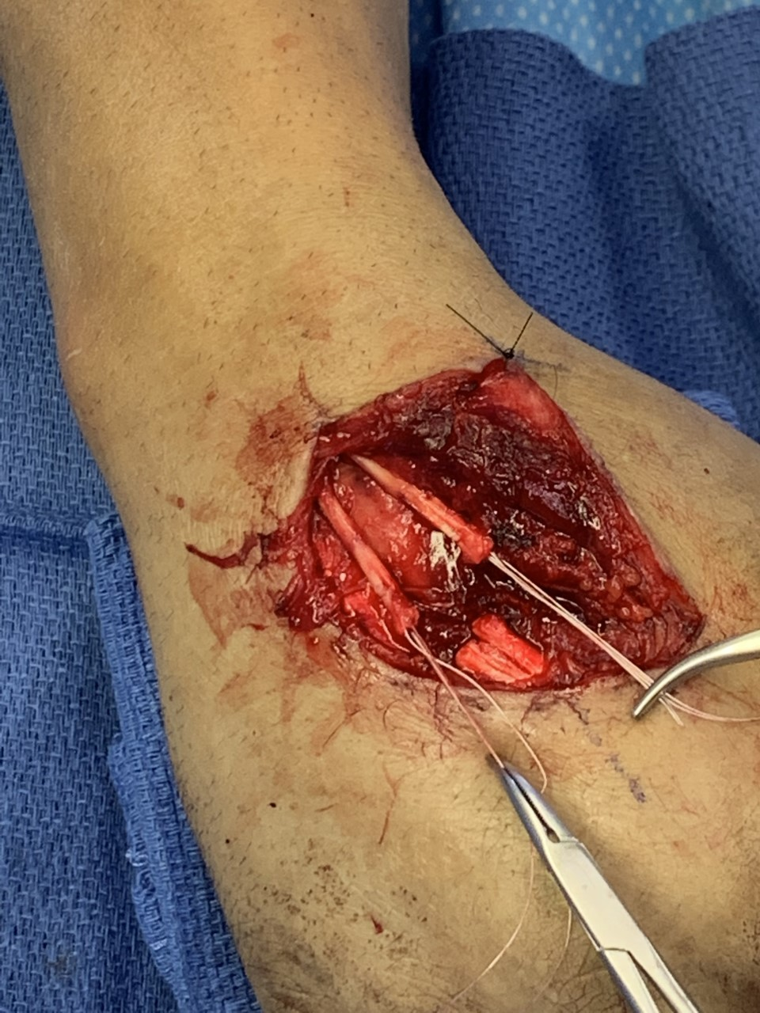
What Zone?
Photos courtesy of Stephanie Malliaris, MD

Slide 137
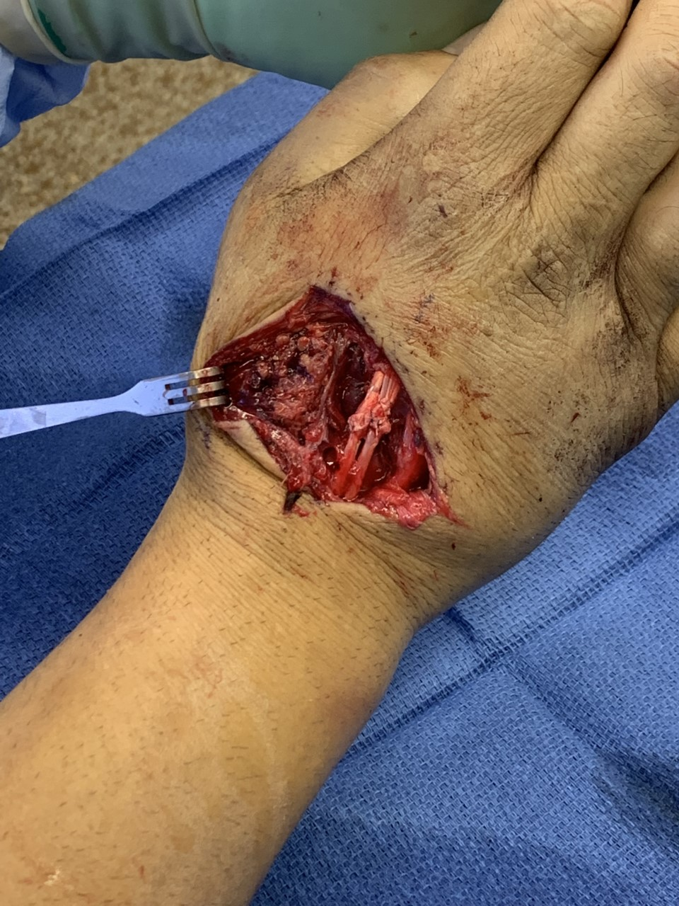
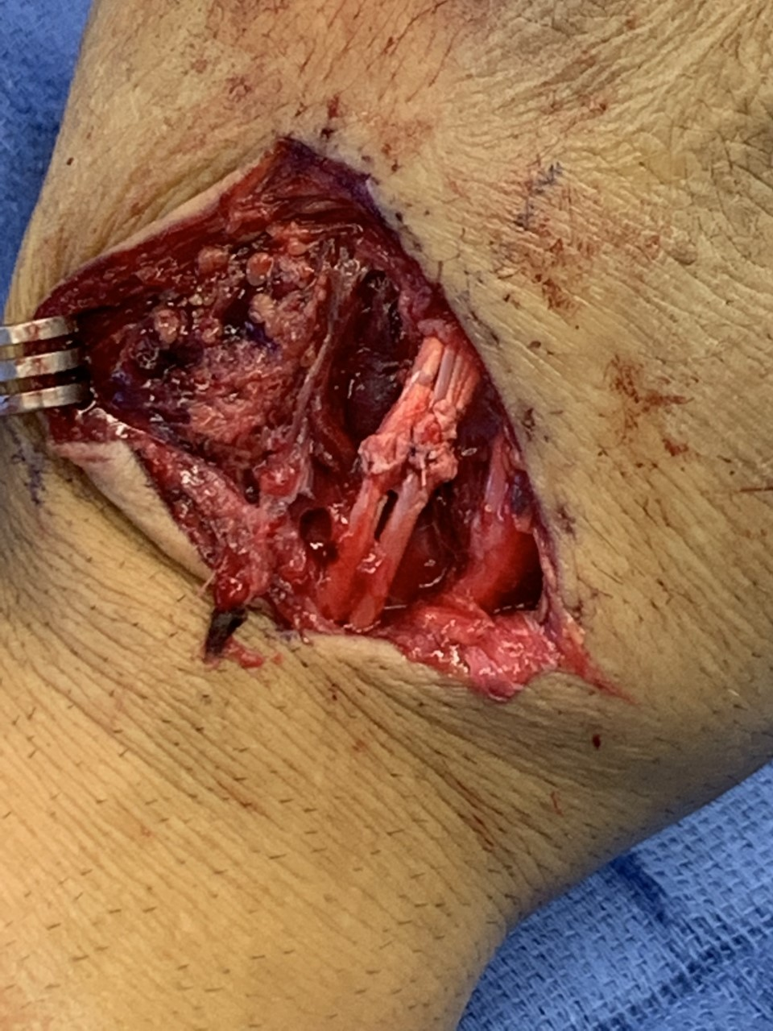
Photos courtesy of Stephanie Malliaris, MD

Slide 138
Zone VI
Pre-op Exam may be difficult
  Confounding effects of juncturae tendinum
Tendons are substantial enough for core sutures.
Prognosis tends to be very good in this zone, with adhesions uncommon.
Use postoperative splint as for zone IV injury.
  Splint with wrist in 20- to 30-degree extension, MP joints in 70- to 90-degree flexion, and IP joints in full extension.
    Begin passive extension after 1 week and gentle active extension at 4 weeks.
Notes:
Extensor tendon and junctura tendinum injuries proximal to the MCP joint are repaired. A single tendon laceration at this level can be masked by an intact junctura. A tendinous defect may require bridging with junctura tendinum or an autogenous tendon graft.
Postoperatively, the wrist is immobilized in extension, the finger MCP joints of the digit involved as well as the adjacent two digits are immobilized in neutral to slight flexion, and the finger IP joints are positioned in full extension.

Slide 139
A 23-year-old man is brought to the emergency department because of a laceration of all extensor tendons at Zone VII of the right upper extremity. Which of the following tendons has the most distal muscle belly when attempting to reappose the tendon ends?
A) Extensor carpi radialis longus
B) Extensor carpi ulnaris
C) Extensor digitorum communis to long finger
D) Extensor indicis proprius
E) Extensor pollicis longus

Slide 140
A 23-year-old man is brought to the emergency department because of a laceration of all extensor tendons at Zone VII of the right upper extremity. Which of the following tendons has the most distal muscle belly when attempting to reappose the tendon ends?
A) Extensor carpi radialis longus
B) Extensor carpi ulnaris
C) Extensor digitorum communis to long finger
D) Extensor indicis proprius
E) Extensor pollicis longus
The correct response is Option D.
Zone 7 extensor tendon injuries are those over the dorsal wrist. The extensor indicis proprius tendon typically has the most distal muscle belly and this fact can frequently be used to uniquely identify this tendon. Extensor tendon zones are useful for describing the locations of injuries:
  Distal interphalangeal (DIP)
  Central slip to DIP
  Proximal interphalangeal (PIP)
  Metacarpophalangeal (MCP) to PIP
  MCP
  Carpometacarpal (CMC) to MCP
  Wrist and proximal

Slide 141
Zone VII
Tendons are substantial enough for core sutures.
Treatment of retinacular rent is controversial.
  Traditional approach
    Excise portion of the retinaculum adjacent to the repair.
    Preserve a distal or proximal portion of retinaculum to prevent bowstringing/subluxation
  Alternative approach
    Repair the retinacular rent and use dynamic splint early (after 10 days).
    Use postoperative splint as for zone IV injury.
Notes:
The extensor tendon(s) is repaired and consideration is given toward partial or complete repair of the overlying extensor retinaculum to prevent tendon bowstringing.
Postoperatively, the wrist is immobilized in extension and the finger MCP joints are positioned in neutral to slight flexion. If only wrist extensor tendons have been injured, the fingers are not included in the orthosis.

Slide 142
Zone VIII
Associated neurovascular injuries are common
  document with a thorough examination.
Lacerated tendons hold core sutures well.
Lacerations or avulsions at myotendinous juncture
  Approximate tendon to the fibrous septa of the muscle belly.
These repairs are tenuous; use tendon transfers as salvage procedures
Splint statically with wrist in 40 degrees of extension, MP joints in 20 degrees of flexion, and fingers free for 5 weeks.
Notes:
Injured muscle-tendon units in the proximal forearm are repaired with figure-eight sutures.
A side-to-side tendon transfer is indicated, if there is loss of muscle and/or tendon tissue.
Extensor tendon ruptures caused by abrasion due to dorsally placed distal radius fixation plates or rheumatoid arthritis of the radiocarpal or the ulnocarpal joints will often be irreparable.
They would need either an intercalary tendon graft or tendon transfer to motor MCP extension of the finger(s) involved.
Postoperatively, the wrist is immobilized in extension and the finger MCP joints are positioned in neutral to slight flexion. If only wrist extensor muscle-tendon units have been injured, the fingers are not included in the orthosis.

Slide 143
Zone IX
Injuries are usually from penetrating trauma and require thorough exploration.
  Nerve injuries are common and should be repaired primarily.
Repair muscle bellies with multiple figure-of-eight absorbable sutures.
Immobilize with wrist in extension, MP joints in 20 degrees of flexion, and fingers free for 4 weeks.
  Follow with 2 weeks of night splinting.
  Immobilize elbow at 90 degrees if repaired muscles originate at or above the elbow.
Use tendon transfers as salvage procedures.

Slide 144
Rehabilitation
The goal of rehabilitation is to regain tendon excursion without gapping or rupture of the tendon repair.
  Assistance from a trained hand therapist is an integral component of postoperative management.
    The initial splint is removed after several days.
    Continued immobilization in a orthosis/cast for ≥6 weeks is preferred after surgical repair of wrist extensor tendon injuries, thumb extensor tendon injuries, and finger extensor tendon injuries in Zones I, II, VIII, and IX.
    Finger extensor tendon repairs in Zones III to VII may be treated by additional immobilization or early protected finger motion.

Slide 145
Rehabilitation
The potential for early mobilization and loading depends on the quality of the tendon repair, associated bone and soft tissue injuries, and patient compliance.
Early motion (4–5 mm of tendon excursion) will increase the tensile strength of a tendon repair and improve tendon gliding properties.
  Varied techniques have been described:
    including controlled passive motion, short arc active motion, dynamic extension orthosis treatment, and relative motion/yoke orthosis treatment.
  Full composite wrist and finger motion and resisted extension across the repair site are avoided for ∼6 weeks.

Slide 146
Complications
RUPTURE
  As with flexor tendons, explore immediately and repeat repair.
ADHESIONS
  Occurrence is less likely than with flexor repairs.
  Adhesions to the supple dorsal soft tissues can move and eventually break away with remodeling.
  When necessary, tenolysis can be performed with no need for pulley reconstruction.
  Preserve the sagittal bands.
  The dorsal retinaculum can be sacrificed when substantially involved.

Slide 147
Complications
SEQUENCE OF EXTENSOR IMBALANCE
Swan neck deformity
Boutonniere deformity
Extrinsic tightness
Intrinsic tightness
Extensor tendon subluxation with ulnar drift

Slide 148
Approach to Stiff Finger
Elective procedure, therefore choose patients wisely/carefully
  Compliant patient
  Pain controllable- anesthetics, narcotics, NSAIDs
  Employers’ understanding
  Have focused goals
    Restore power grip
    Restore active extension
    Restore hand’s ability to get into tight spaces

Slide 149
Stiffness Following Extensor Tendon Repair
Loss of MCP, PIP, or DIP flexion can be due to:
  Loss of tendon excursion
    Shortening
    Adhesions
  Jt contracture
Restoration of functional ROM may require multiple procedures

Slide 150
Extensor Tendon Adhesions
Timing of tenolysis
  3 months or longer depending on tissue quality
  Need to achieve tissue equilibrium before exploration/repair
Early intensive post-op therapy
  Essential to maintain the regained ROM

Slide 151
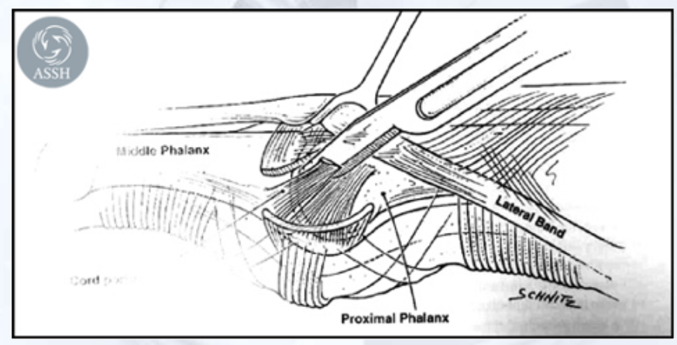
Joint Contracture
May require:
  Open release of Collateral ligaments
  Dorsal Capsular release

Slide 152
Summary
Extensor injuries can be as debilitating as flexor injuries
Even a small ga formation can lead to extensor lag
If external splints cannot keep the digit immobilized consider tendon repair with or without trans-articular fixation with k wires

Slide 153
Summary
Digital stiffness following extensor tendon repair can often be treated successfully with outpt hand therapy
In treating the “stiff finger”, extensor tenolysis can be useful to regain digital flexion and extension
Detailed understanding of the anatomy is critical before undertaking surgical releases of adhesion and joint contractures

Slide 154
Boutonniere Deformity
characterized by flexion at the PIP joint and hyperextension of the DIP joint.
  results from initial loss of extensor force at the PIP joint
  subsequent palmar migration of the conjoined lateral band of the extensor mechanism secondary to triangular ligament insufficiency
  increased or concentrated extensor force at the DIP joint.
In a chronic condition, the digit may be stiff and the deformity fixed, that is, it cannot be actively or passively correctable.

Slide 155
Boutonniere Deformity

Slide 156
Boutonniere Deformity - Etiology
A boutonnière deformity is caused by imbalance of the extensor mechanism, usually initiated by loss of extensor mechanism’s attachment at the middle phalanx (central slip).
The central slip can be injured by:
  Laceration
  Closed avulsion
    Direct blow to the distal end of the outstretched digit, forcing the PIP joint into flexion while there is tension on the central slip (thus avulsing the central slip off of the middle phalanx)
  Attrition by weakening from chronic inflammation at the PIP joint
    Rheumatoid arthritis
    Other chronic inflammatory afflictions
  Burns

Slide 157
Boutonniere Deformity - Etiology
The loss of the central slip results in active loss of extension at the PIP joint.
  Unopposed motion of the digital flexors (flexor digitorum sublimis and profundus) will result in the PIP joint assuming a flexed position.
  Progressive palmar migration of the adjacent portions of the extensor mechanism (lateral conjoined bands) at the PIP joint results in further PIP joint flexion.
  The extensor force becomes concentrated at the distal phalanx, resulting in hyperextension of the DIP joint due to the conjoined lateral bands remaining dorsal to the axis of rotation of the DIP joint.
In the chronic state, the deformity may become fixed, and not passively correctable
  In long-standing conditions, the chronic, fixed contractures at the PIP (or DIP) joint can lead to secondary arthrosis and associated joint pain.

Slide 158
Boutonniere Deformity
Clinical problems and patients’ complaints
Patients will usually have complaints regarding inability to flex DIP joint and inability to fully extend the PIP joint.
Often, the fixed hyperextension at the DIP joint is the main complaint, because it interferes with the DIP joint flexion needed for grasping objects.
In the chronic state, there is usually little or no associated pain or tenderness at the central slip.
In the chronic state, if arthrosis develops at the PIP joint, associated joint pain and swelling will usually occur.

Slide 159
Boutonniere Deformity
Physical examination
Acute setting:
  the digit should be anesthetized and the PIP joint extended passively to full extension.
  The patient is then asked to extend the PIP fully:
    if the patient cannot maintain active extension, incompetence of the triangular ligament is diagnosed
  simple orthosis or PIP pinning will not lead to reliable active PIP extension at the completion of treatment.
On inspection, the digit will have the visible classic boutonnière deformity of flexion at the PIP joint and hyperextension at the DIP joint.
The sensate pad of the pulp of the digit is not used for object grasp.
There may be varying degrees of flexibility, that is, active or passive motion. If mild, and passively correctible, the digit will reassume the deformity position when released or relaxed.
In the advanced or chronic condition, the deformity may be stiff and fixed. It will not be passively correctible.
  Secondary arthrosis at the PIP (or DIP) joint leads to painful attempted motion, and/or further loss of function.

Slide 160
Boutonniere Deformity
Treatment of Boutonnière Deformity
Conservative (nonsurgical)
  Hand therapy for passive stretching, combined with corrective orthosis, may increase mobility and flexibility at both the DIP and PIP joints.
  In the chronic state, achieving true correction may not be possible without surgery.
    stretching and orthosis that increase mobility may facilitate surgical correction.

Slide 161
Boutonniere Deformity
Treatment of Boutonnière Deformity
Operative management
  To address the hyperextension at the DIP joint
    surgical lengthening of the terminal tendon is performed (Fowler procedure).
      Lengthening of the terminal tendon decreases the hyperextension force, and also can potentially allow some of the extensor force to be transferred to the PIP joint, and the flexion deformity may be decreased.
  To address the flexion at the PIP joint, multiple procedures may be necessary.
    mobilization and dorsal repositioning of the subluxated lateral tendons
    repair, tightening, or tendon grafting of the central slip (Littler procedure).
    Tendon transfers using the lateral bands (Matev)
  Contracture release of the palmar aspect of the PIP joint (volar plate release) may be required if full passive correction cannot be achieved.
  Palmar release and dorsal reconstruction would usually occur in two stages temporally separated by three months.
  If PIP or DIP joint arthrosis has developed, arthrodesis or arthroplasty may be performed, along with repositioning of the lateral tendons and rebalancing the extensor mechanism.

Slide 162
Boutonniere Deformity
Complications of Treatment
Boutonnière deformity is one of the most difficult hand deformities to correct. Often the surgical results are less than optimal, leaving the patient with a residual deformity.
Postoperative complications include:
  Incomplete correction of deformity
  Recurrence of deformity
  Overcorrection of the DIP joint, resulting in residual flexion at the DIP joint
  Residual stiffness at the PIP joint, loss of flexion
  Chronic pain at the PIP joint secondary to joint arthrosis

Slide 164
Swan Neck Deformity
characterized by flexion at the DIP joint and hyperextension at the PIP joint.
  results from imbalance of the extensor mechanism of the digit
    from either laceration or incompetence (stretch) of the extrinsic tendon force on the distal phalanx
    or from over-pull of the extensor mechanism (intrinsic and extrinsic) at the PIP
Initially the deformity may be flexible and passively correctable.
In the chronic condition, the deformity may become fixed.

Slide 165
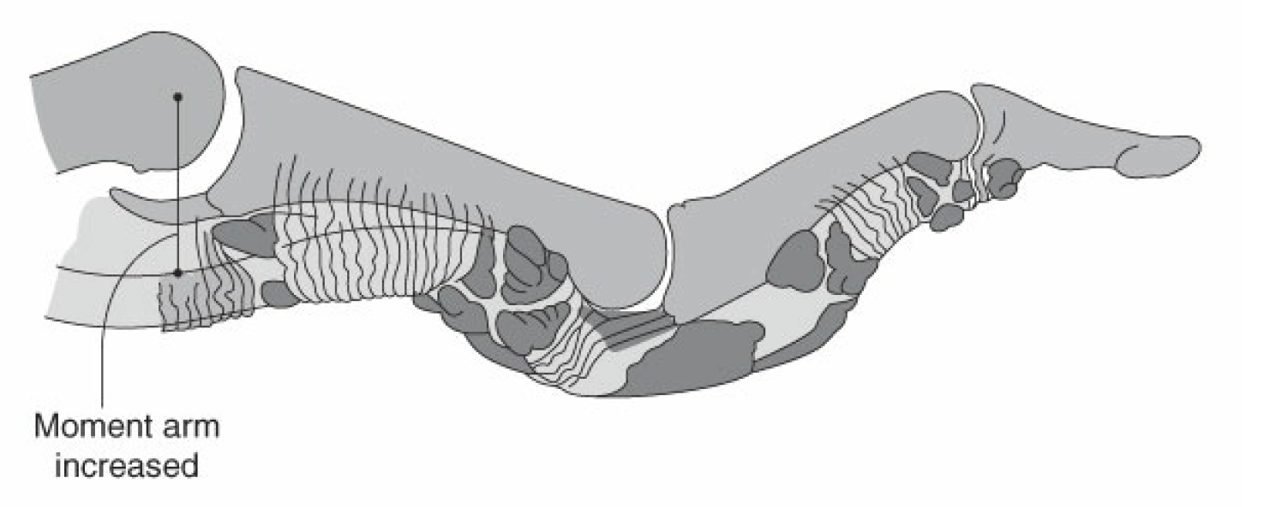
Swan Neck Deformity

Slide 166
Swan Neck Deformity - Etiology
develops from either loss of extension force at the distal phalanx
or
from over-pull of extensor force on the proximal phalanx.

Slide 167
Swan Neck Deformity - Etiology
can develop initially from loss of the extensor tendon at the terminal tendon at the distal phalanx
  resulting in extensor force transferred to the proximal phalanx
  The terminal tendon can be injured initially by:
    Closed avulsion from direct blow on the distal phalanx of the outstretched digit, forcing the distal phalanx into flexion and rupturing or stretching the taught extensor tendon (mallet finger)
    Open laceration of the terminal tendon
    Attrition by weakening from chronic inflammation at the DIP joint, along with extensor tendon subluxation and intrinsic tightness:
      i. Rheumatoid arthritis
      ii. Other inflammatory conditions.

Slide 168
Swan Neck Deformity - Etiology
can also develop form at the PIP joint
  from over-pull of the intrinsic muscles and increased pull at the central slip (spasm and spasticity)
    Rheumatoid arthritis.
    Spasticity from traumatic brain injury or stroke.
    Intrinsic tightness.
      Bunnell intrinsic tightness test:
        performed to compare the tightness of the PIP joints when the MP joint is extended and the MP joint is flexed.
        If the PIP joint is tighter with the MP joints extended→indication of intrinsic tightness
          should be addressed when addressing the swan neck deformity.

Slide 169
Swan Neck Deformity - Etiology
Volar subluxation of the MCP joints in inflammatory conditions
  rheumatoid arthritis
    lead to an increased pull on the central slip through the tethered common extensor
Loss of the pull of the FDS
  laceration, closed rupture, or iatrogenic tendon harvest
Congenital laxity of the volar plate of the PIP joint may lead to joint hyperextension
The deformity, in an advanced or chronic state, is accompanied by stretch or rupture of the volar plate of the PIP joint.
  In the chronic condition
    The deformity may develop secondary fixed joint contractures.
    Chronic hyperextension at the PIP joint (or flexion at the DIP joints) leads to abnormal mechanical stresses of the joints and secondary degenerative arthrosis.
      Associated pain of the PIP (or DIP) joint usually develops.

Slide 170
Swan Neck Deformity
Clinical Problems and Patients’ Complaints
Patients usually complain of inability to flex the PIP joint.
  The digits may become “locked” in hyperextension at the PIP joint, and, to initiate digital flexion, the patient must manually bring the digit out of hyperextension with the contralateral hand.
Grasp is weak from inability to flex the PIP joint.
In the chronic state,
  secondary contracture of the ligaments of the PIP joint leads to a fixed extension deformity.
  secondary arthrosis of the PIP (or DIP) joint leads to pain, and further weakness of flexion.

Slide 171
Swan Neck Deformity
Physical Examination
On inspection, the digit will have the visible classic swan neck deformity of hyperextension at the PIP joint and flexion at the DIP joint.
In the early stages
  may be varying degrees of flexibility, active or passive motion.
  If passively correctible, the digit will reassume the deformity position when released or relaxed.
To initiate PIP flexion, the patient often uses the contralateral hand to bring the PIP joint out of locked hyperextension.
  Once the joint is out of hyperextension, active flexion of the joint is often possible.
In the advanced or chronic condition,
  the deformity may be stiff and fixed.
    It will not be passively correctible.
Secondary degenerative arthrosis at the PIP joint leads to joint pain and/or further loss of motion.

Slide 172
Swan Neck Deformity –
Treatment of Chronic Swan Neck Deformity
Conservative (nonsurgical)
  Even in the chronic condition, hand therapy for passive stretching, combined with corrective orthosis, may increase mobility and flexibility at both the DIP and PIP joints.
  Extension block orthoses will help correct or manage hyperextension at the PIP joint.
  Progressive extension orthosis at the DIP joint will help correct the flexion deformity.
  In the severe or long-standing condition, achieving true correction is usually not possible without surgery.
    However, stretching and orthosis that increase mobility may facilitate operative correction.

Slide 173
Swan Neck Deformity –
Treatment of Chronic Swan Neck Deformity
Operative management:
Because there are many initiating causes of the swan neck deformity, many surgical procedures have been described. Different procedures address different causes.
  Hyperextension at the PIP joint can be addressed by lengthening the central slip.
    If intrinsic tightness is present, lengthening or release of the intrinsic muscle contributing to the central slip is performed.
  Hyperextension at the PIP joint may also be addressed from the volar aspect of the joint,
    tethering the joint in partial flexion using the FDS tendon (FDS tenodesis),
    removing an ellipse of skin on the volar aspect of the joint (dermodesis).
    Both of these procedures are directed to creating a mild flexion contracture at the PIP joint, which is preferable to hyperextension

Slide 174
Swan Neck Deformity –
Treatment of Chronic Swan Neck Deformity
Operative management:
  In the chronic state,
    if PIP (or DIP) arthrosis is present,
      joint arthrodesis or replacement (arthroplasty) may be indicated.
      Soft tissue rebalancing is also necessary.
  If there are accompanying associated problems such as MCP subluxation from arthritis,
    these joints are addressed as well (usually including MCP arthroplasty).

Slide 175
Swan Neck Deformity –
Complications of Treatment
Like the chronic boutonnière deformity, chronic swan neck deformity is considered one of the most difficult hand deformities to correct.
Postoperative complications include:
  Incomplete correction of deformity.
  Recurrence of deformity.
  Residual stiffness at the PIP joint.
  Tenodesis or dermodesis at the PIP joint result in a flexion contracture at the joint
    which is still preferable to hyperextension deformity, as long as DIP hyperextension does not develop secondarily.
  Residual or chronic pain at the PIP or DIP joint secondary to joint arthrosis.
  Persistent loss of extension at the DIP joint due to over correction.

