Slide 1
Local Anesthetics and Liposuction
January 14, 2019
Aline Rau, MD.

Slide 2
Local Anesthetics
Background
Adjuncts
Commonly Used
Tumescent
Technique
Complications
Examples of Use

Slide 3
Background

Slide 4
Mechanism of Action
Chemical nerve blockade
  Blockage of voltage-gated sodium channels inside the neuron
Compression of the nerves
Distension of the nerves
Ischemia of the nerves produced by vasoconstrictors
*The effect of the anesthetic depends on the concentration of the drugs, the use of epinephrine, the blood supply of the area injected, and the thickness of the nerves
Notes:
-block voltage-gated sodium channels inside the neuron
-prevent large transient sodium influx associated with membrane depolarization
- threshold for excitation is raised so that no action potential can be generated and impluse propagation is abolished

Slide 5
Classes of Local Anesthetics
Divided into 2 classes: Ester compounds and Amide compounds
Esters- metabolized by plasma pseudocholinesterases, shorter T1/2
Amides - metabolized by the liver
  Contain “i” in the prefix of the generic name
Notes:
- in general, ester compounds are more rapidly hydrolyzed and metabolized by plasma pseudocholiesterases and, as such, have shorter half-lives.
- amides are degraded by the liver resulting in slower metabolism and the potential for accumulation and systemic reactions (all amides contain the letter “i” in the prefix of the generic name)

Slide 6
Adjuncts

Slide 7
Epinephrine
Standard concentration: 1:1000
Dilutions:
  100ml: 1:100,000
  500ml: 1:500,000
  1000ml: 1:1,000,000 (liposuction)
Vasoconstrictive effect peaks at 1-4 hours, lasts 4-6 hours

Slide 8
Carbonated Anesthesia
pH of lidocaine is 3.3-5.5 - causes pain.
Can minimize pain with sodium bicarbonate (raise pH to 7.4)
  1ml of 8.4g/L solution Sodium bicarb to 10 ml of 1% lidocaine with 1:100,000 epinephrine
Notes:
Neutralize with bicarb 10cc of lido with 1cc of bicarb

Slide 9
Commonly Used Anesthetics

Slide 10
Agent | Class | Duration of Action | Recommended Dosage | Max Total
Procaine (Novocain) | Ester | 15-60 min | 7 mg/kg | 350-600 mg
Chloroprocaine (Nesacaine) | Ester | 15-30 min | w/o epi: 11 mg/kg w epi: 14 mg/kg | 800 mg 1000 mg
Lidocaine (Xylocaine) | Amide | 30-60 min 120-260 min | w/o epi: 4.5 mg/kg w epi: 7 mg/kg | 300 mg
Mepivacaine (Carbocaine) | Amide | 45-90 min | 7 mg/kg | 400 mg
Bupivacaine (Marcaine) | Amide | 120-240 min 180-420 min | w/o epi: 2.5 mg/kg w epi: 2.5-4 mg/kg | 175 mg 225-400 mg
Prilocaine (Citanest) | Amide | 30-90 min | 8 mg/kg | 500-600 mg

Slide 11
Let’s do some math
How much 1% lidocaine with epinephrine can you give a 60 kg patient?
Maximum allowable dose (mg/kg) x (weight in kg/10) x (1/concentration of local anesthetic) = mL lidocaine
7 x 6 x 1 = 42 mL
Notes:
2% would be x ½ ….

Slide 12
Tumescent

Slide 13
Tumescent
Epinephrine + lidocaine + saline.
  Sodium bicarbonate can also be added to reduce the acidity of the solution
Lidocaine level peaks after 12-14h, declines over next 6-14h
Max lidocaine: 35-55 mg/kg
*Hunstad Solution for lipo: 1L LR, 50cc 1% lidocaine, 1 ampule epinephrine
Advantages
Shorter surgical times
Less postoperative edema
Reduced risk of hematomas
Improved postoperative pain control
Avoidance of general anesthetic technique
Added bonus - can act as a natural hydrodissector
Notes:
shorter surgical times, less postoperative edema, reduced risk of hematomas, improved postoperative pain control, and avoidance of general anesthetic technique when paired with conscious sedation techniques.. Added bonus - when infiltrated at the appropriate depth, the tumescent solution acts as a natural hydrodissector, creating avascular anatomic tissue planes for easier and more rapid dissection

Slide 14
Techniques for “Painless” Injection

Slide 15
Most important - buffer your lidocaine!
Most important principle is to neutralize the pH of the lidocaine.
1 cc of bicarbonate for every 10 cc of lidocaine

Slide 16
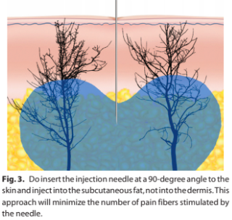
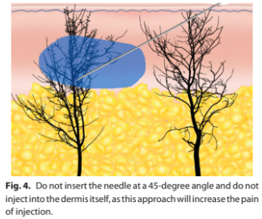
Needle Positioning
Notes:
Don’t put the needle in at 45 degrees - hit many more nerves and cause more pain. Put the needle in at 90 degrees to hit fewer nerves (try to put the needle inside of pore parallel to a hair shaft) - inject the into the fat just below the dermis, don’t inject into the dermis - hurts more

Slide 17
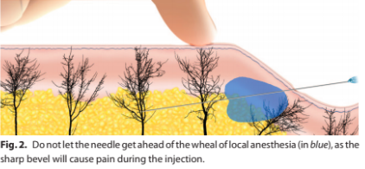
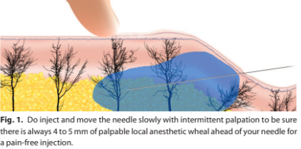
Never let the needle get ahead of the local
Notes:
Never let the needle get ahead of the local - always make sure there’s 5-6mm of local anesthetic ahead of your advancing needle

Slide 18
Size Matters
Small needle
27 or 30 gauge needle
Big volume
Think tumescent whenever you can
Notes:
Use a smaller gauge needle (30 or 27 rather than 25). Encourages you to inject slower too (eliminates pain of the pressure of fluid against nerves)
Think tumescent:
Big volume wherever you can - volume is more important than concentration
¼% lido with 1:400,000 epi is very effective and you can inject 200cc in the avg person and stay below 7mg/kg

Slide 19
Complications

Slide 20
Allergic Reactions
Rare, more common with esters
Most likely allergen is para-aminobenzoic acid (PABA), less likely methylparaben
Notes:
Type I hypersensitivity reactions may include anaphylaxis, and are modulated by immunoglobulin E. Both ester-based local anesthetics, such as procaine, and amide-based local anesthetics may induce an allergic response. The most likely allergen is para-aminobenzoic acid (PABA). Preservatives such as methylparaben have also been shown to cause allergic reactions to local anesthetics, but are less likely than allergic reactions caused by PABA.

Slide 21
Local Anesthetic Systemic Toxicity (CNS and CVS)
The brain is more susceptible than the myocardium; consequently, the early symptoms of toxicity are related to CNS and later to myocardial dysfunction.

Slide 22
Complications - LAST
CNS
Numbness of the mouth and tongue
Tinnitus
Lightheadedness
Visual disturbance
Slurred speech
Muscle twitching
Unconsciousness
Generalized convulsions
Apnea, and coma
CVS
1st
  HTN
  Tachycardia
  Ventricular arrhythmias
2nd
  Cardiac depression
  Bradycardia
  Conduction block
  Decreased contractility
  Asystole
Notes:
Classic descriptions of LAST depict a progression of subjective symptoms of CNS excitement (agitation, auditory changes, metallic taste or abrupt onset of psychiatric symptoms), followed by seizures then CNS depression (drowsiness, coma, or respiratory arrest). Near the end of this continuum, initial signs of cardiac toxicity (hypertension, tachycardia, or ventricular arrhythmias) are supplanted by cardiac depression (bradycardia, conduction block, asystole, decreased contractility). However, there is substantial variation in this classic description, including: ) Simultaneous presentation of CNS and cardiac toxicity) Cardiac toxicity without prodromal signs and symptoms of CNS toxicity) Thus, the practitioner must be vigilant for atypical or unexpected presentation of LAST

Slide 23
Complications - LAST
Timing
Immediate (<60s) - Intravascular injection
Early (1-5m) - intermittent IV injection, lower extremity injection, delayed tissue absorption
Delayed (>15m) - suggest monitoring for at least 30 min after injection
*** Tumescent - can present after 12-14h
Notes:
The timing of LAST presentation is variable. Immediate (<60s) presentation suggests intravascular injection of local anesthetic with direct access to the brain, whereas presentation that is delayed 1-5 mins suggests intermittent intravascular injection, lower extremity injection, or delayed tissue absorption. Because LAST can present >15 mins after injection, patients that receive potentially toxic doses of local anesthetic should be closely monitored for at least 30 mins after injection

Slide 24

Treatment of LAST
Airway - prevent hypoxia and acidosis
Seizures - benzodiazepines
Cardiac Arrest - ACLS
  Smaller doses of epinephrine, don’t use vasopressin, avoid CCB and alpha-adrenergic receptor blockers
Lipid emulsion therapy
  1.5 ml/kg of 20% lipid emulsion bolus, followed by 0.25 ml/kg/min infusion
Cardiopulmonary bypass if failure to respond to above
Notes:
-prompt and effective airway management
-crucial to preventing hypoxia and acidosis (worsen systemic toxicity)
-if seizures occur, they should be rapidly treated with benzodiazepines
-if cardiac arrest occurs - ACLS with the following modifications
-vasopressin not recommended (pulmonary hemorrhage)
-avoid CA channel blockers and alpha-adrenergic receptor blockers
-amiodarone is preferred for ventricular arrhythmias
-lipid emulsion therapy
-start at the first signs of LAST, after airway management
-dosing: 1.5 ml/kg 20% lipid emulsion bolus
-followed by 0.25ml/kg per minute of infusion
-failure to respond to lipid emulsion and vasopressor therapy should prompt institution of cardiopulmonary bypass

Slide 25
Examples of Use

Slide 26
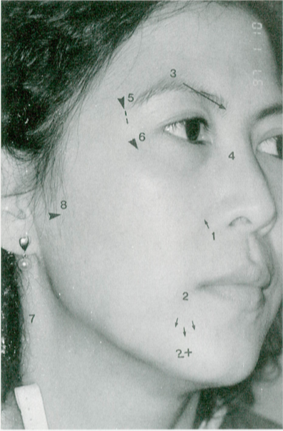
Field Blocks: Face
Infraorbital
Mental and mental plus
Supraorbital/supratrochlear infratrochlear
Dorsal nasal nerve
Zygomaticotemporal
Zygomaticofacial
Great auricular
V3 block
*Infra-alveolar

Slide 27
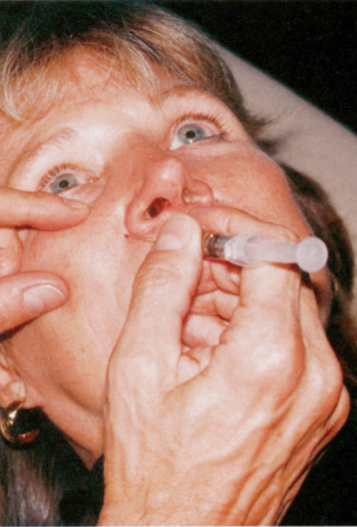
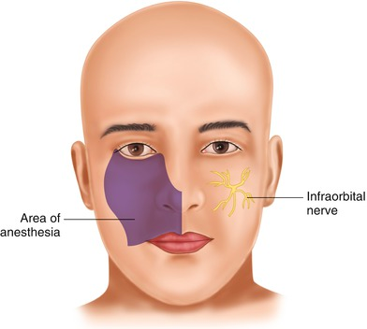
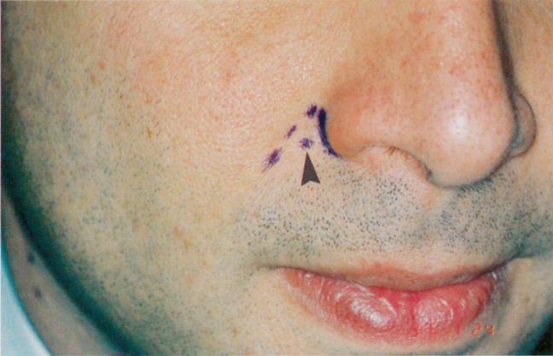
Infraorbital
Notes:
-Anterior gingiva and maxillary teeth - can expect the gums and teeth from the central incisor back to the bicuspitds to get numb
- 3 ways to do it - transcutaneous nasolabial (paper says this way you know you’ve entered the foramen), intraoral, or perpendicular transcutaneous
- pt of injection - medial to the upper nasolabial groove a few mm lateral to the alar groove (center of the small triangle lateral to the alar rim and medial to the nasolabial fold)
- w/your index finger onthe infraorbital rim, as the pt to look straight ahead. Advance the needle to the bone toward the designated point about 4-7mm down from the rim. Inject 1-2cc (100% success rate)
(intraoral - over the 1st pre-molar)

Slide 28
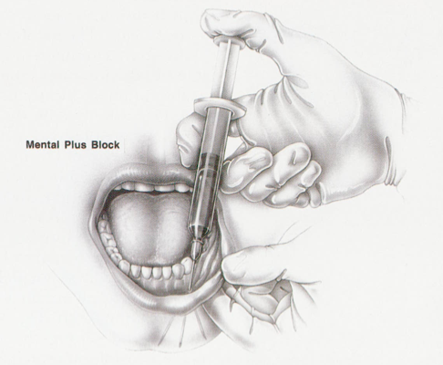
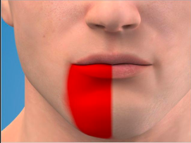
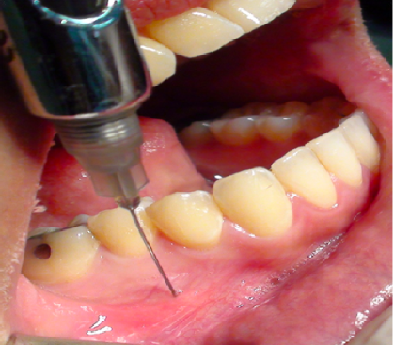
Mental Nerve + Mental Nerve Plus
Notes:
Foramen - below the apex of the 2nd bicuspid
Technique: locate the 2nd lower bicuspid sulcus near the base of the tooth and inject
Area: the lower lip to the labiomental fold +/- the chin pad and area lateral to it
Mental plus if you need to include the chin: anterior premandibular injection anterior to the vestibule in front of the anterior teeth

Slide 29
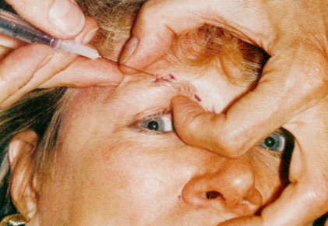
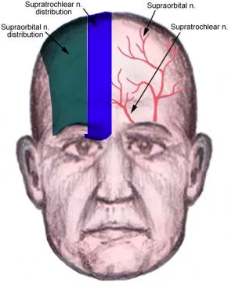
Supraorbital/supratrochlear
Notes:
Technique: along the supraorbital rim from lateral to medial. Stretch the eyebrow laterally and pierce the lateral part of the middle third of the eyebrow. Aim the needle at the supraorbital notch. The other hand is always on the rim. After injecting 1-2cc prior to the notch under the muscle, the needle moves medially a few mm along the rim and another cc is deposited. Finally, another 1 cc is deposited as the needle advances toward and touches the nasal bones
Area: forehead skin from level of the superior temporal line or temporal fusion line almost to middline, middle 50% of the upper eyelid skin, frontoparietal scalp between the midline and the superior temporal line

Slide 30
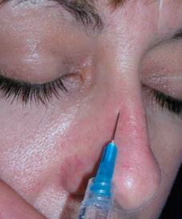

Dorsal nasal nerve
Notes:
Technique: palpate the nasal midline and feel the end of the nasal bones using the thumb on one side and the index finger on the other. The nerve exits about 6-10mm from the midline of the nasal bones, and 1-2cc of injectate is sufficient for each side
Area: cartilaginous dorsum and tip (much better than painful infection into tip of nose)

Slide 31
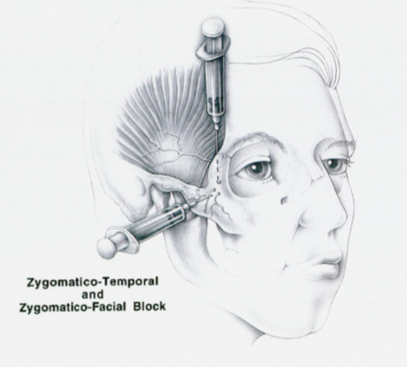
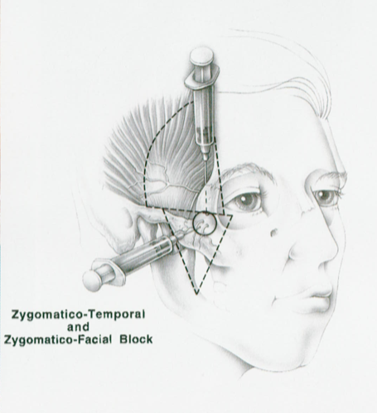
Zygomaticotemporal & Zygomaticofacial
Notes:
ZMT Technique: inject behind the lateral orbital rim with needle insertion about 10-12mm behind and just below the zygomaticofrontal suture (palpable). Slide the needle along the mid-posterior bony wall toward a point about 1 cm below the canthal level
ZMT area: sideways, fan-shaped area about a quarter of a circle. The upper limit abuts the area numbed by the supraorbital/forehead block. The lower limit is a line from the lateral canthal area back to the hair and into the temporal scalp
ZMF technique: always done right after the ZMT block. Inject into a dime-sized area just lateral to the junction of the lateral and inferior orbital rim.
ZMF area: area of teh cheek prominence and below. A horizontal line about 3cm in length starting along lateral ⅓ of the orbit represents the base of a large inverted isosceles triangle, which ends in mid-cheek. The center of the triangle sits on the cheek prominence. The apex of the triangle is just anterior to the palpable lowerst portion of the anterior ramus of the mandible.

Slide 32
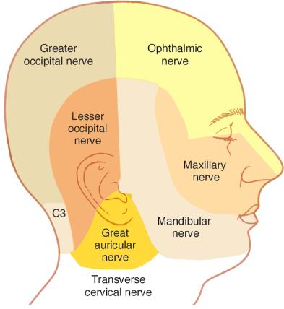
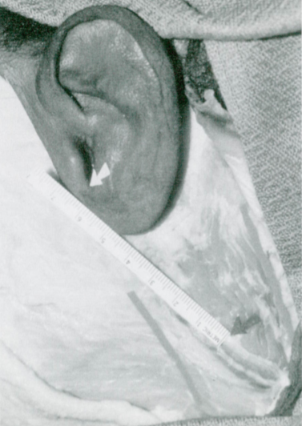
Great Auricular
Notes:
Technique: have the patient flex the SCM. Mark the skin of the upper anterior and posterior SCM borders with two parallel lines. Then draw a third line between the 2 parallel lines directly in midmuscle. Measure down 6.5 cm from the lower border of external acoustic meatus to the mid-SCM. Inject a nickel to quarter sized circle of anesthetic onto the muscle fascia.
Area: lower ⅓ of the ear and lower postauricular skin. Varying amounts of skin over the mandibular angle from the tragus downward and forward from 3-4cm

Slide 33
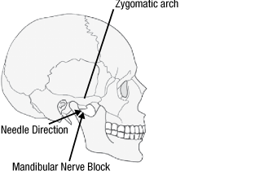
V3 Block
Notes:
Technique: sigmoid notch (between condyle and coronoid process of the mandible) (about 2.5 cm anterior to the tragus) - mark middle of notch with U and inject into the skin with a small gauge needle. Then switch to a 22g spinal needle in a 5cc syringe. Inject the needle into the original dot and advance the needle straight into the pterygoid plate and note how much of the needle remains outside of the skin. Retract the needle almost to the skin and redirect about 1cm back from your first pterygoid bump. Stop at the same depth from before. Aspirate and inject 3-4cc
Area: bulk of the cheek, upper preauricular, and auriculotemporal hair regions

Slide 34
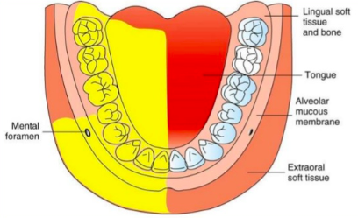
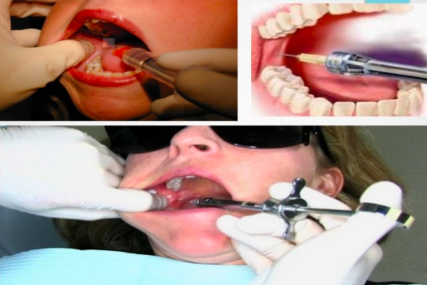
Infra-alveolar
Notes:
Technique: place thumb in coronoid notch and visualize line extending from thumb back to the pterygomandibular raphe. Hold needle parallel to occlusal plane with the bevel away from bone and approach from contralateral premolars. Insert needle ~1cm above the occlusal plane, 3-5mm lateral of raphe. Advance needle to bone, retract 1-2mm, aspirate, inject.
Area: mandibular teeth to midline, body of mandible, inferior portion of ramus, buccal mucoperiosteum, mucous membrane anterior to the first mandibular molar, anteiror ⅔ of tongue and oral cavity, linguial soft tissues adn periosteum

Slide 35
Field Blocks: Hand
Ulnar nerve
Median nerve
Radial nerve
Hematoma block
Digit block

Slide 36
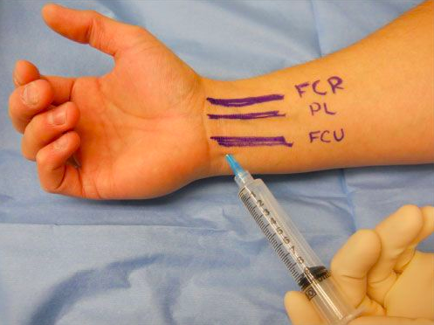
Ulnar Nerve
Notes:
Area: This procedure provides anesthesia to the entire fifth digit, half of the fourth digit and the medial aspect of the hand and wrist
Technique: The surgical field should be prepared just proximal (1-2 cm) to the most distal wrist crease. Raise a wheal of anesthetic in the subcutaneous space and insert the needle under the flexor carpi ulnaris one centimeter just palmar to the ulnar styloid. If blood is aspirated, withdraw the needle a few millimeters and aspirate again, the nerve is more superficial from the injection point. Inject approximately 5 to 7 milliliters of anesthetic. To block the cutaneous branches of the ulnar nerve, inject 3 to 5 milliliters of anesthetic just above the tendon of the flexor carpi ulnaris.

Slide 37
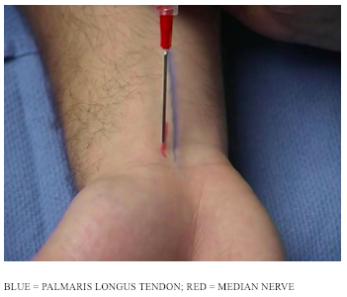
Median Nerve
Notes:
Area: The median nerve provides sensory to the lateral three and a half digits except the dorsal aspect of the thumb, and the corresponding area of the palm.
Technique: The surgical field should be prepared across the entire volar surface of the wrist at the proximal palmar crease. Raise a wheal of anesthetic in a subcutaneous space and insert the needle until it pierces the deep fascia. If the "pop" of the deep fascia can not be felt, continue to insert the needle until it contacts the bone. Withdraw the needle 2 to 5 millimeters and inject 5 to 7 milliliters of anesthetic. A fan like technique is recommended to ensure complete anesthesia of the median nerve. This can be accomplished by reinserting the needle in the same position approximately 30 degrees medial and 30 degrees lateral and injecting 2 to 5 additional milliliters of anesthetic. The palmar branch of the medial nerve is quite superficial and can be blocked by withdrawing the needle to the subcutaneous space and injecting 3 to 5 milliliters of anesthesia.

Slide 38
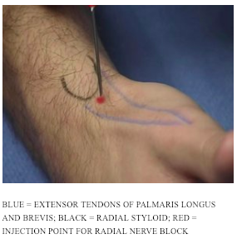
Radial Nerve
Notes:
Area: The radial nerve provides sensory innervation to the dorsal lateral half of the hand and the dorsal aspect of the thumb. The radial nerve provides no motor innervation to the intrinsic muscles of the hand however; it does provide innervation for all of the extensor muscles in the posterior forearm.
Technique: The surgical field should be prepared across the entire dorsal surface of the wrist, including the radial styloid and the anatomic snuff box. Raise a wheal of anesthesia in the subcutaneous space and inject 5 to 7 milliliters of anesthetic just above the radial styloid, aiming the needle first medially and then laterally.

Slide 39
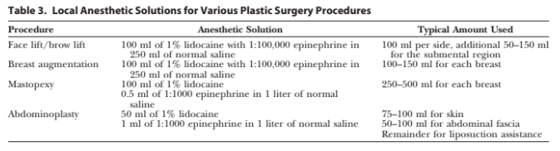

Slide 40
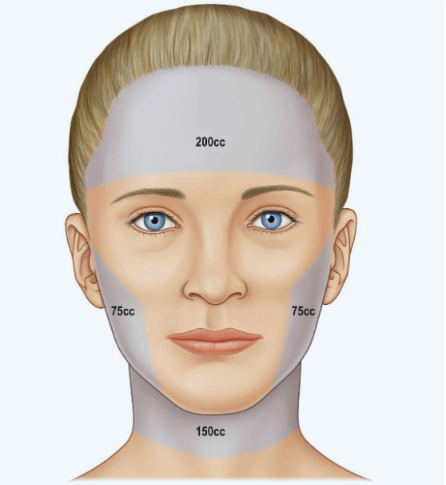
Facelift/Browlift
Scalp first - incision line and 2cm behind it
Forehead next, deeply, up to orbital rim ann nasal dorsum
Cheeks and neck next
Inject superficial musculoaponeurotic plane for hydraulic dissection and vasoconstriction

Slide 41
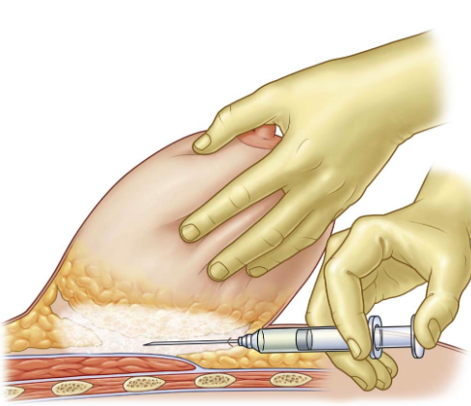
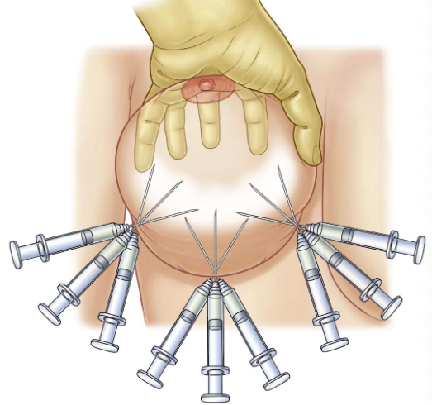
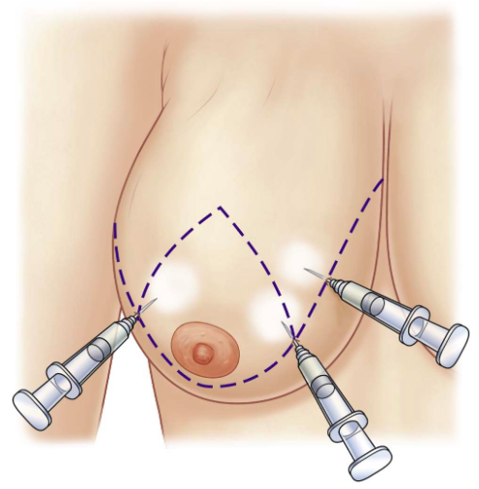
Breast Reduction
400-600ml of total anesthetic used depending on size of breasts
First: 20-40 ml in submammary fold
Retroglandular plane (60-80ml)
  Medial - anterior brs of intercostal nerve
  Lateral- lateral perforans
  Medial retroglandular space - anterior perforators
Subcuticular space (20-60ml)
  Follow incision lines

Slide 42
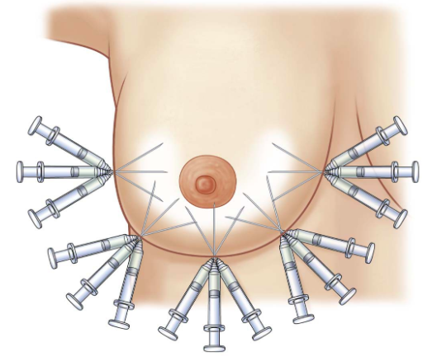
Breast Augmentation
Prepectoral placement - technique similar to reductions
Transaxillary approach
  Skin incision first
  Submammary sulcus
  Anterior surface of 4-6th rib - infiltrate in fan-shaped manner
  Submammary crease and lateral sternal border - fan over anterior 4-6th ribs
  Lateral - hold up pectoral muscle, direct needle from ant ax line to anterioir surface of 2-6 ribs

Slide 43
Liposuction
Anatomy
Patient Selection
Surgical Plan
Types of Liposuction
Adjuncts
Complications

Slide 44
Anatomy

Slide 45
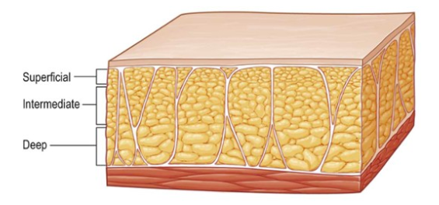
Subcutaneous fat
For purposes of liposuction - superficial, intermediate, deep layers
  Superficial layer is rarely violated - vascular compromise, contour irregularities
Consistency and thickness of each layer varies for different anatomic areas
Notes:
The relative consistency and thickness of each of these separate layers varies for different anatomic areas. For example, the fat of the back has a more fibrous, compact superficial and intermediate layer, with an underlying loose, areolar layer. This contrasts with the fat of the inner thigh, which is not as fibrous and is less compact.

Slide 46
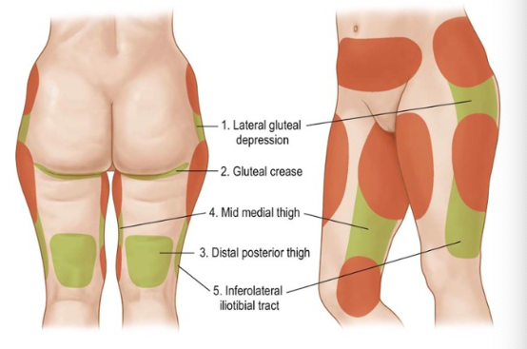
Zones of Adherence
Areas of dense fibrous attachments to underlying deep fascia
High-risk areas for contour irregularities if violated

Slide 47
Classification
Type I: localized lipodystrophy - good skin tone, minimal skin irregularities
Type II: Generalized lipodystrophy - diminished skin tone, some irregularities, circumferential lipodystrophy throughout trunk and extremities
Type III: Skin redundancy and lipodystrophy - significant skin redundancy

Slide 48
Patient Selection

Slide 49
History
HPI
  Weight gain/loss and stability
  Goal BMI and weight
  Patient goals
  Future plans for pregnancy
Past history
  Risk for DVT
  Prior surgeries

Slide 50
Exam
Broad
  Prior scars, hernias, diastasis, stretch marks, BMI
Specific
  Evaluation of areas of lipodystrophy and contour deformities
  Skin tone and quality
  Asymmetries
  Dimpling and cellulite
  Myofascial support
  Zones of adherence

Slide 51
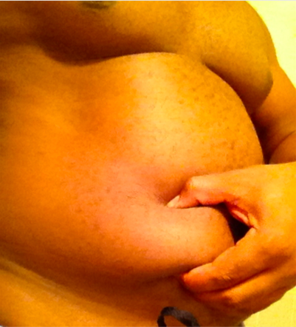
Pinch test
Differentiate intra- vs extra-abdominal fat

Slide 52
Surgical Plan

Slide 53
Outpatient versus Inpatient
Volumes <5000cc total aspirate
Case limit should not exceed 6 hours
Cases should end by 3pm to allow adequate time for recovery
OK to combine liposuction with other procedures
BMI < 35, ASA 1 or 2

Slide 54
Types of Liposuction
Dry
  No longer used
  EBL component of aspirate ~20-45%
Wet
  No longer used
  100-300 ml of fluid into each site
  EBL component of aspirate ~ 4-30%
Superwet
  1ml of lidocaine/epinephrine solution for every 1 ml of aspirate
  EBL component of aspirate ~1%
Tumescent
  2-3 ml of solution for every 1 ml of aspirate
  EBL component of aspirate ~1%

Slide 55
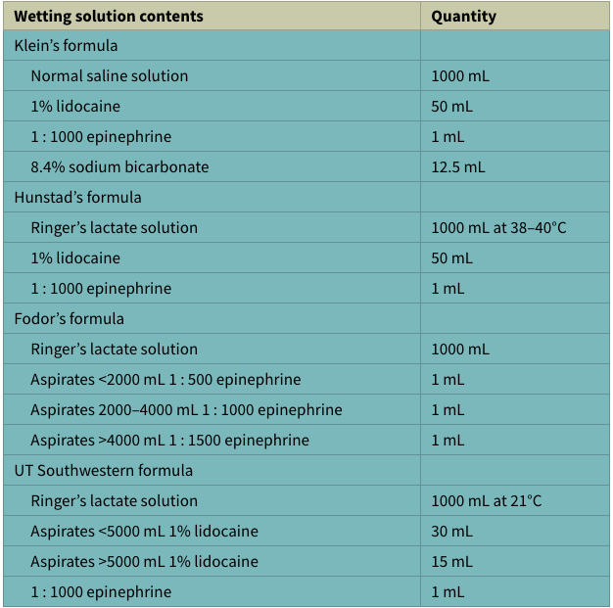
Common Wetting Solutions

Slide 56
Lidocaine in Wetting Solutions
Provides analgesia up to 18 hours
  Peak plasma concentration: 6-12 hours postop
Safe in concentrations of 35 mg/kg, and as high as 55 mg/kg
Medications that increase lidocaine levels:
  OCP
  Beta blockers
  TCAs

Slide 57
Epinephrine in Wetting Solutions
Vasoconstrictive - key to minimal blood loss
Decreases rate of vascular absorption of lidocaine
Upper safety limit of 15 mg per surgical procedure
  Dose shouldn’t exceed 0.07 mg/kg
Peak concentrations at 5h after infiltration

Slide 58
Let’s do some math (Hunstad’s Formula)
1L LR, 50ml 1% lidocaine, 1 ampule of epinephrine
Assume an 80 kg patient: how many bags of tumescent can you use?
maximum allowable dose (mg/kg) x (weight in kg/10) x (1/concentration of local anesthetic) = mL lidocaine
  35 mg/kg x 8 x 1 = 280ml
There are 50 ml of lidocaine per liter, so patient can have 5.6 liters
Notes:
1L LR, 50cc 1%lido, 1amo epi
Risks fluid overload, lido toxicity
5.6 maximum bags allowed (if you want to use more than this, you need to dilute the amount of lidocaine in each bag)

Slide 59
Adjuncts

Slide 60
Adjuncts to Suction Assisted Liposuction
Power Assisted Liposuction - decreases surgeon workload
Water Assisted Liposuction
Heat adjuncts
  Ultrasound Assisted - improved skin retraction
    Infiltration → emulsification → evacuation & contouring
  Laser Assisted
  Radiofrequency Assisted
SAFElipo technique
  Reduces irregularities and bruising, increases skin retraction
Notes:
Safe lipo
Fat separation is performed without suction using an angled 5mm exploded tip cannula
Aspiration of the separated fat is performed with an angled 3mm or 4mm mercedes cannula
Fat equalization (after tunnelling) of the previously treated areas is performed with the 5mm exploded tip cannula, without suction

Slide 61
Postoperative Care
Compression garments
  1 week for every decade of life
  If worn too long: skin creases, hyperpigmentation, pain, swelling
Techniques for decreasing postoperative swelling
  Not suturing the incisions & applying bulky absorbent dressings for 24-48 h
  Bimodal compression
    1st: high degree of compression while drainage persists
    2nd: 24h after drainage stops, switch to moderate or no compression

Slide 62
Complications

Slide 63
Perioperative Complications (0-48h)
Anesthesia and cardiac complications
Cannula trauma to skin and/or internal organs
Volume loss/overload from bleeding or excess fluid administration
Hypothermia

Slide 64
Early Postoperative Complications (days 1-7)
VTE
Infection / Necrotizing Fasciitis
Skin Necrosis

Slide 65
Late postoperative complications (1 week - 3 months)
Seroma formation
  ? from denuding the fascia - technique dependent
Edema
  Can last up to 3 months
Ecchymosis
Paresthesias
  Can take 10 weeks to recover
Hyperpigmentation
  From significant ecchymoses leading to hemosiderin deposition
Contour irregularities

Slide 66
Contour Deformities
Up to 20%
Initial treatment: conservative, lymphatic massage
Fat grating
  Either at the time of surgery or after 6 months
Prevention
Contour should be slightly undercorrected to allow for postoperative fat lysis
Use small cannulas
Avoid superficial liposuction
Turn off suction when exiting incisions
Criss-cross areas
Proper positioning

