Slide 1
Non Surgical Treatments for Facial Aging
Sanjeev puri, MD

Slide 2
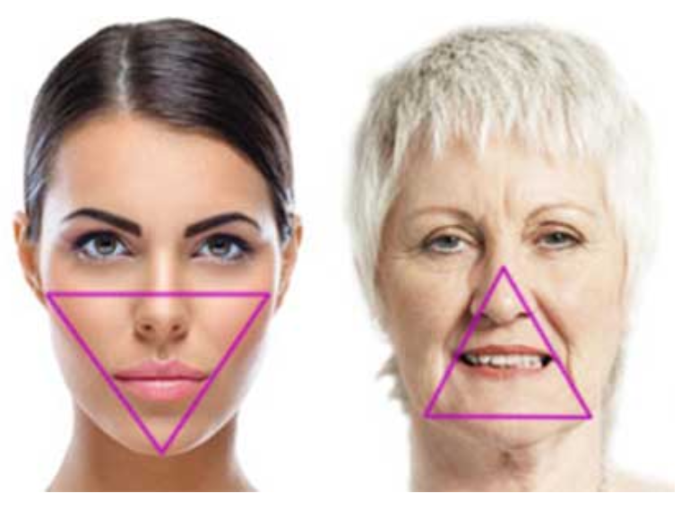
Treatment of the Three “D’s”
Degeneration (skin)
  Thickness
  Pigment
  Fine lines
Deflation
  Facial Fat atrophy
  Facial bone structural changes
Descent
  Muscle descent
  Differentials in ligament stretching
  Changes in collagen ratio

Slide 3
Anti Aging Mantra
The older thought process simply involved waiting until it was time to offer a facelift
The new mantra involves prevention, subunit treatment, minimally invasive treatments, maintenance, and then facelift
Current treatments that we will cover:
  Creams
  Lasers
  Chemodenervation
  Fillers
  RFA
  Helium Plasma
  PRP

Slide 4
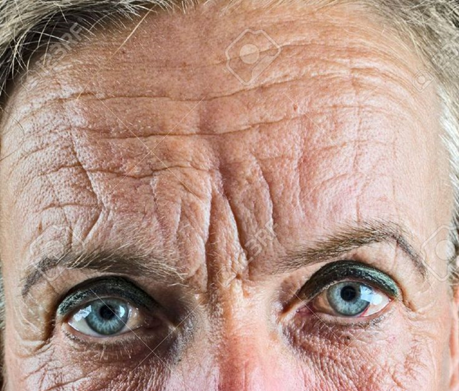
The Aging Upper Face
The Frontalis causes transverse forehead lines
The Corrugator Supercilli cause vertical lines
The Procerus causes horizontal lines
Brow ptosis
Upper lid ptosis

Slide 5
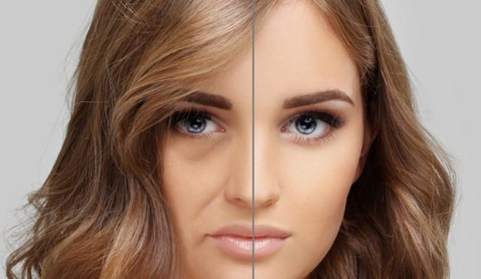
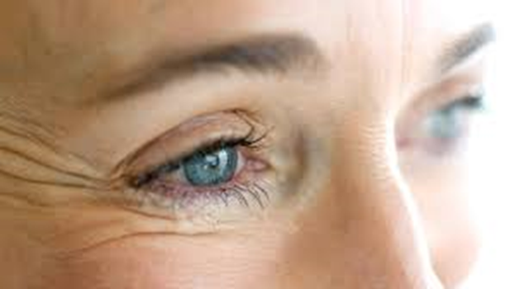
The Aging Mid Face
Orbicularis Oculi cause crow’s feet
Loss of elasticity and descent of fat paired with rigid fixation of the orbitomalar ligament = tear troughs
Descent/atrophy of the malar fat pads causes decreased cheek projection
This same process against a strong nasolabial ligament causes nasolabial folds
The Nasalis causes bunny lines

Slide 6
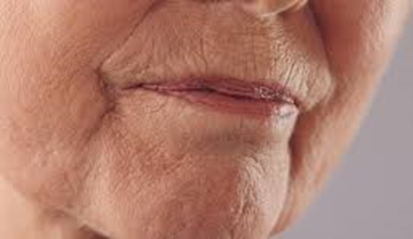
Lower Face Aging
Jowling is caused by descent of the buccal fat pad, descent of the premasseteric space and strength of mandibular cutaneous ligaments
Cuaneous upper lip lengthening caused by laxity/descent
Thinning of the upper and lower lips with perioral rhytids
Marionette lines can be caused by the confluence of the nasolabial ligament and the mandibular (cutaneous) ligament
Decreased chin projection from fat atrophy

Slide 7
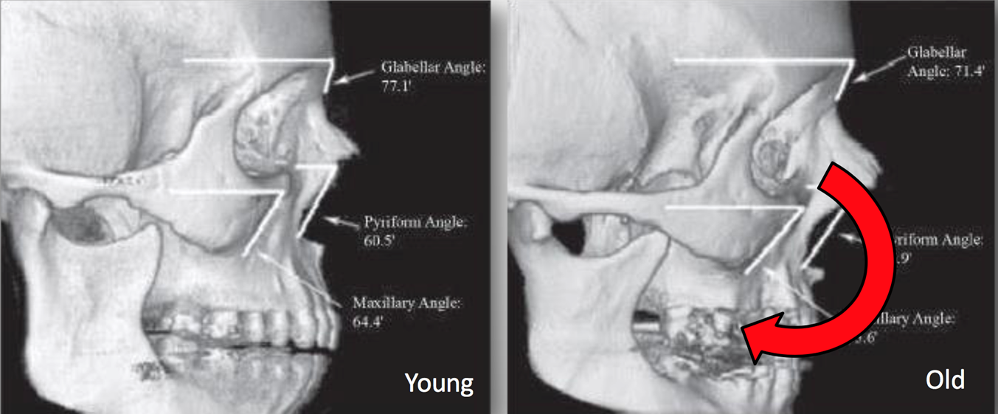
Bony Changes
Significant bony changes can occur over time
  Upper nasal angle widens
  Malar and maxillary projection decrease
  Mental angle widens
  Orbital and nasal apertures increase in size causing a hollowed out look and causing nasal tip descent

Slide 8
Tretinoin/Retinoic acid/Retinol
Retinol is a precursor which is converted into retinoic acid (tretinoin is a type of retinoic acid)
Used daily
Multiple prescription and non prescription versions available
Retinol has been shown to increase epidermal thickness, and increase gene expression for Type I and III collagen with concomitant increases in procollagen I and III
Tretinoin specifically causes hyperplasia of the epidermis with decreased atrophy, decrease in microscopic actinic keratosis, decrease in other atypia and dysplasia, more uniform dispersion of melanin, new collagen in the papillary dermis, angiogenesis with increased blood flow, and greater permeability of the epidermis

Slide 9
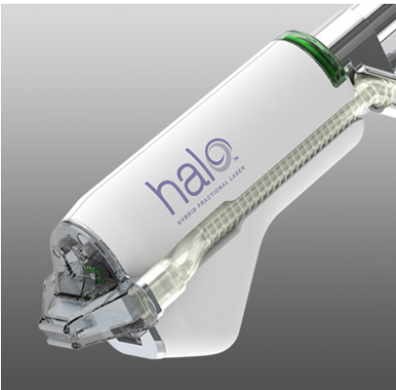
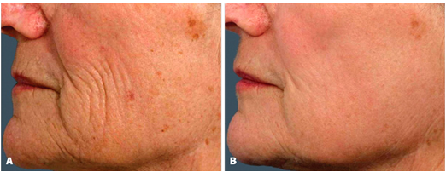
Laser
Only two lasers have been indicated for facial aging
  Erbium YAG – 2,940nm wavelength (absorbed by water) tends to be more superficial with less healing time, but is overall less powerful
  CO2 – 10,600nm wavelength, tends to penetrate more deeply with more significant results but also a longer down time and greater risk of pigment abnormalities
  Both lasers are fractional and thus require multiple treatments with 5 passes of the Erb:YAG being equivalent to 2-3 passes of the CO2
  Down time is 3-14 days
  Choice usually comes down to what you have
  Acne scars require deeper penetration
  Erb:YAG safer in pigmented patients

Slide 10
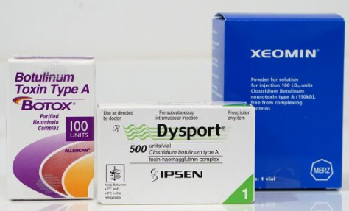
Botulinum Toxin
Three major competitors
  Botox – onset 3 days, proprietary blend (never off patent)
  Dysport – 3-5 units for every 1 of the others, onset 1 day, more “drift” possibly, but some cost savings
  Xeomin – Only Botulinum toxin A with no additives, so less chance of antibodies and no need for refrigeration, onset 4 days
  Maximal effect for all is 2-3 weeks, and duration of action is generally equivalent
  Current FDA approved indications for Botox cosmetic are?
  crow’s feet, glabellar furrows, and forehead lines
  What is the mechanism of action for Botox?
  Non competitive binding of presynaptic acetylcholine receptors

Slide 11
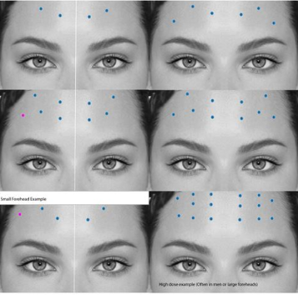
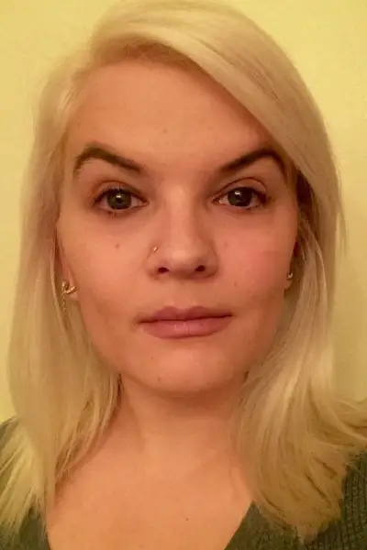
Forehead Lines
Forehead wrinkles are treated in a stacked or diagonal pattern depending on severity
1-2u per site
Some experts recommend avoiding injections centrally as it can be a waste of product
Patients should be injected laterally to avoid “spock eye”, but high on the forehead to avoid brow ptosis

Slide 12
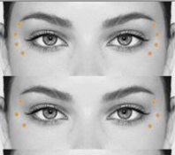
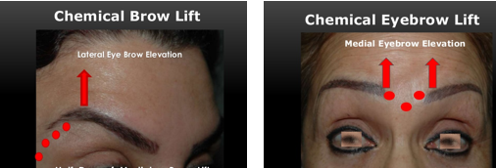
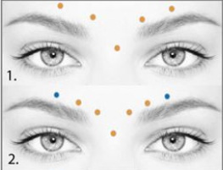
Brow Lift Technique
Two techniques to lift the brow have been described, one medial and one lateral
Medial can be achieved with glabellar treatment
Lateral can be achieved by treating the upper lateral orbicularis oculi or the area above the areas treated for crow’s feet
Be careful near the upper lid, as lid ptosis is possible
Treatment is Apraclonidine – alpha2 adrenergic agonist which works on Muller’s muscle

Slide 13
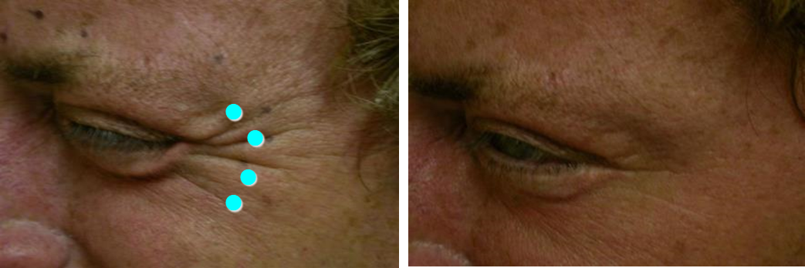
Glabella and Crow’s Feet
Glabella treatment requires 3-6u in 3-7 sites
Crow’s feet treatment requires 4-12u per side over multiple sites (I tend to do 2-3u in the most medial row and feather to 1-2u if a more lateral row is necessary)
Must warn the patient that excessive treatment of crow’s feet can leave the patient looking “Doe-eyed” although that can be desirable for some
Continued lateral treatment of the glabellar row can raise the brow as well, but you must worry about the quizzical brow (can resemble spock eye)

Slide 14
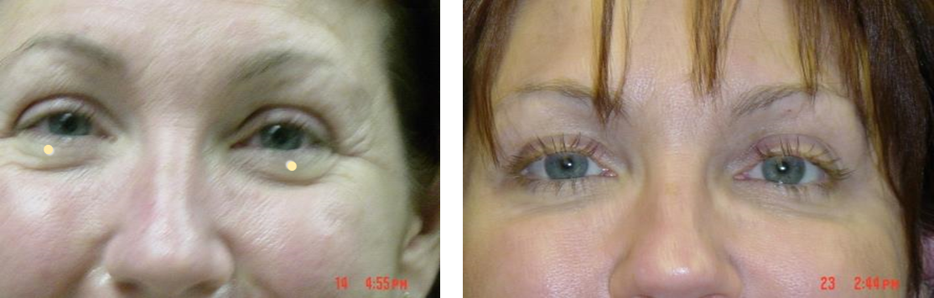
Lower Lids
Injection site Is below the tarsus by about 3mm, superficial, and just lateral to the midpupillary line
Requires only 1-2u
Can worsen tear troughs

Slide 15
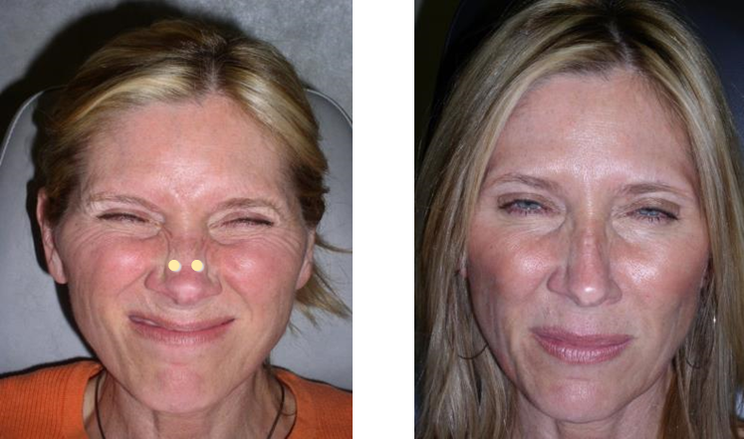
Bunny Lines
Nasalis is bilateral and sits just lateral to the nasal dorsum
Requires 2-3u per side
Injection is medial to the nasofacial sulcus and should be directed in a direction aimed in the sagittal plane towards the dorsum (may be deeper than you expect)
Can also inject 1-2u across the dorsum if otherwise refractory

Slide 16
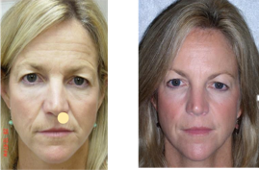
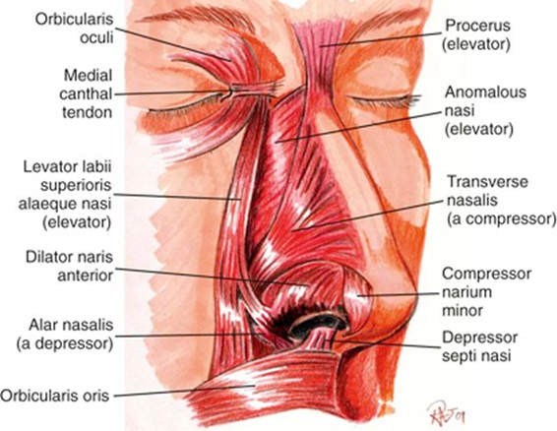
Nasal Tip Elevation
Injection should be directly below the nasal septum, targeting the depressor septi nasi
Can add the dilator naris anterior for better projection
Dose is 2u per muscle
Diffusion or incorrect plane can affect the labial levators or even the orbicularis oris
This can result in sphincter incompetence, philtral flattening, or cutaneous lip lengthening

Slide 17
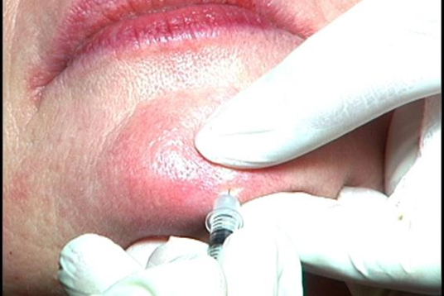
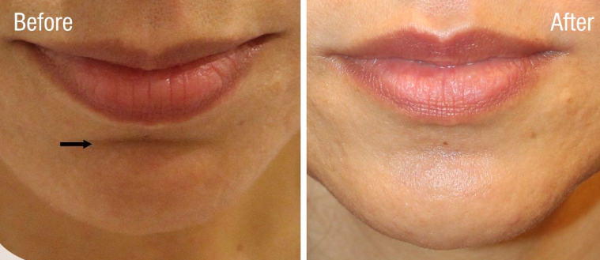
Mental Crease
Can be used to treat the horizontal lines below the lower lip or dimpling
Inject directly into the muscle at an upward 45 degree angle
If there is a cleft, inject on either side as the muscle usually does not cross within the cleft (fibrotendinous)
If no cleft, inject midline
2-8u in 1-3 sites

Slide 18
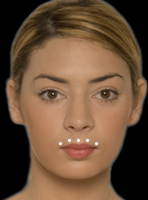
Perioral Lines
Meant to reduce the number of perioral fine lines
These tend to be greater in the upper lip than the lower lip
5-6u total with 1-2u per injection site
Sites are at or just above the vermillion border
Be wary that this will decrease perioral rhytids, but may lengthen the cutaneous lip or cause sphincter incompetence
Can sometimes change the amount of visible red lip (+/-)

Slide 19
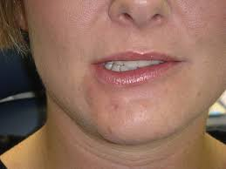
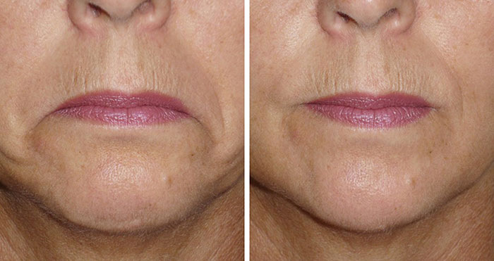
Down Turned Commissure
Inject into the Depressor Anguli Oris
Found by following the nasolabial folds to its origin at the mandibular border
2-3u in only one injection site per side
Significant complications such as drooling if oral incompetence is caused by treating the sphincter, or asymmetry if the depressor labii is inadvertently affected

Slide 20
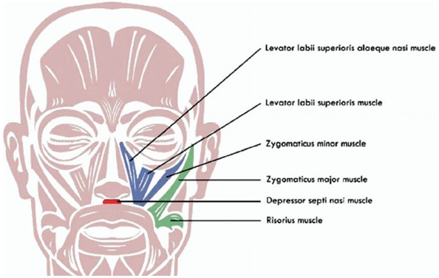
Gummy Smile
Treatment of gummy smile, often after orthodontic hardware, can be achieved with specific points of treatment
2.5 units in 2 areas per side, the confluence of the Levator labii superioris alequae nasi/levator labii superioris and confluence of the levator labii superioris/zygomaticus minor
This can be determined by having the patient smile and palpating the levators or injecting along the nasolabial fold above the mid alar border and then just lateral to it

Slide 21
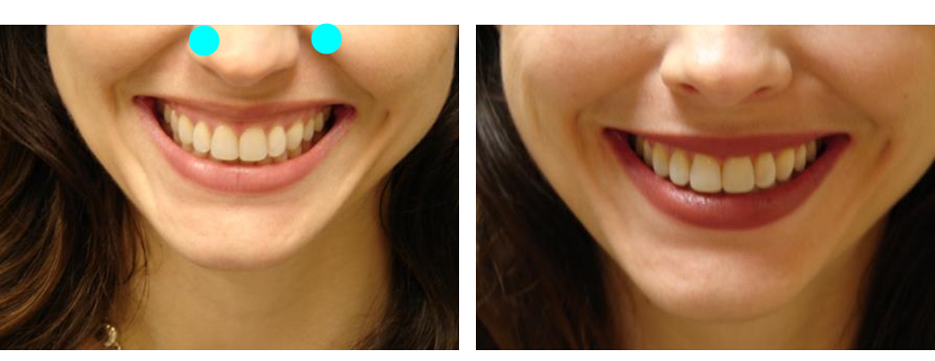
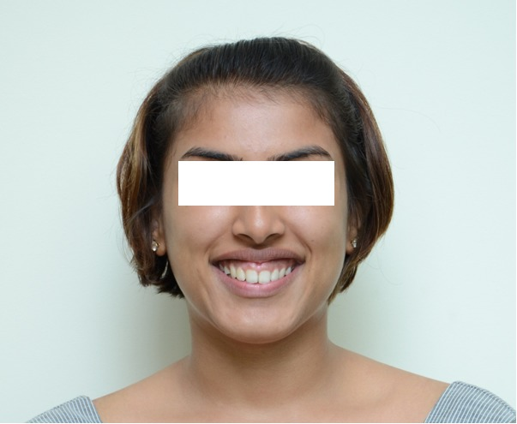
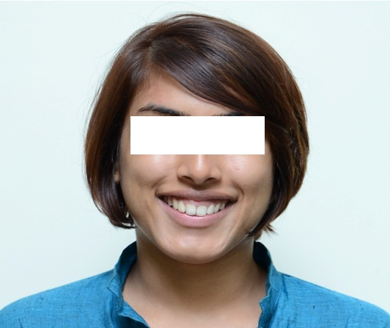

Slide 22
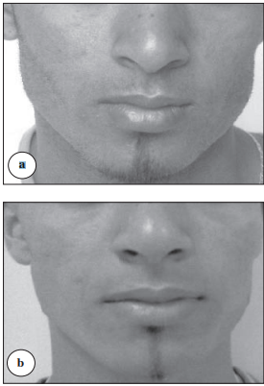
Masseter Hypertrophy
Can be a very powerful way to change facial contour and sometimes even relieve pain from bruxism
25u minimum necessary per side
Preferentially inject the bulkiest area, but err on the lower portion of the muscle
Low complication rate, but sagging and subzygomatic hollowing possible

Slide 23
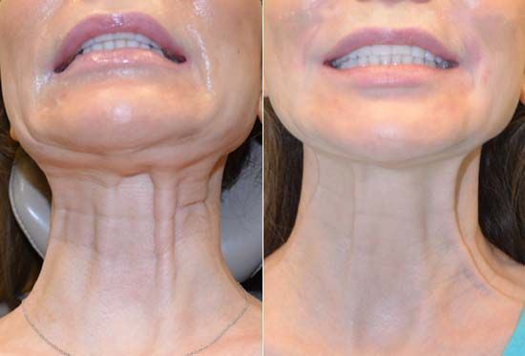
Platysmal Banding
Usually requires a large amount of Botox
Each band injected with 10u at 1cm interval
Total number of units can be in 50-100, but can even reach 250 total units

Slide 24
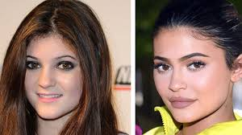
Fillers
Most popular fillers are temporary, and the trend has been towards Hyaluronic Acid based fillers
My advice is to get comfortable with 4-5 types that you stick with
Concepts are different than fat grafting because of the cost per unit volume and involve attacking lines directly most of the time rather than volumizing deflated areas
Approved for wrinkles, acne scars, NLFs, fine lines, lipoatrophy, and hand augmentation

Slide 25
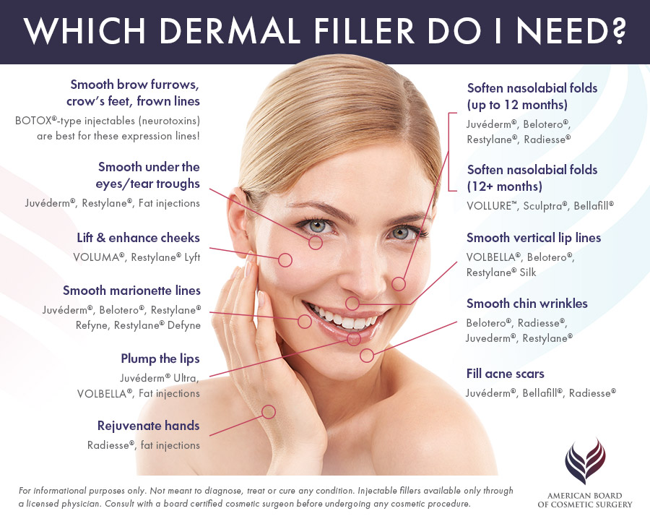

Slide 26
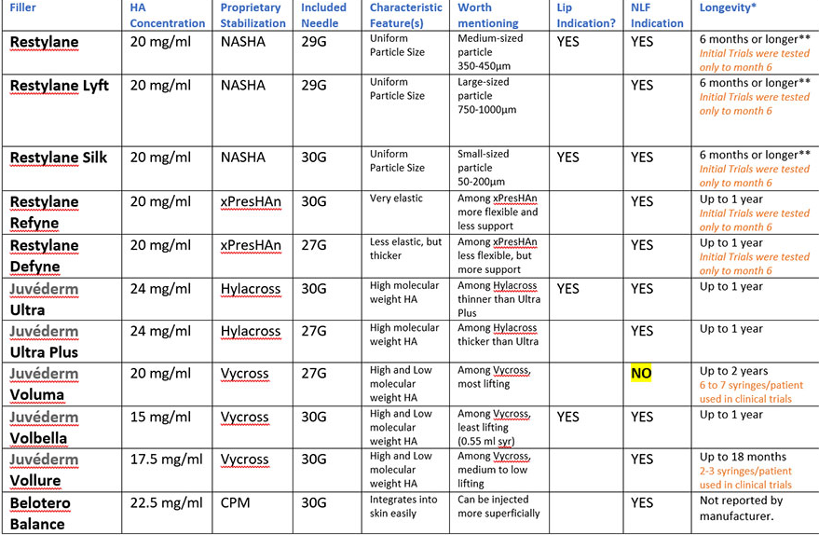

Slide 27
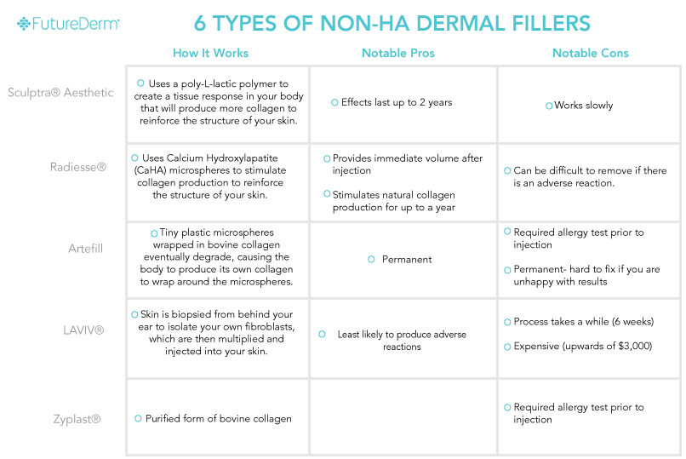

Slide 28
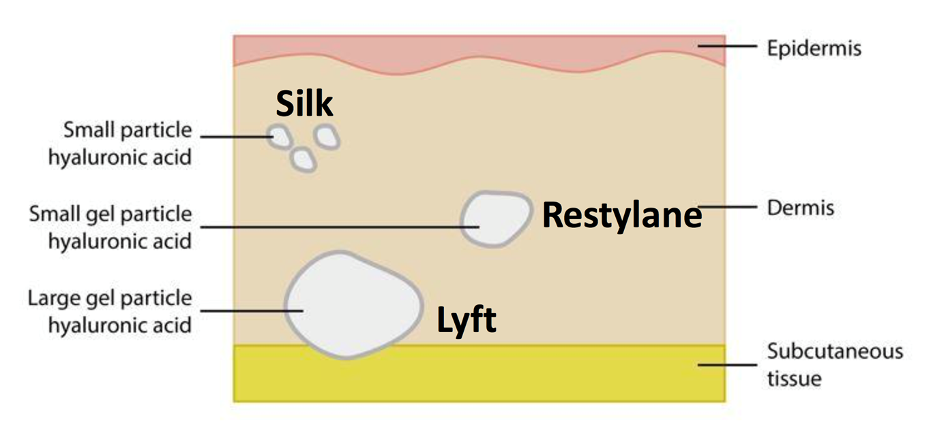
Choosing the right filler
Smaller particle sizes used for more superficial placement
Elastic Modulus (G’) determines visco-elasticity, higher numbers spread less, but act more to lift, whereas lower numbers spread more and lift significantly less
Longevity should be discussed with the patient, as well as treatment of the side effects. Be wary of using long term fillers on patients who have never had filler before, or who have been dissatisfied in the past

Slide 29
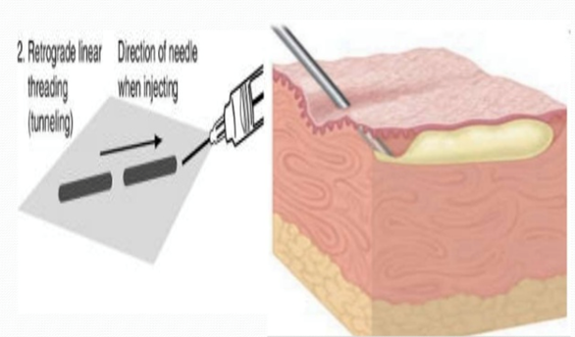
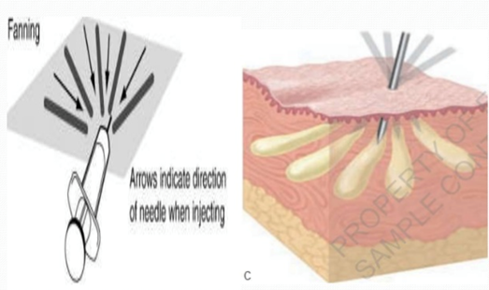
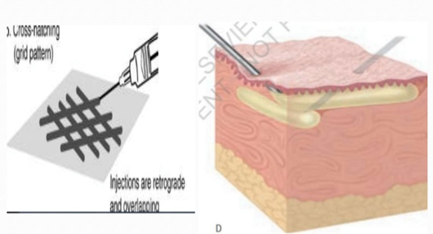
Injection Techniques
Blunt cannula technique – start with a slightly larger bore needle, followed by a blunt cannula, which can be used in any of the standard techniques. Less pain reported, but can leave permanent “acne” looking scar if you are too aggressive through one port
Fanning – one puncture, multiple tangential lines
Linear aliquot – small aliquots that can be massaged
Cross Hatching – multiple punctures but creates a more 3-D effect

Slide 30
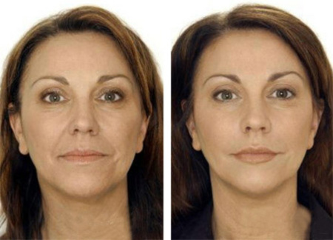
Nasolabial Folds
Numerous fillers indicated for NLF treatment
Two treatment designs, first is direct injection into the fold with a smaller particle filler vs deeper injection of the zygoma
Direct injection is great for finer lines especially in younger patients
Deep injections better for treatment of deflation and descent

Slide 31
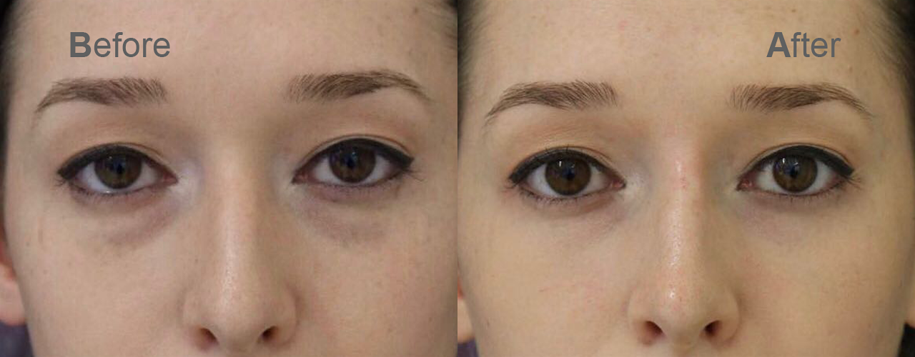
Tear Troughs
Not for beginners, and usually a bridge to lower blepharoplasty
Higher complication rates
Edema is unpredictable
No literature on how this affects blepharoplasty down the line
Will not change pigmented areas

Slide 32
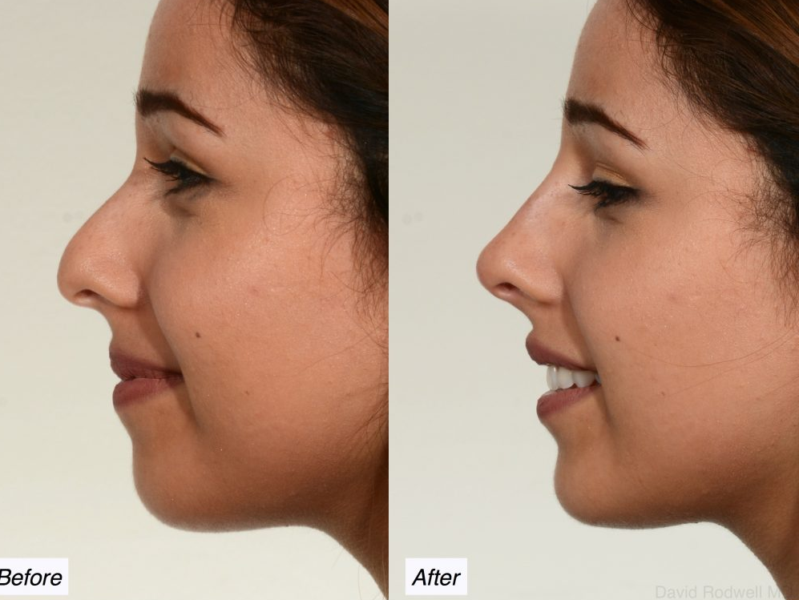
Nonsurgical Rhinoplasty
Filler is used to camouflage dorsal hump deformities, correct deficiencies of the nasal bridge, or raise the nasal tip
HA fillers preferred
Must take into account skin thickness as in standard rhinoplasty
Complications can be catastrophic

Slide 33
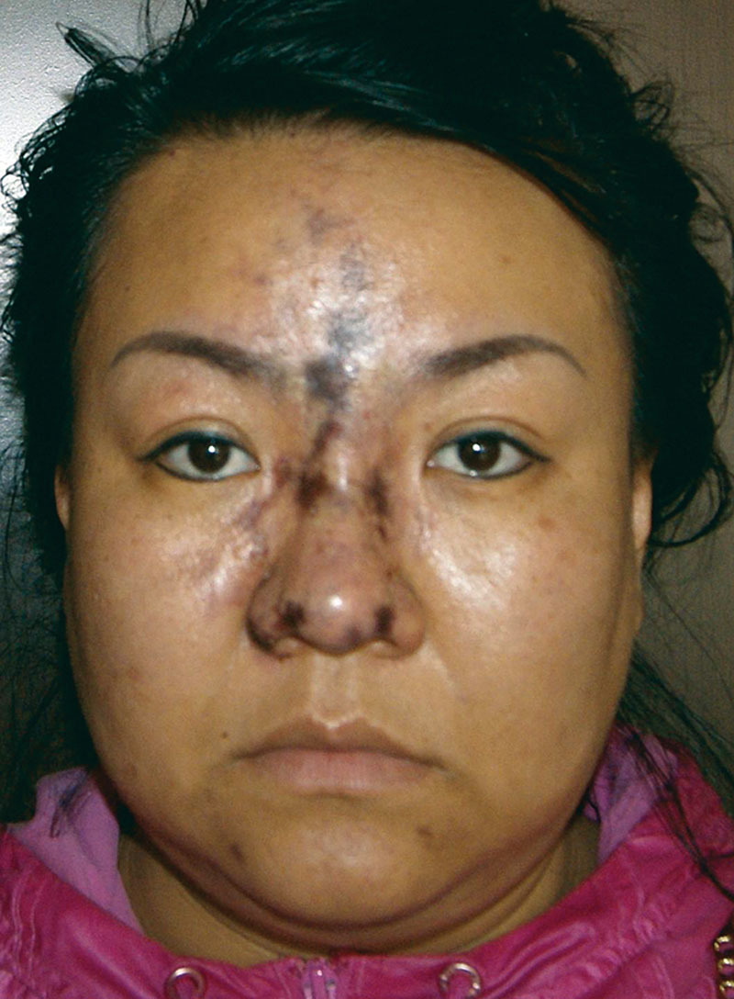
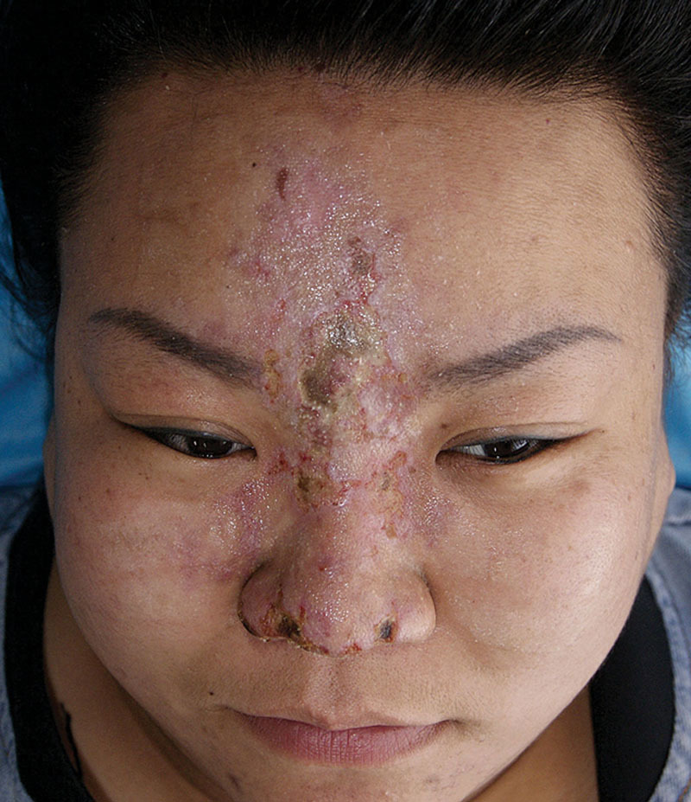
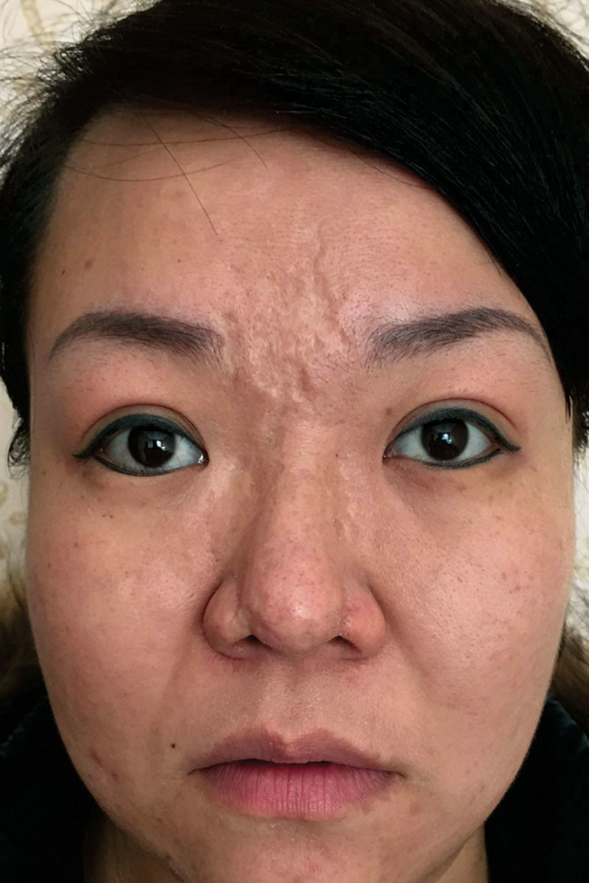

Slide 34
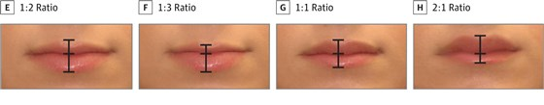
Lips
JAMA study states that the preferred increase in lip size is 50% for Caucasian women
The ideal ratio is still 1:2 upper lip to lower lip, however celebrities have been pushing patient demands toward 1:1
Small particle, lower elastic fillers necessary
Superficial injections can cause visible nodules, deep injections can cause palpable mucosal nodules
Choose injection site based on desired outcome

Slide 35
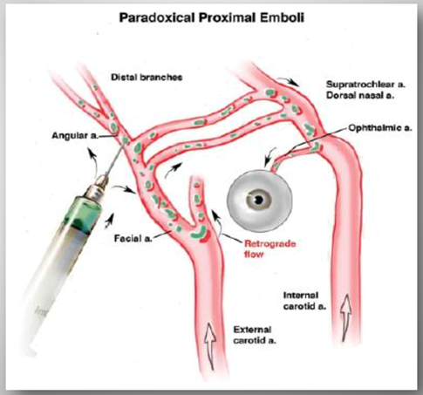
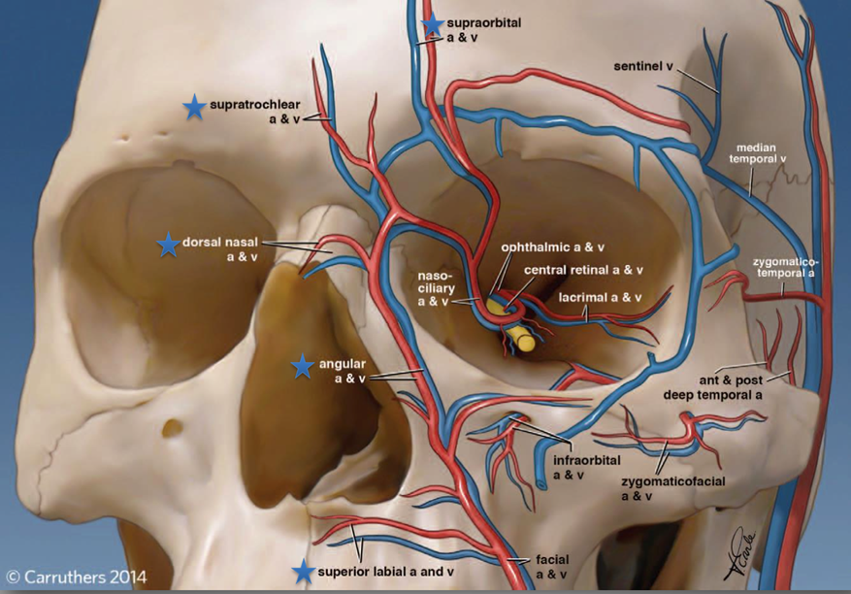
Complications
Swelling is normal – Higher concentrations of HA cause a greater degree of swelling
Allergic reaction – rare with HA fillers, more likely with xeno based fillers
Nodules – Can be temporary (last as long as the filler) or persistent (granulomatous)
Infection – treat with abx, always use sterile technique when injecting
Intravascular Injection – Can cause tissue loss, or even blindness by embolizing the ophthalmic artery
Visible Bluish hue at the surface near the injection site
Tyndall effect

Slide 36
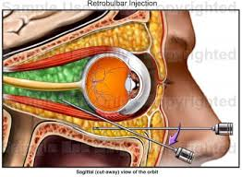
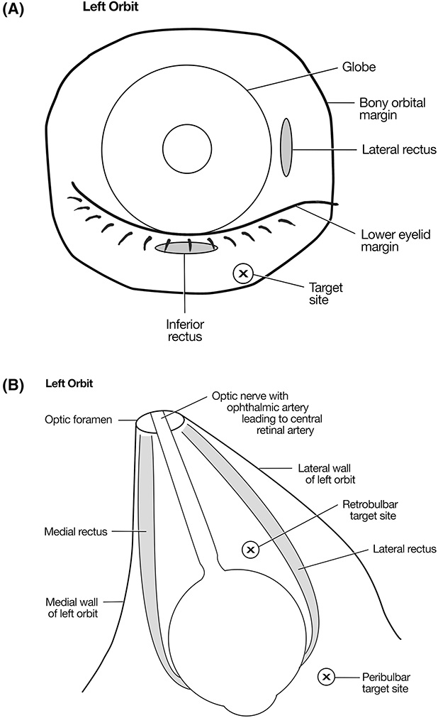
Hyaluronidase
Comes in multiple forms, standard is 150u per 1cc of filler
Inject local area as well as treated area when signs of skin necrosis
Pair with ASA, nitropaste, warm pack, and massage
If all unsuccessful, consider Hyperbaric oxygen
Hyaluronidase is only effective within the first 24 hours for vascular issues
For blindness, consider injecting into the supraorbital and supratrochlear branches, as well as a retrobulbar injection 300-600u
Hyaluronidase crosses vessel walls, thus infiltrating the area of concern is adequate treatment

Slide 37
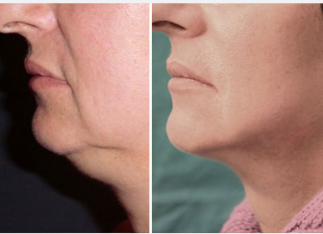

RFA Treatment
Multiple brands and treatment possibilities, including monopolar, bipolar, or even multipolar
Heating of the skin causes dermal contraction, collagen turnover, and contraction of septal attachments to the skin
Multipolar RFA is often times part of microneedling devices that can penetrate dermis or even down to subq with the aim of fat remodeling
Heats subq fat as well to aide in liposuction post procedure

Slide 38


RFA
Cost of the capital equipment can be prohibitive
May require many months to years prior to becoming profitable
Currently no restrictions on who can perform microneedling RFA in Colorado, but other states vary
20% of the tightening occurs on table, the rest occurs over the next 6-9 months

Slide 39


Helium Plasma
Cold Plasma technique that heats to 85 degrees Celsius
Similar mechanism of action to RFA techniques, but less dermal heat so, in theory, less dermal contraction
Price point is lower than RFA devices, and does include a surface device

Slide 40



Helium Plasma
Similar time frames to RFA
20% tightening on the table with full effects seen at 6-9 months
Often times paired with lipo as well, but remember that disrupting the septal attachments defeats the purpose of the product, so VASER and laser assisted lipo not used

Slide 41

PRP injection
Created by centrifuging a blood draw
Shows in vitro increases in collagen turnover as well as MMPs
No evidence that there is any aesthetic improvement in vivo long term
All effects were temporary during a review of all available literature
PRP is usually administered during microneedling

Slide 42

Oral Board Cases

Slide 43


Slide 44
References
Hoefflin Steven M. M.D.Plastic and Reconstructive Surgery: April 1998 - Volume 101 - Issue 4 - ppg 1148
Kaplan, Julie Bass MSN, RN, CPSN, CANS, PHN, HCMT.Plastic Surgical Nursing;January/March2017, Volume 37 Number 1 , p 32 – 38
A comparative study of the effects of retinol and retinoic acid on histological, molecular, and clinical properties of human skin Rong Kong PhD Yilei Cui PhD Gary J. Fisher PhD Xiaojuan Wang BS Yinbei Chen MS Louise M. Schneider BS Gopa Majmudar PhD First published: 18 November 2015
Comparison of Erbium:YAG and Carbon Dioxide Lasers in Resurfacing of Facial Rhytides Khalil A. Khatri, MD; Victor Ross, MD; Joop M. Grevelink, MD, PhD; et al
Sudeeptha Dinker, Assistant Professor, A Anitha, Assistant Professor, Abhinay Sorake, Assistant Professor, andKishore Kumar, Associate Professor. Management of gummy smile with Botulinum Toxin Type-A: A case report
The treatment of masseter hypertrophy with botulinum toxin type A. Hazem T. Al-Ahmad, Mansour A. Al-Qudah

Slide 45
References
Serious Vascular Complications after Nonsurgical Rhinoplasty: A Case Report
Qiqing Chen, MD,* Yu Liu,* and Dongliang Fan, MD †
Blindness following Cosmetic Injections of the Face Lazzeri, Davide M.D.; Agostini, Tommaso M.D.; Figus, Michele M.D., Ph.D.; Nardi, Marco M.D.; Pantaloni, Marcello M.D.; Lazzeri, Stefano M.D.
Vascular complications of hyaluronic acid fillers and the role of hyaluronidase in management. Deok-WooKimEul-SikYoonYi-HwaJiSeung-HaParkByung-IlLeeEun-SangDhong
Restoration of Visual Loss With Retrobulbar Hyaluronidase Injection After Hyaluronic Acid Filler. Chesnut, Cameron, MD, FAAD, FASDS
Can Platelet-rich Plasma Be Used for Skin Rejuvenation? Evaluation of Effects of Platelet-rich Plasma on Human Dermal Fibroblast
Dae Hun Kim, M.D., Young Jin Je, M.S., Chang Deok Kim, Ph.D., Young Ho Lee, M.D.,¹ Young Joon Seo, M.D., Jeung Hoon Lee, M.D. and Young Lee, M.D.

